Slide 1
THERE IS / THERE ARE
We mention THERE IS/ ARE to say that something exists somewhere.
There is for singular nouns
There are with plural nouns.
We often use them to describe the position of somethings in a place.

Slide 2
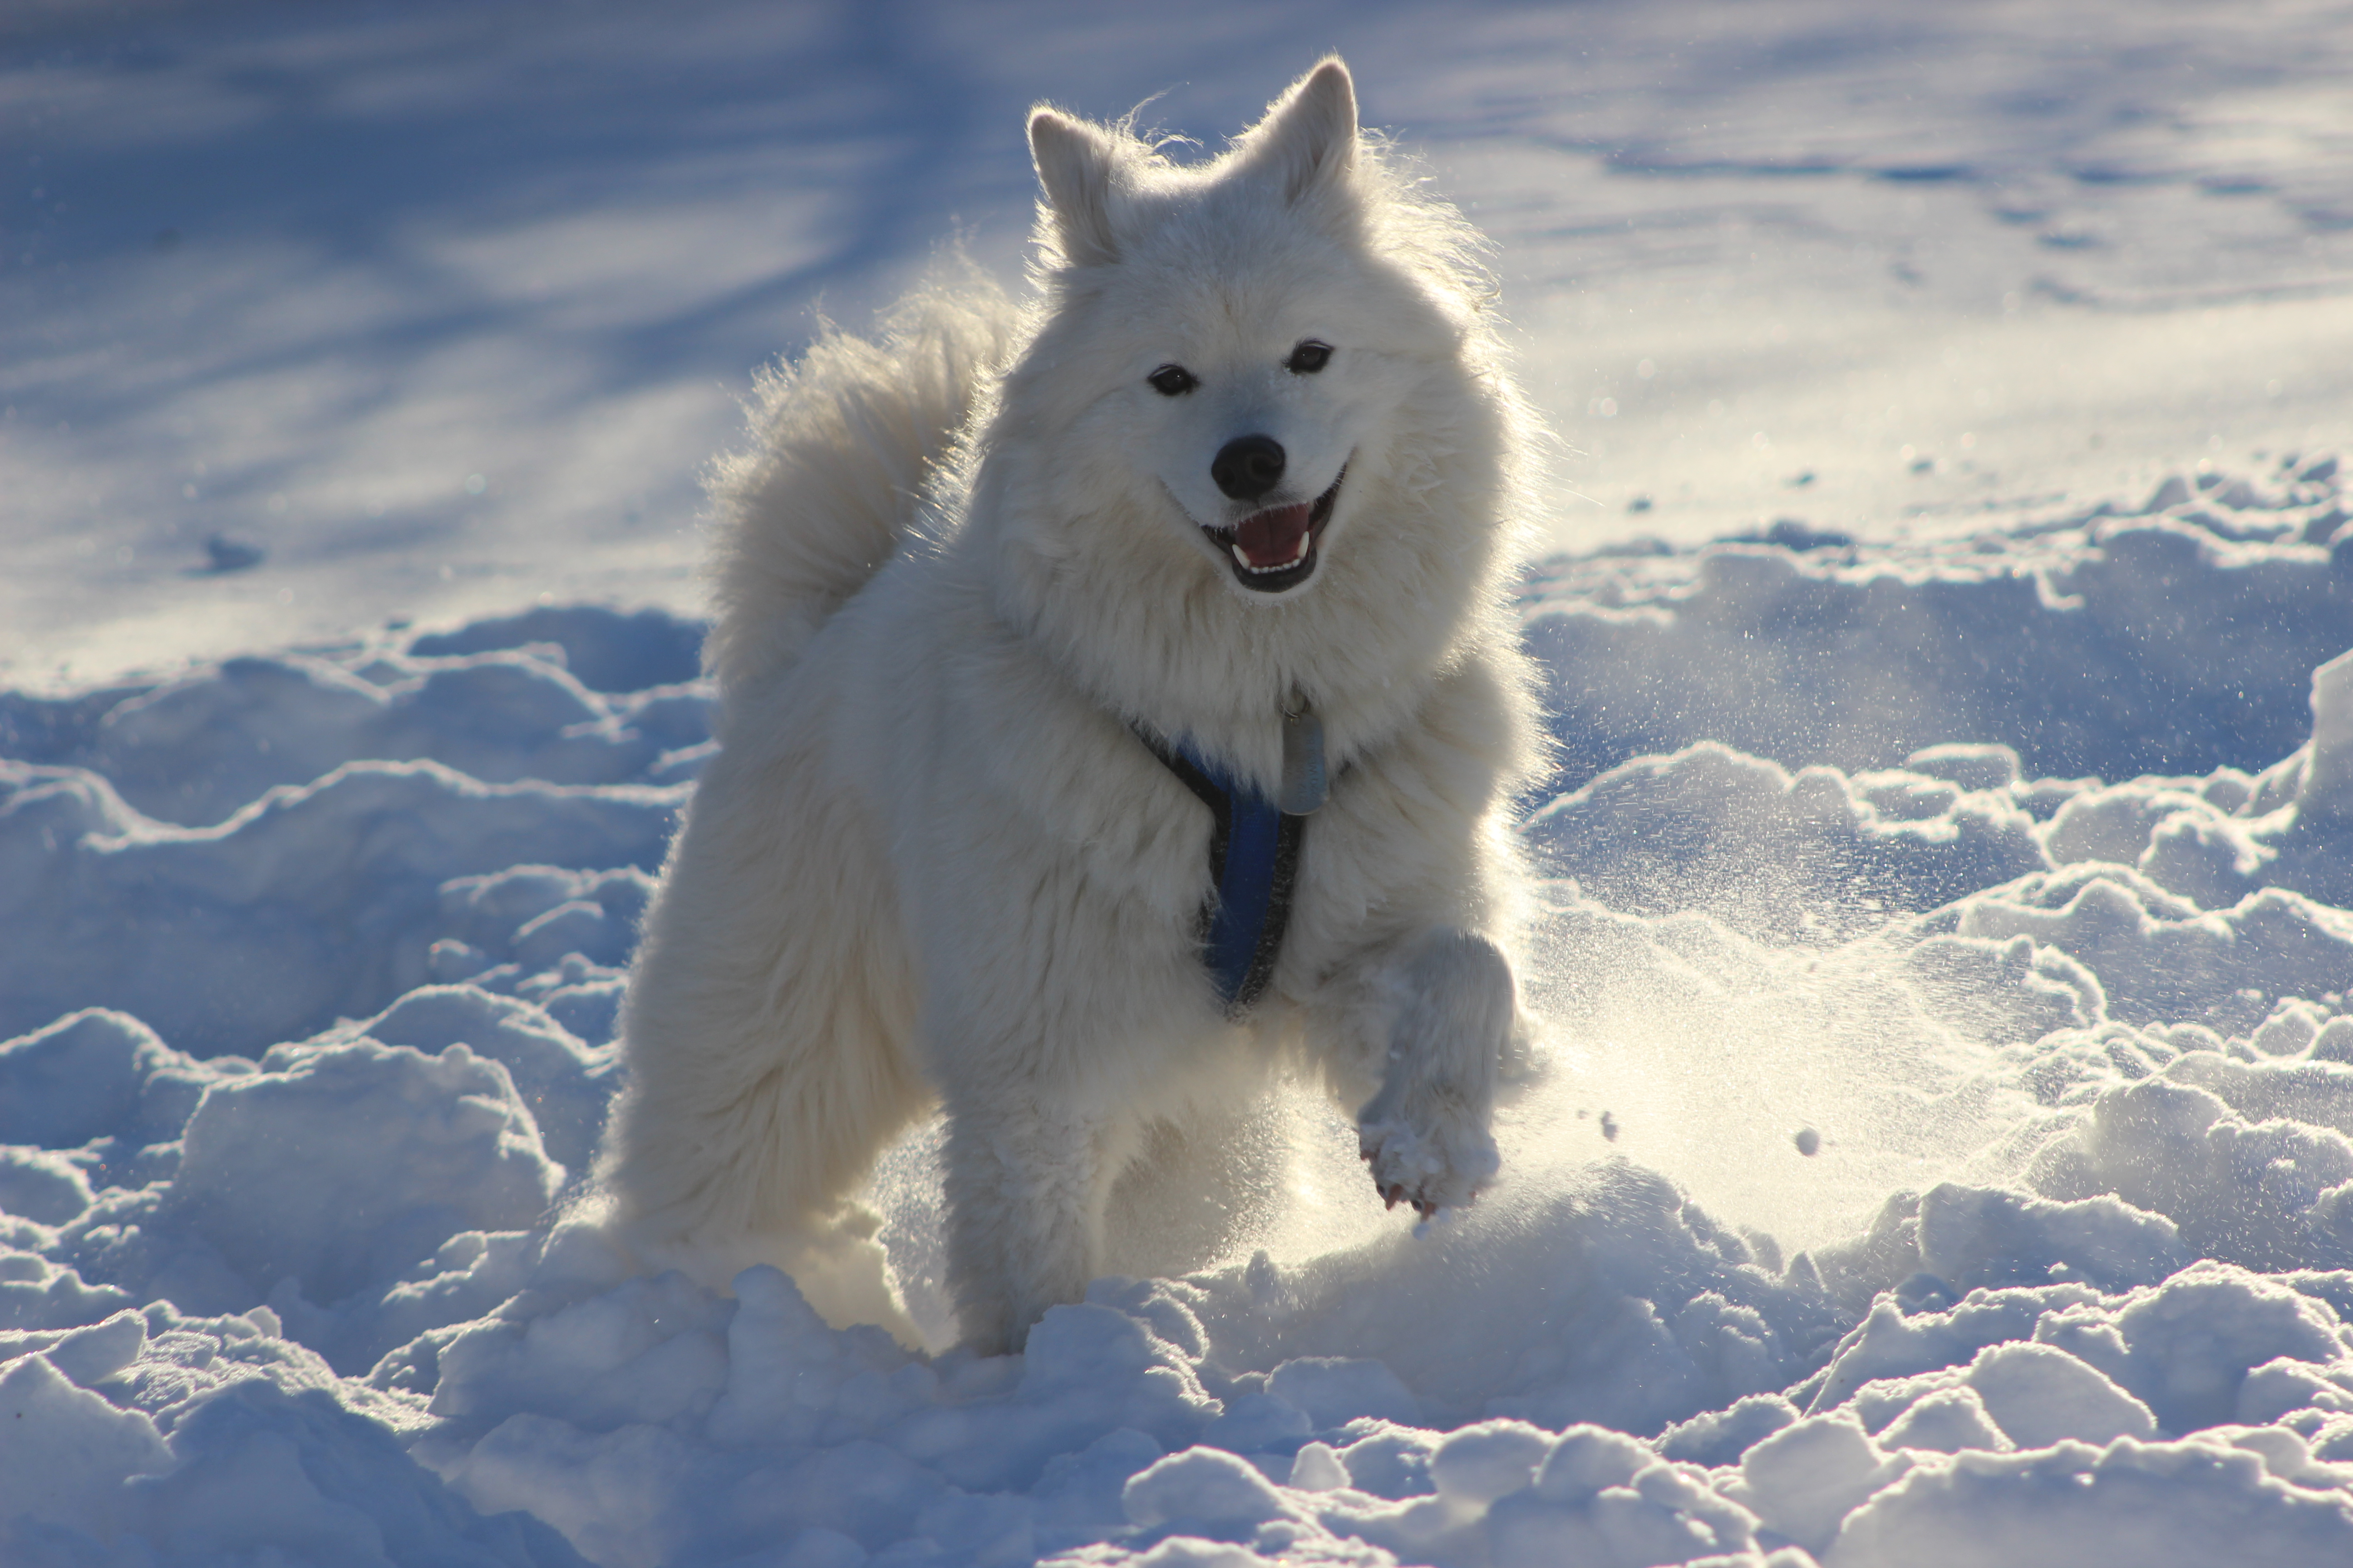
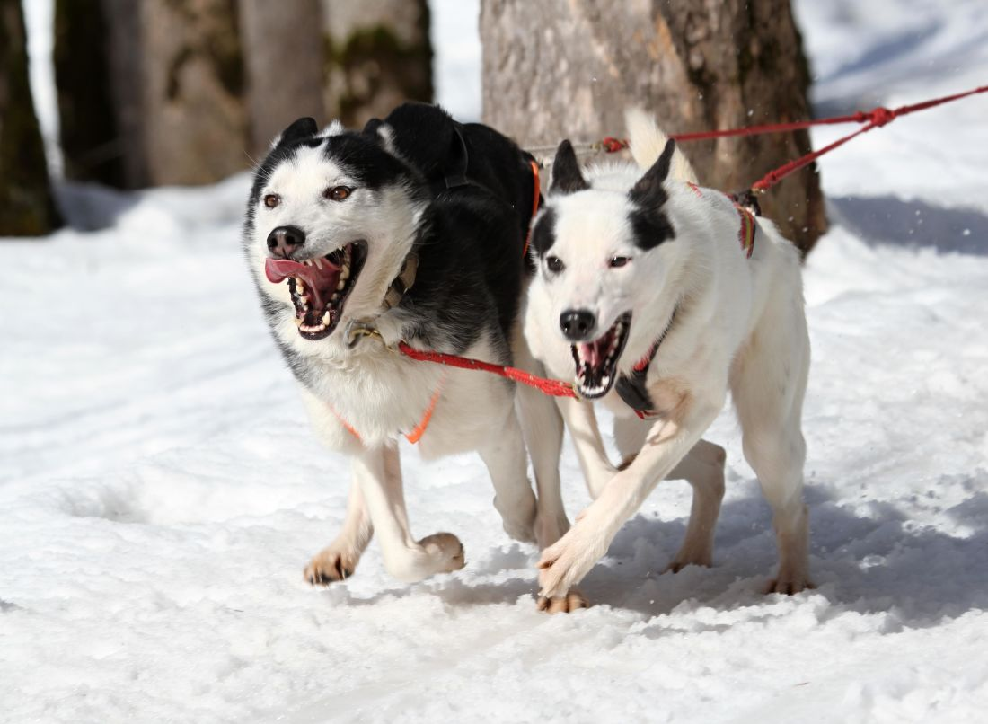
There is snow on the mountains There is a dog in the mountain. There`s a dog in the mountain
There are two dogs on the snow
There are some trees in the park

Slide 3
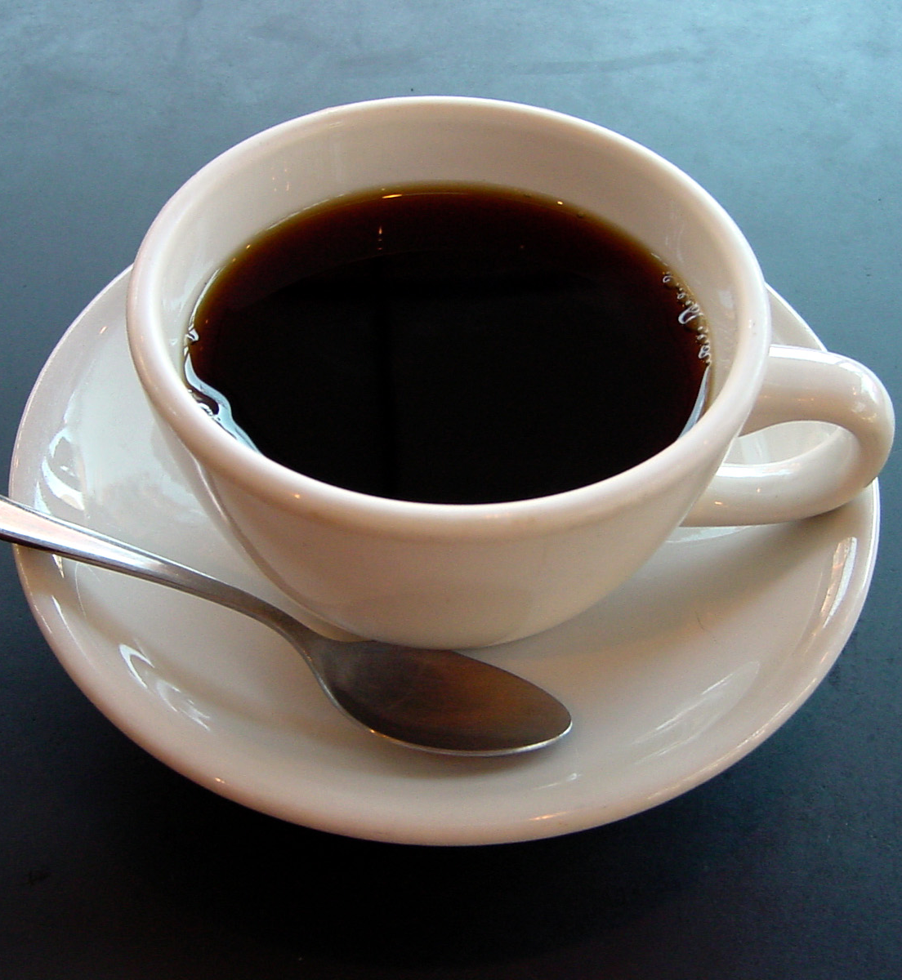
Negative form
Singular
There is not = contracted form There isn´t
There is not any sugar in this coffee
There isn`t any sugar in this coffee
Plural
There are not = Contracted form There aren`t
There are not any trains on Sunday
There aren`t any trains on Sunday

Slide 4
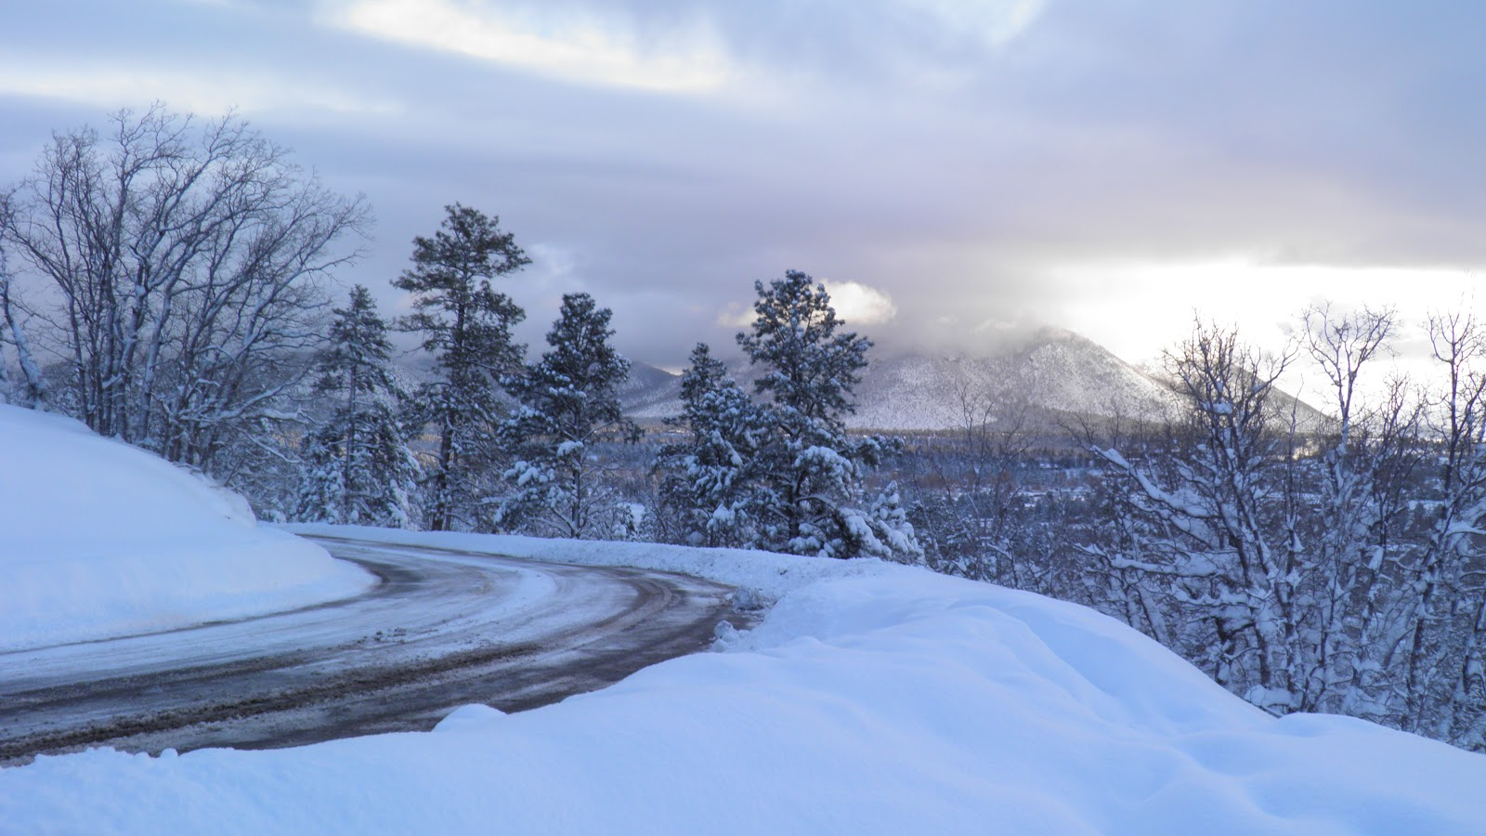
Other way to say a negative idea
There is no snow on the mountain
There are no good films on TV.
There are no animals in our house

Slide 5
Questions
Is there
Is there any ice in the fridge?
Is there a possibility of rain today?
Are there
Are there any aspirins in your bag?
Are there any trains to the airport?

Slide 6
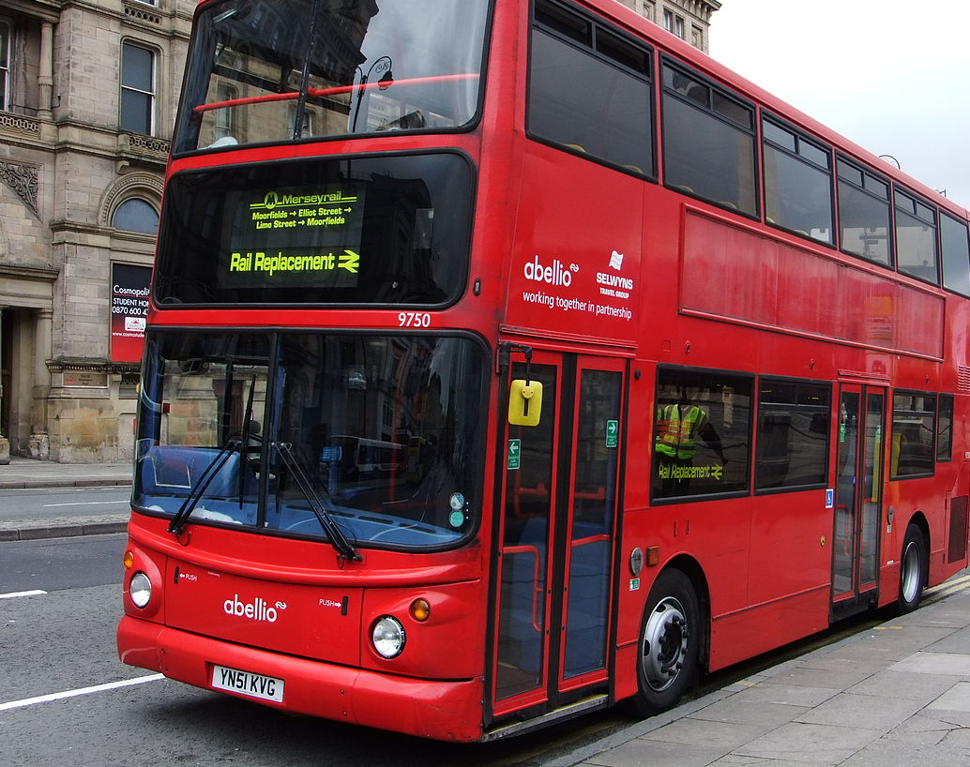
Short answers
Is there a bus to the airport?
Yes, there is
Is there any sugar in this tea?
No, there isn`t
Are there any taxis on Sunday?
No, there aren`t

Slide 7
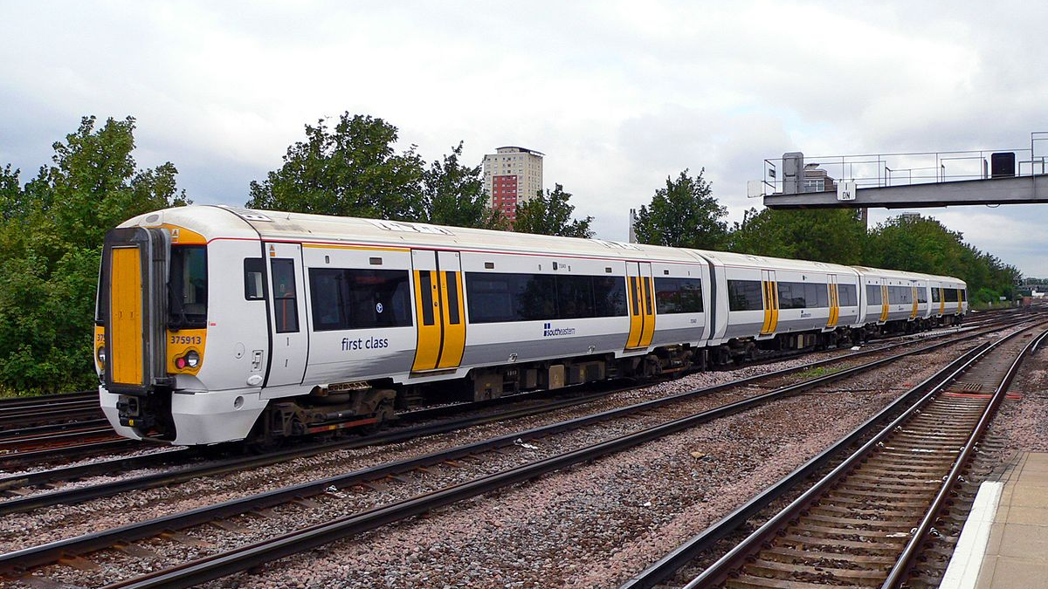
Question tags
Used to ask for confirmation.
There is a good film on TV tonight, isn`t there?
There isn`t much to do here, is there?
There are a lot of people here today, aren`t there?
There aren`t any trains in our city, are there?

Slide 8
Conversation
Transcribe the conversation

Slide 9
Now, listen the conversation and number Jon`s questions in the correct order in the boxes
Is there air conditioning?
Are there many shops in the village?
How many bedrooms does it have?
Is there a garden?
Is the house near a village?
Is there only one bathroom?
How much is the house?
Are there any schools in the area?

Slide 10
Answer all the questions
………………………….
………………………….
………………………….
……………………………
……………………………
………………………….
………………………….
………………………….

Slide 11
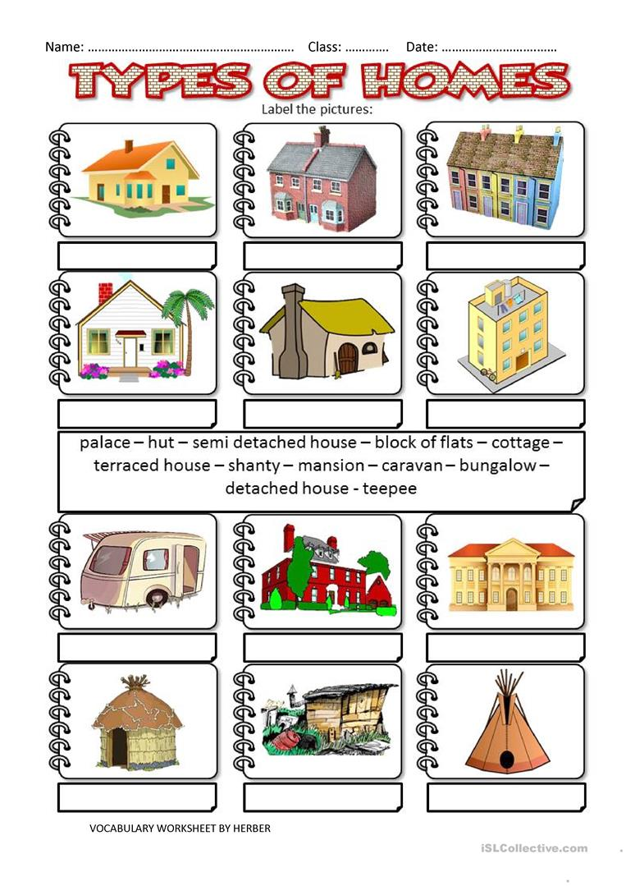

Slide 12
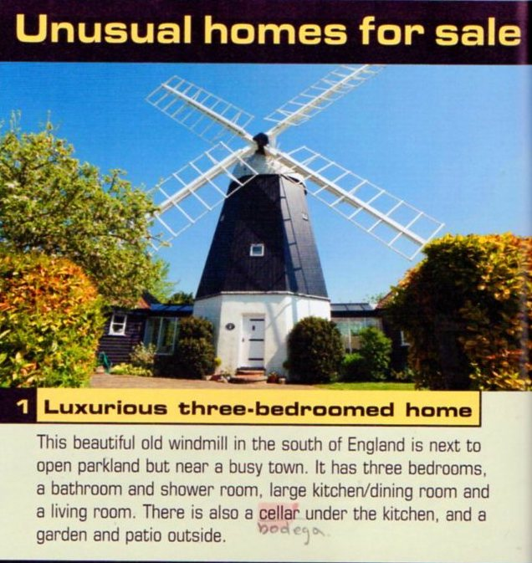
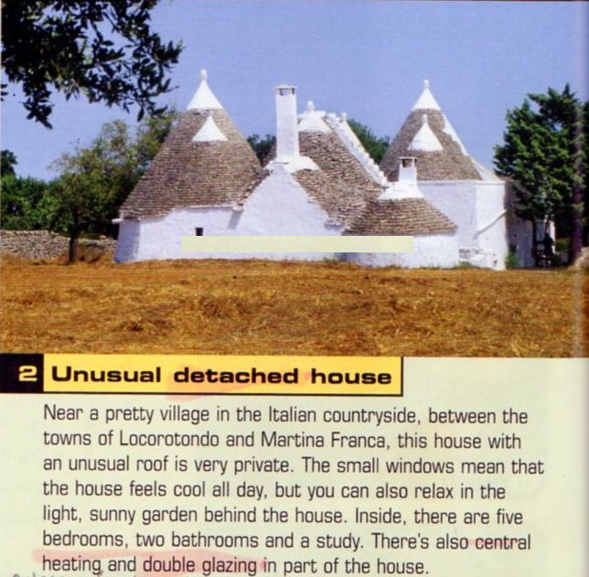
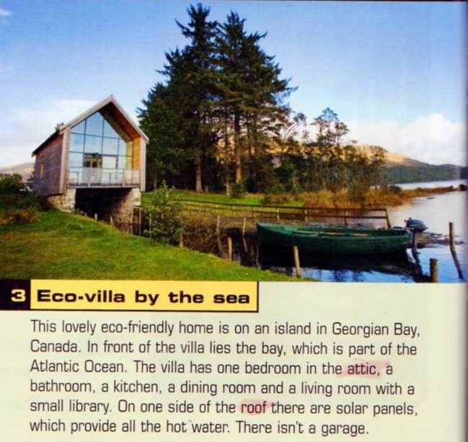
Reading: Dream homes

Slide 13
Read the text and match the features with the house
1. It is …
By the sea.
Not hot during the day
Near a town
2. It has …
A room at the top of the house.
A room below the house.
A room to work in.

Slide 14
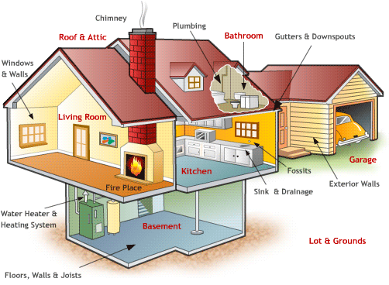
Parts of a house

Slide 15
Vocabulary: Homes
Type of building
Rooms in a house
Other
features
Adjectives
Describing house
1.
2.
3.
(
(
(
(
(
(
(
(
Roof
(
(
(
(
(
(
(
Beautiful
(
(
(
(
(
(

Slide 16
Take a picture and describe your kitchen and bedroom (12 lines, Arial 10, use there is, there are.

