Slide 1
Simple Present
Do- Does

Slide 2
WH- Questions
Use WH- questions when you need information.
Who: people
What: names, things, actions
Where: places
Why: explanations
When: Time, dates, months.
How: manners, conditions, quality

Slide 3
Match the “WH” word with the corresponding ideas.
Column A | Column B
Where | Color, name
Who | School, house, office, building
why | I, You, Vanessa, It, we, they, David
when | long, often, many, good, happy, bad
How | July, 14th, 1998
what | Because I study here

Slide 4
SIMPLE PRESENT
WHEN TO USE IT
HOW TO USE IT
SPELLING
LISTENING SKILLS PRACTICE

Slide 5
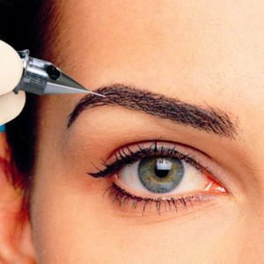
PERMANENT SITUATIONS

Slide 6
DAILY ROUTINES

Slide 7
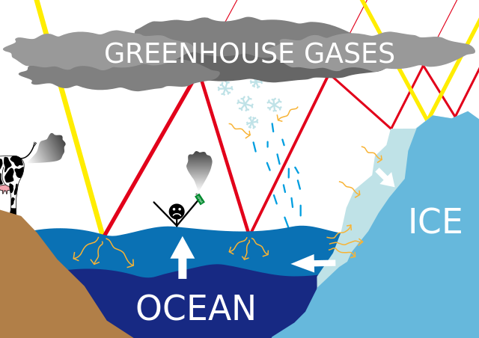
FACTS

Slide 8
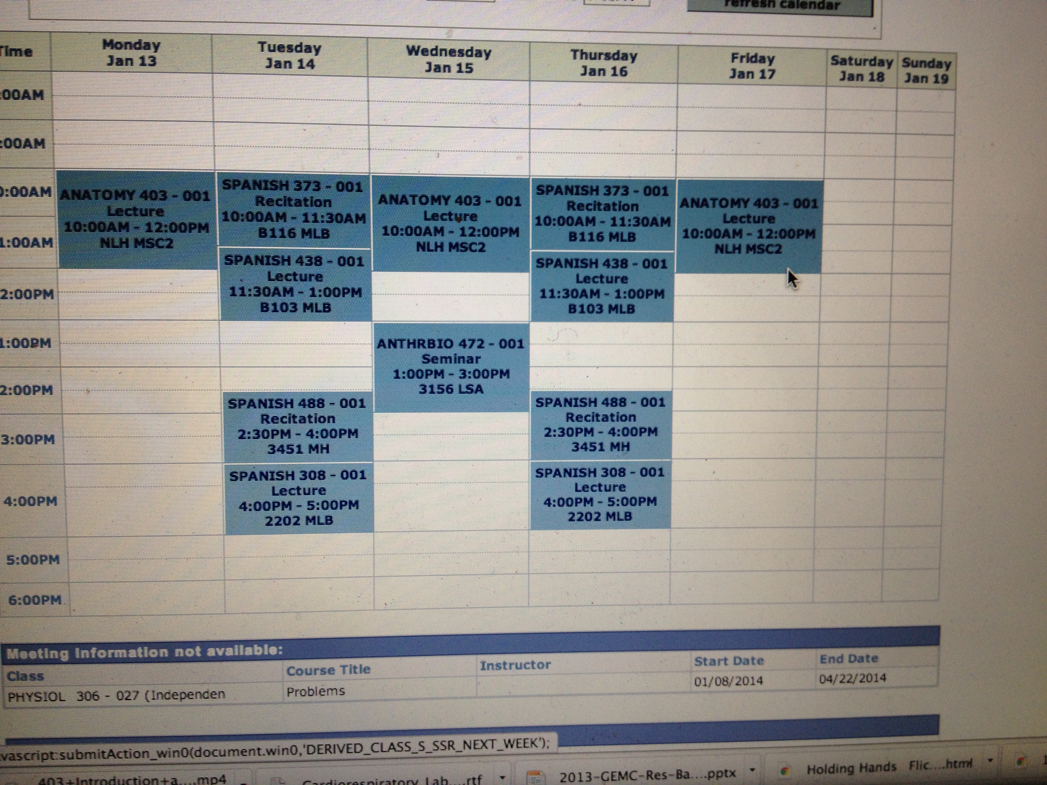
SCHEDULES

Slide 9
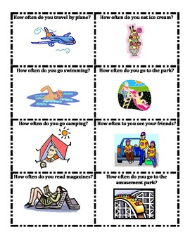
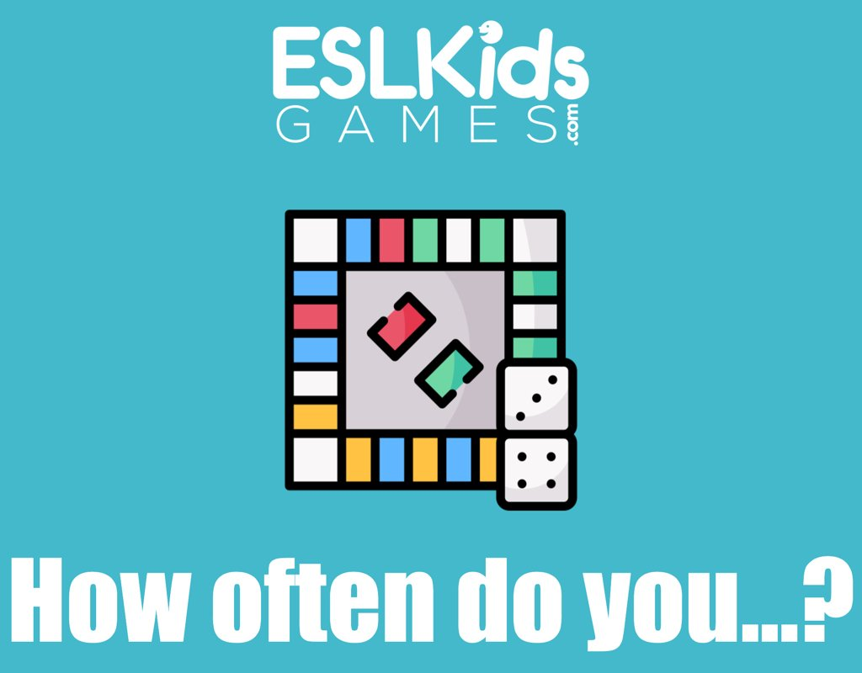
HOW OFTEN/ FREQUENCY

Slide 10
Spelling.
Most verbs add S: dance=dances / cook= cooks / sleep= sleeps
Verbs ending in S, Sh, Ch, O, X, add ES:
Kiss= kisses /Wash= washes
teach= teaches / fix = fixes /Go= goes
Verbs ending in consonant and y: drop Y and add IES
Study= studies / try= tries
/ have = has

Slide 11
Classify these situations. Write them down
Water boils at 100 Centigrades
Our class starts at 8:00 am on Wednesdays
They read fashion magazines at the weekends
How often occurs an Earthquacke in Bogota?
The sun rises in the east
I wake up at 6:00 am every day
We live in Patio Bonito
The flight leaves at noon
David goes to sleep at midnight
We don`t drink coffee in the morning

Slide 12
Simple Present – affirmative and negative
LIVEWORKSHEETS:
https://www.liveworksheets.com/za26318ec
OXFORD UNIVERSITY PRESS: Ans.
https://elt.oup.com/student/solutions/elementary/grammar/grammar_01_012e?cc=co&selLanguage=en

Slide 13
Listening skills practice: Interview with a swimmer
https://es.liveworksheets.com/ug161266gq

Slide 14
Daily Schedule
https://www.esl-lab.com/easy/daily-schedule/
Habits (Please me Video Activity)

Slide 15
Simple Present (permanent situations, habits and emotions)
1. …I… live in a flat. …I… have a daughter. ……We. Speak English at work.
Questions: / Do you have a daughter? / ?
2. I read fashion magazines in the evenings. They drink coffee every morning.
…We… eat fast food at the weekends.
Questions: What do you do in the evenings? I read fashion Magazines.
What do they drink in the mornings? They drink orange Juice.
What does Didier drink in the morning? Didier drinks milk in the mornings
What do you eat at the weekends?
What beverage does Mary/ she/ drink every morning? She drinks te.
3. …I….like dogs.
Questions: Do you like dogs? Yes, I do. No, I don`t. Yes, I like dogs/ No , I don`t like dogs.

Slide 16
DO OR does?
Complete the questions with "do" or "does". Then choose the right form to complete the answers.
Liveworksheets: https://www.liveworksheets.com/hj17509hm

Slide 17
Listening Activity 1.21 Transcribe the dialog

Slide 18
HOUR HAND
MINUTE HAND
Esta foto de Autor desconocido está bajo licencia CC BY-SA

