Slide 1
For loops

Slide 2
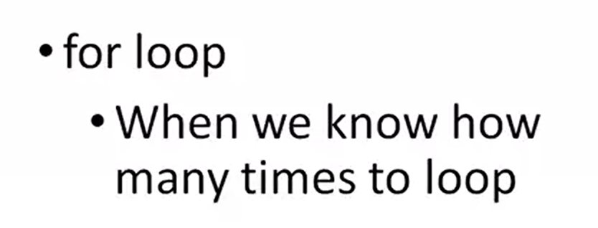

Slide 3
Para
Ejecuta un conjunto de instrucciones un número determinado de veces. Ese número es controlado por una variable contadora (entera), que toma valores desde un límite inferior hasta un límite superior.

Slide 4
CICLO PARA
DIAGRAMA DE FLUJO | PSEUDOCODIGO
 | para (<variable> := <lim_inf> hasta <lim_sup>) hacer <bloque instrucciones> fin_para

Slide 5
EJEMPLO
Realizar la suma de los números
del 1 hasta el N e imprimirla en
pantalla

Slide 6
EJEMPLO
:=

Slide 7
EJEMPLO
Programa
(pseudocódigo)
Memoria
suma, n, i: entero
suma = 0
leer n
para i=1 hasta n hacer
suma = suma+i
fin_para
escribir suma
suma i n
???
S
xxx
0
1
3
6
xxx
1
2
3
4
xxx
3
X
6

Slide 8
#include <stdio.h>
#include <stdlib.h>
/*
* Demonstrates for loops
*/
int main(int argc, char** argv)
{
// print squares from 1 to 10
return (EXIT_SUCCESS);
}

Slide 9
#include <stdio.h>
#include <stdlib.h>
/*
* Demonstrates for loops
*/
int main(int argc, char** argv)
{
// print squares from 1 to 10
for ()
{
}
return (EXIT_SUCCESS);
}

Slide 10
#include <stdio.h>
#include <stdlib.h>
/*
* Demonstrates for loops
*/
int main(int argc, char** argv)
{
// print squares from 1 to 10
for (int i = 1;i <=10;i++)
{
}
return (EXIT_SUCCESS);
}
Loop condition
Loop control
Incrementing one in each loop

Slide 11
#include <stdio.h>
#include <stdlib.h>
/*
* Demonstrates for loops
*/
int main(int argc, char** argv)
{
// print squares from 1 to 10
for (int i = 1; i <= 10; i++)
{
printf("The square of %d is %d\n", i, i*i);
}
return (EXIT_SUCCESS);
}

Slide 12
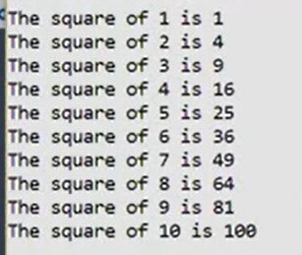

Slide 13
{
// prompt for and get number of squares to print
printf("How many squares do you want to print (1-10)? ");
// print squares from 1 to 10
for (int i = 1; i <= 10; i++)
{
printf("The square of %d is %d\n", i, i*i);
}
return (EXIT_SUCCESS);
}

Slide 14
{
int n;
// prompt for and get number of squares to print
printf("How many squares do you want to print (1-10)? ");
scanf("%d", &n);
// print squares from 1 to 10
for (int i = 1; i <= 10; i++)
{
printf("The square of %d is %d\n", i, i*i);
}
return (EXIT_SUCCESS);
}

Slide 15
{
int n;
// prompt for and get number of squares to print
printf("How many squares do you want to print (1-10)? ");
scanf("%d", &n);
// print squares from 1 to n
for (int i = 1; i <= n; i++)
{
printf("The square of %d is %d\n", i, i*i);
}
return (EXIT_SUCCESS);
}

Slide 16
Other alternative
{
int n;
// prompt for and get number of squares to print
printf("How many squares do you want to print (1-10)? ");
scanf("%d", &n);
// print squares from 1 to n
for (int i = 1; i <= n;)
{
printf("The square of %d is %d\n", i, i*i);
i++;
}
return (EXIT_SUCCESS);
}

Slide 17
Other alternative
{
int n;
// prompt for and get number of squares to print
printf("How many squares do you want to print (1-10)? ");
scanf("%d", &n);
// print squares from 1 to n
int i = 1
for (; i <= n; i++)
{
printf("The square of %d is %d\n", i, i*i);
}
return (EXIT_SUCCESS);
}

Slide 18
Nested For Loops

Slide 19
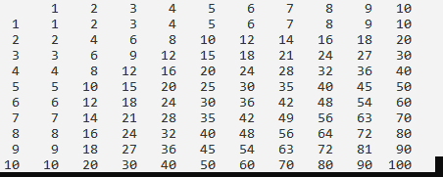
/*
* File: main.c
* Author: Dr. T
*/
#define _CRT_SECURE_NO_WARNINGS
#include <stdio.h>
#include <stdlib.h>
/*
* Demonstrates nested for loops
*/
int main(int argc, char** argv)
{
// print header
printf(" ");
return (EXIT_SUCCESS);
}

Slide 20
/*
* File: main.c
* Author: Dr. T
*/
#define _CRT_SECURE_NO_WARNINGS
#include <stdio.h>
#include <stdlib.h>
/*
* Demonstrates nested for loops
*/
int main(int argc, char** argv)
{
// print header
printf(" ");
for (int i = 1; i <= 10; i++)
{
printf("%5d", i);
}
return (EXIT_SUCCESS);
}

Slide 22
// print header
printf(" ");
for (int i = 1; i <= 10; i++)
{
printf("%5d", i);
}
printf("\n");
// print table

Slide 23
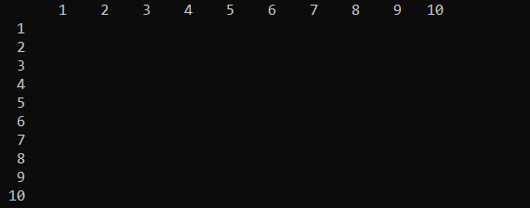
// print header
printf(" ");
for (int i = 1; i <= 10; i++)
{
printf("%5d", i);
}
printf("\n");
// print table
for (int i = 1; i <= 10; i++)
{
printf("%5d", i);
printf("\n");
}

Slide 24
// print header
printf(" ");
for (int i = 1; i <= 10; i++)
{
printf("%5d", i);
}
printf("\n");
// print table
for (int i = 1; i <= 10; i++)
{
printf("%5d", i);
for (int j = 1; j <= 10; j++)
{
printf("%5d", i*j);
}
printf("\n");
}

Slide 25
