Slide 1
Verb be
Mg. Elizabeth Rodríguez

Slide 2
Cases
He is Miguel Angel / You are 190cm tall, / His uncle is French
They are quiet and silent
He is an architect
She is in the hospital

Slide 3
Used –to say personal information
He is Miguel Angel / Mary is 190 centimeters tall
I am twenty-one years old.
He is from Faca

Slide 4
Used: To describe something with an adjective (characteristics) Used - To describe physical condition – states.
That lady is beautiful.
You are happy, quiet and silent.

Slide 5
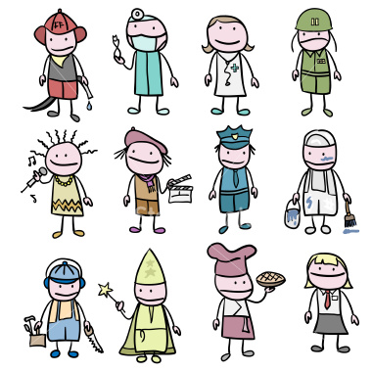
Used - To describe a role or relationship
Profession: I am your english teacher.
He is your boss.

Slide 6
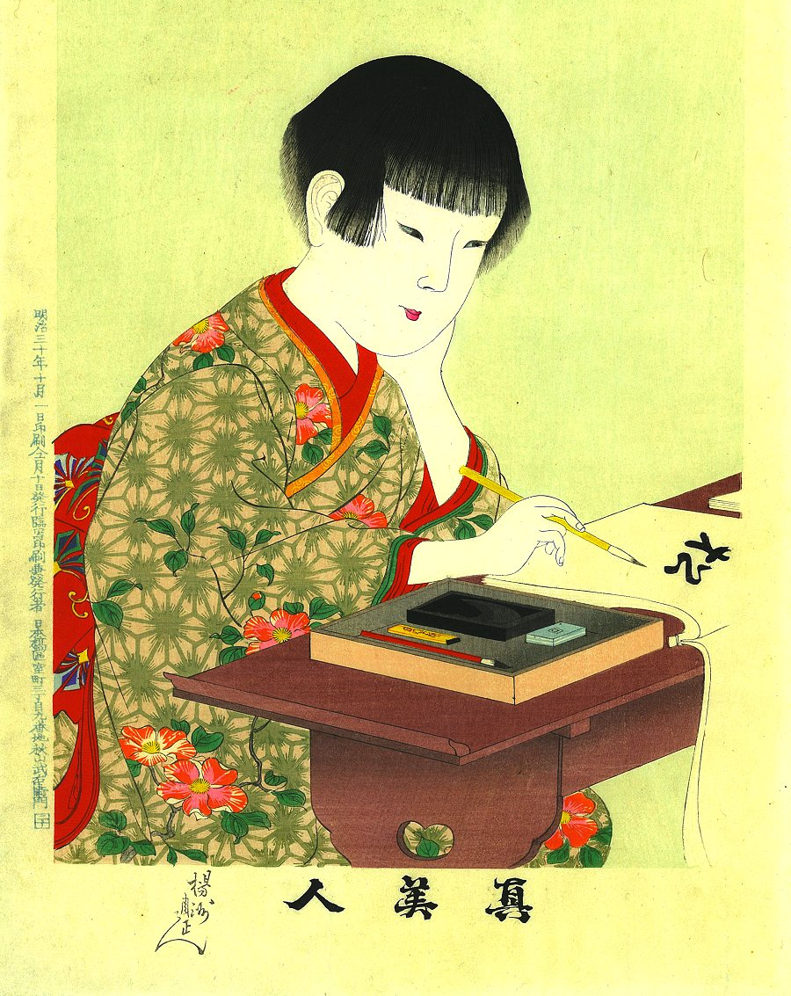
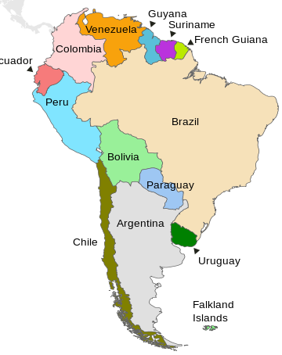
Used – location /places - nationalities
We are in Latin America
Valentina is at the university
She is Japanese

Slide 7
Country Nationality
1.
2.
3.
4.
5.
6.
7.
8.
9.
10.
11.
12.
13.
14.
15.

Slide 8
Contractions
Subject Pronoun | Verb To Be | contraction
I
You
He
She
It
We
You
They

Slide 9
Table #3: Complete the sentences using contractions.
I am so good in English
You are not my best friend
He is an excellent person
She is so cute
It is on the table
We are interested in the loan
You are the best lawyers
They are not losers

Slide 10
Exercise: To be
Personal Pronouns | Affirmative | Negative | Questions
I am | I am on time for class. | I’m not sure to be your father. | Am I a good police officer?
You
He is
She is
It is
We are
You are
They are

Slide 11
Replace the underlined words with the correct subject- include be where necessary.
The cake ……. Delicious/ . . . . . . . . . . . . . . . . . . . .
My mother …. a sweetheart. . . . . . . . . . . . .. .
That boy ….. A pain in the neck.
Laura and valentina …. . Team players.
Andres ……. going to be late for his conference.
My friend Daniel …… a real people person. “…….. so out going and friendly.”
My sister ….. such a tyrant! She makes her kids do all the housework.
the car ….a problem. …. . . . . . . . . . . . . . . . . . . . . . .
………. starving, can we go out?
(me)……. Trying to look on the bright side.

Slide 12
Audio (track 6): Listen and repeat
I am sorry = I`m sorry.
She is Lorie = She`s Lorie
You are fired= You`re fired.
He is in room 1234= He`s in room 1234

Slide 13
Short answers: (track: #12)
Question: Are you John Mendes?
Long Answer: Yes, I am John Mendes
Short Answer: Yes, I`m.

Slide 14
Questions with the verb To Be
to make questions with the verb to be, put the verb before the “Subject Pronoun” and a question mark (?) at the end. (ask the questions using table #3)

Slide 15
Write the correct questions
1. ……………………… ? Yes, they are good at English.
2. ………………………..…? No, she`s not a teacher; she is a student.
3. ……………………… …? No, we aren’t Japanese; we`re Korean.
4. ……………………….….? Yes, She is reliable and helpful.
5. ………………………….…? Yes, It is a funny story.
6. …………………………..? No, Sebastian is not a brain.

Slide 16
Match the questions with the short answers (use numbers).
_ Are you going to change my mind? | 1. Yes, it is.
____ Are Jerry and Vanessa Colombian? | 2. Yes, we are.
____ Is Laura a teacher? | 3. Yes, they are
____ Is discrimination a problem? | 4. No, he isn`t.
____ Are you friends? | 5. No, she`s not
____ Is John Mendes a doctor? | 6. Yes, I am.

