Slide 1
TALKING ABOUT LIKES AND DISLIKES

Slide 2
TOPIC: LIKES AND DISLIKES
LIKE +V ing or noun
ENJOY
LOVE
I like sports
I like doing sports
sports /like / do/ doing / you/ ?
HATE +V ing or noun
DISLIKE
DON´T ENJOY
DON´T LOVE
DON´T LIKE
I don´t like dogs. I don`t like walking the dog.
I dislike walking the dog.

Slide 3
Activities: reading, running, swimming, shopping, travelling, watching DVD´S, chatting online, dancing, going to the cinema, cooking, listening to music, camping.
LIKES ☺
Shopping
Cycling
Listening to music
DISLIKES ☹
Cooking
Camping
dancing

Slide 4
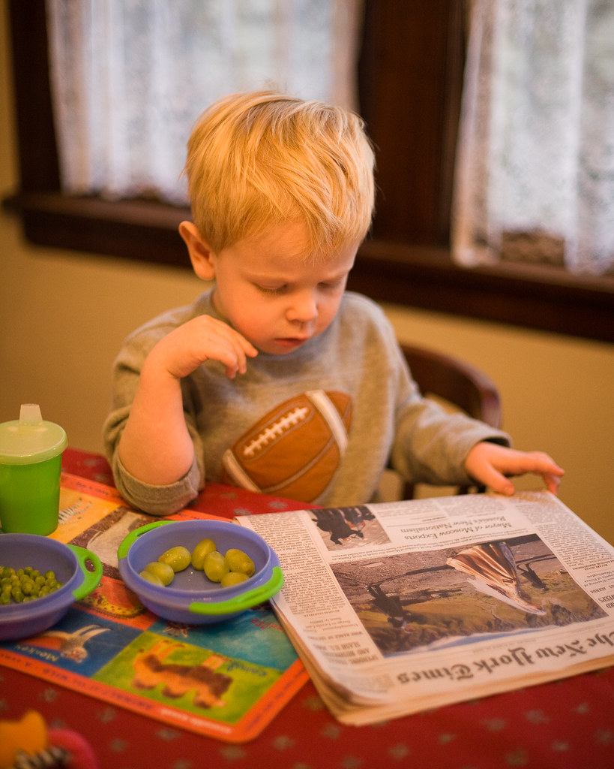
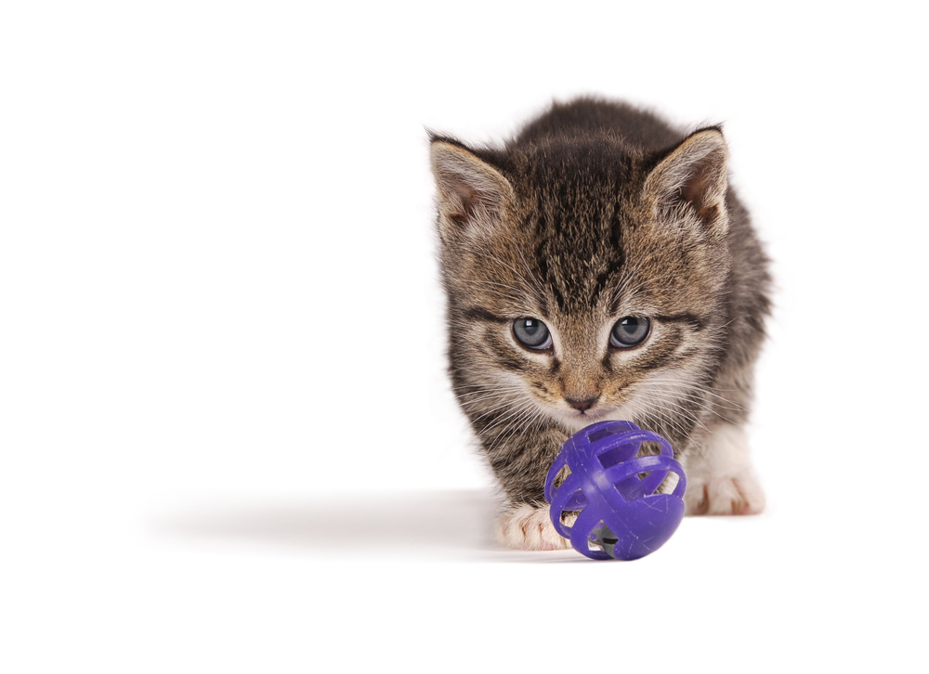
Look at the pictures and answer the questions.
She/ painting/ like / ? /does/
….
They/do/ football/ like /?
…..
He/ likes/ with/ a / playing /ball/does/ ?

Slide 5
LISTENING: 2.27 New Total English

Slide 7
Keywords and phrases
Like
Enjoy
Love
Dislike
Don’t like
hate
Activities:

