Slide 1
How Far Do We Have To Go

Slide 3
/*
* File: main.c
* Author: <your name here>
*/
#include <stdio.h>
#include <stdlib.h>
/*
* Calculate distance between 2 points
*/
int main(int argc, char** argv)
{
printf("\n");
return (EXIT_SUCCESS);
}

Slide 4
/*
* File: main.c
* Author: <your name here>
*/
#include <stdio.h>
#include <stdlib.h>
#include <math.h>
/*
* Calculate distance between 2 points
*/
int main(int argc, char** argv)
{
float pointOnex;
float pointOney;
float pointTwox;
float pointTwoy;
// prompt for and get usar input
printf("Enter x for first point: ");
scanf_s("%f", &pointOnex);
printf("Enter y for first point: ");
scanf_s("%f", &pointOney);
printf("Enter x for second point: ");
scanf_s("%f", &pointTwox);
printf("Enter y for second point: ");
scanf_s("%f", &pointTwoy);
// calculate and print distance
printf("\n");
return (EXIT_SUCCESS);
}

Slide 5
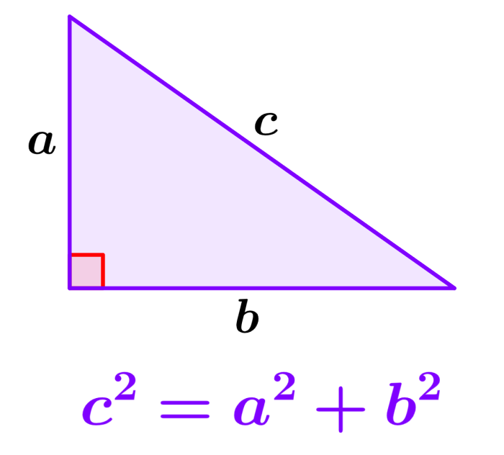
// calculate and print distance

Slide 6
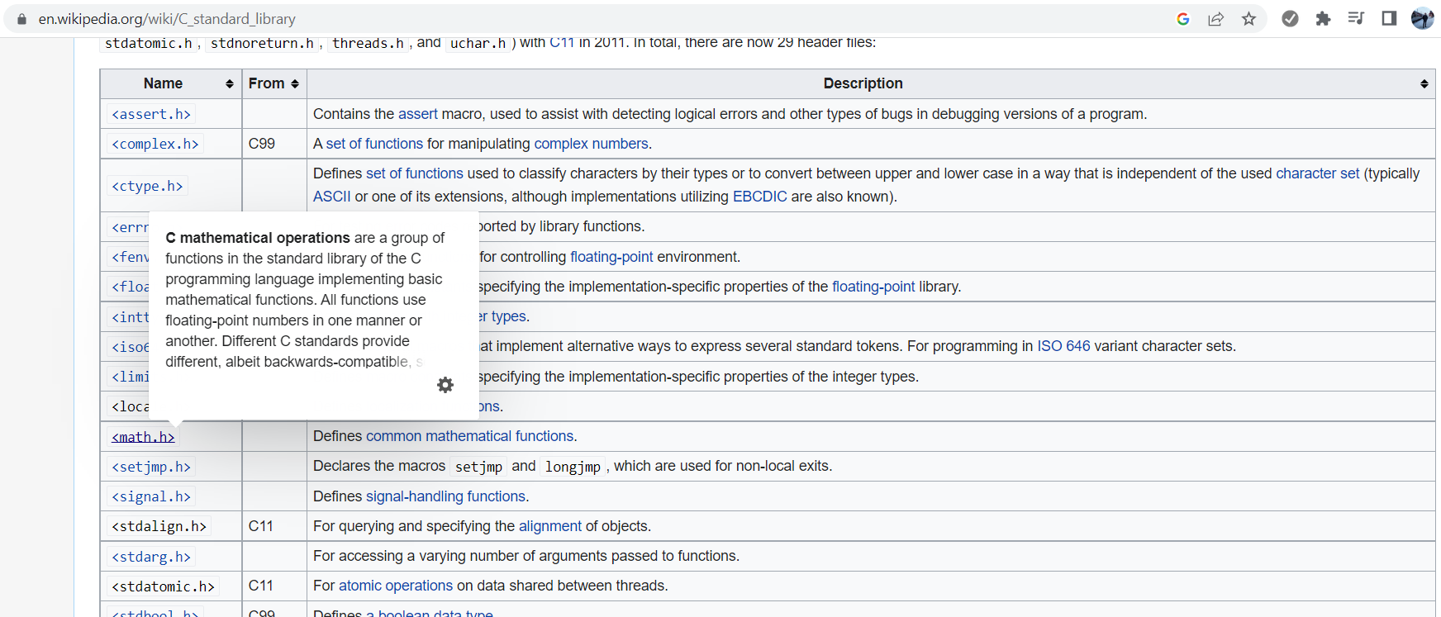
https://en.wikipedia.org/wiki/C_standard_library

Slide 7
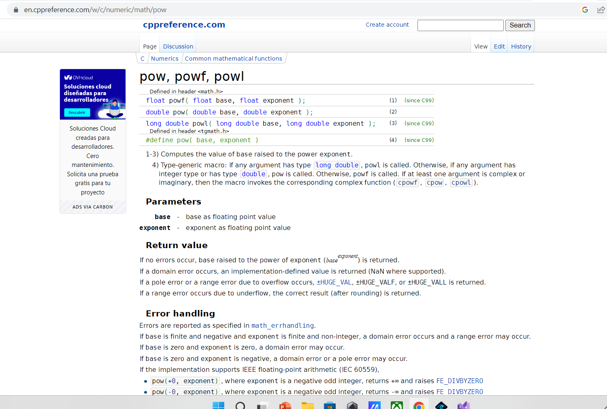

Slide 8
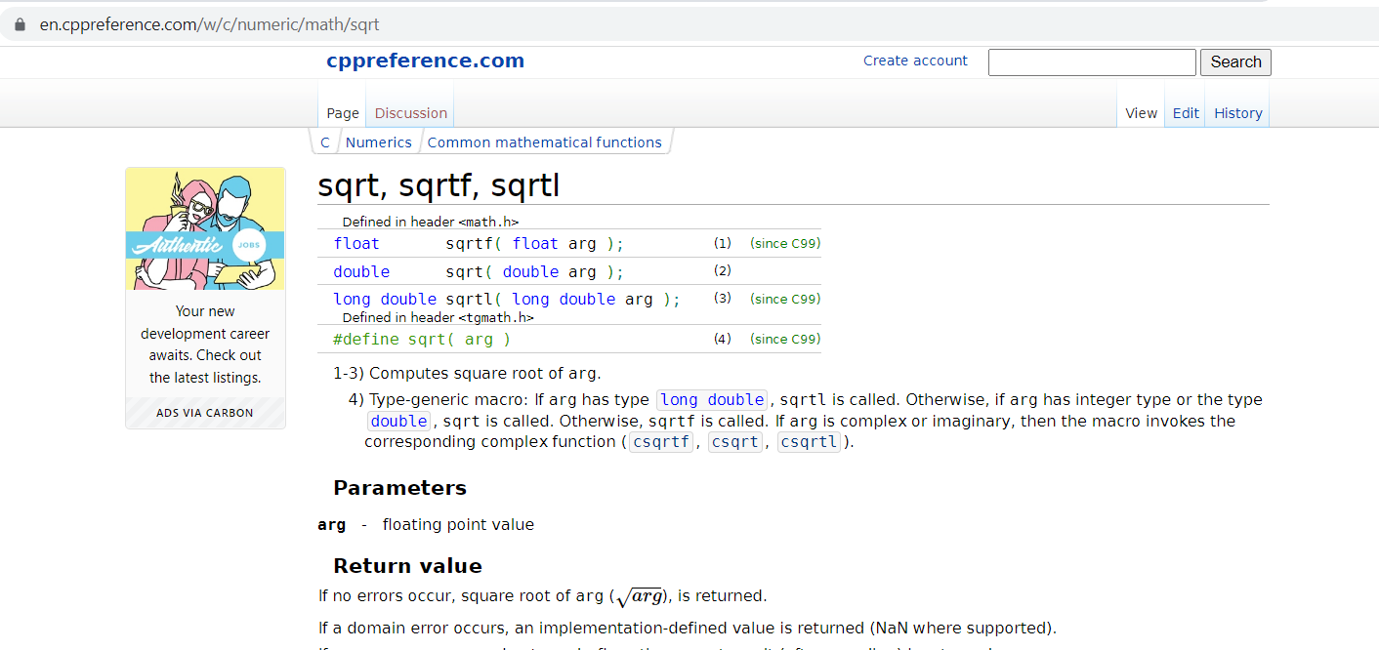

Slide 9
/*
* File: main.c
* Author: <your name here>
*/
#include <stdio.h>
#include <stdlib.h>
#include <math.h>
/*
* Calculate distance between 2 points
*/
int main(int argc, char** argv)
{
float pointOnex;
float pointOney;
float pointTwox;
float pointTwoy;
// prompt for and get usar input
printf("Enter x for first point: ");
scanf_s("%f", &pointOnex);
printf("Enter y for first point: ");
scanf_s("%f", &pointOney);
printf("Enter x for second point: ");
scanf_s("%f", &pointTwox);
printf("Enter y for second point: ");
scanf_s("%f", &pointTwoy);
// calculate and print distance
float distance = sqrtf(powf(pointOnex - pointTwox, 2) + powf(pointOney - pointTwoy, 2));
printf("\n");
printf("Distance: %.2f", distance);
printf("\n");
return (EXIT_SUCCESS);
}

