Slide 1
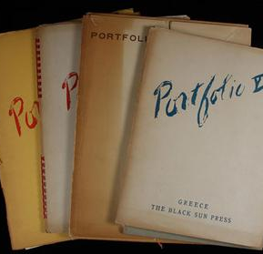
English 1 My e-portfolio
This project is based on: Cooperative work and the evaluation is done by students. You are encharged of the evaluation of your projects.

Slide 2
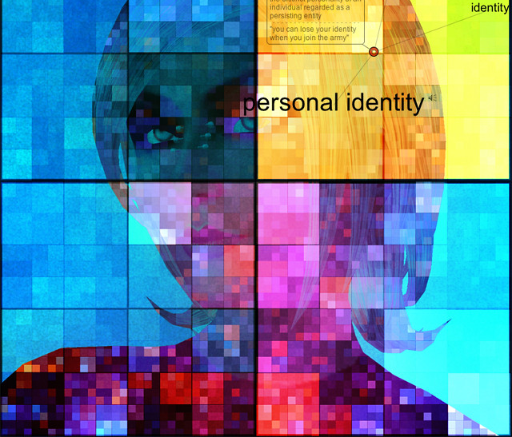
Personal Information
Personal Information (picture, full name, age, career, birthday, dream city, lucky number, favorite singer/band, pets.)
Esta foto de Autor desconocido está bajo licencia CC BY-SA-NC

Slide 3
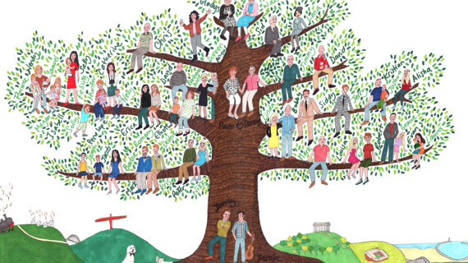
Family Tree
Students design their own family tree. Includes: grandparents, uncles, aunts, cousins, father´ side and mother´ side.

Slide 4
Family relationships
Students write 8 questions and answers related to the members of their own family. It is important to use possessives.
Example: What is your mother’s name? My mother’s name is Sophia.

Slide 5
Word Webs
TARGET WORD (Family members)
DEFINITION
SAMPLE SENTENCE
FAMILY MEMBER
FAMILY MEMBER
SAMPLE SENTENCE
FAMILY MEMBER
SAMPLE SENTENCE
Students prepare 6 word webs using these categories: adjectives, verbs, nouns, adverbs, family, personal information, places in the city, professions, nationalities and countries.

Slide 6
Other categories: verbs, nouns, adverbs.
amazing
(ADJECTIVE)
DEFINITION
SYNONYM
ANTONONYM
SAMPLE SENTENCE
SYNONYM
ANTONYM
SAMPLE SENTENCE

Slide 7
Saber pro
Students do some research about types of questions used in sections of saber- pro exams.
Then, give the definition of each type of question and give two examples.
Esta foto de Autor desconocido está bajo licencia CC BY-SA

Slide 8
Co-evaluation English 1 My e-Portfolio First term
Aspect | Evaluation criteria |  |  |  | Score
 | Alto | Medio | Bajo | Nulo
FIRST SLIDE
1. Picture | (2) | (1) | (0.5) | (0)
2. Full name | (2) | (1) | (0.5) | (0)
3. Age | (2) | (1) | (0.5) | (0)
4. Career | (2) | (1) | (0.5) | (0)
5. Birthday | (2) | (1) | (0.5) | (0)
6. Dream city | (2) | (1) | (0.5) | (0)
7. Lucky number | (2) | (1) | (0.5) | (0)
8. Favorite singer /band | (2) | (1) | (0.5) | (0)
9. Favorite animal | (2) | (1) | (0.5) | (0)
10. Favorite webpage | (2) | (1) | (0.5) | (0)
SECOND SLIDE
11. Draw family tree (with Pictures) | (10) | (5) | (3) | (0)
THIRD SLIDE
12. Questions with possessives (8) | (10) | (5) | (3) | (0)
13. Answers with possessives (8) | (10) | (5) | (3) | (0)
FOURTH SLIDE
14. (6) Word webs with categories: adjectives, family, places in the city, personal information/ 6 words each one. | (20) | (10) | (5) | (0)
FIFTH SLIDE
15. (2) more Word webs, categories: professions, nationalities, continents/ 6 words each one. | (20) | (10) | (5) | (0)
SIXTH SLIDE
16. Saber Pro /Question 1 (type, definition, examples) | (2) | (1) | (0.5) | (0)
17. Saber Pro /Question 2 (type, definition, examples) | (2) | (1) | (0.5) | (0)
18. Saber Pro /Question 3 (type, definition, examples) | (2) | (1) | (0.5) | (0)
19. Saber Pro /Question 4 (type, definition, examples) | (2) | (1) | (0.5) | (0)
20. Saber Pro /Question 5 (type, definition, examples) | (2) | (1) | (0.5) | (0)
Student`s Portfolio: code: Checked by: Date: |  |  |  |  | 100

Slide 9
Evaluating My e-portfolio
According to the list: student 1 co-evaluates student number 2, student number 2 evaluates student number 3, and so on. student 1 grades your partner´s presentation then students upload the coevaluation at moodle/ PROJECTS, besides students share your e-portfolios at google drive). Give your files your names.
The teacher has the autonomy to check the e-portfolio she consider must be evaluated for second time.

Slide 10
Evaluations:
First Term:
E-portfolio: Dic. 10th., 2021
Speaking project: Dic. 15th.
Exam: Dic.17th. 2021

