Slide 1
Search a string

Slide 2
#include <stdio.h>
#include <stdlib.h>
#include <string.h>
/*
* Demonstrates searching a string
*/
int main(int argc, char** argv)
{
return (EXIT_SUCCESS);
}

Slide 3
{
char data[] = "8.7,5.3";
// find comma manually
int length = strnlen(data, sizeof(data));
int i = 0;
while (data[i] != ',' && i < length)
{
i++;
}
printf("Comma is located at %d\n", i);
Print

Slide 4
{
char data[] = "8.7,5.3";
// find comma manually
int length = strnlen(data, sizeof(data));
int i = 0;
while (data[i] != ',' && i < length)
{
i++;
}
if (i < length)
{
printf("Comma is located at %d\n", i);
}
else
{
printf("Comma not found\n");
}

Slide 5
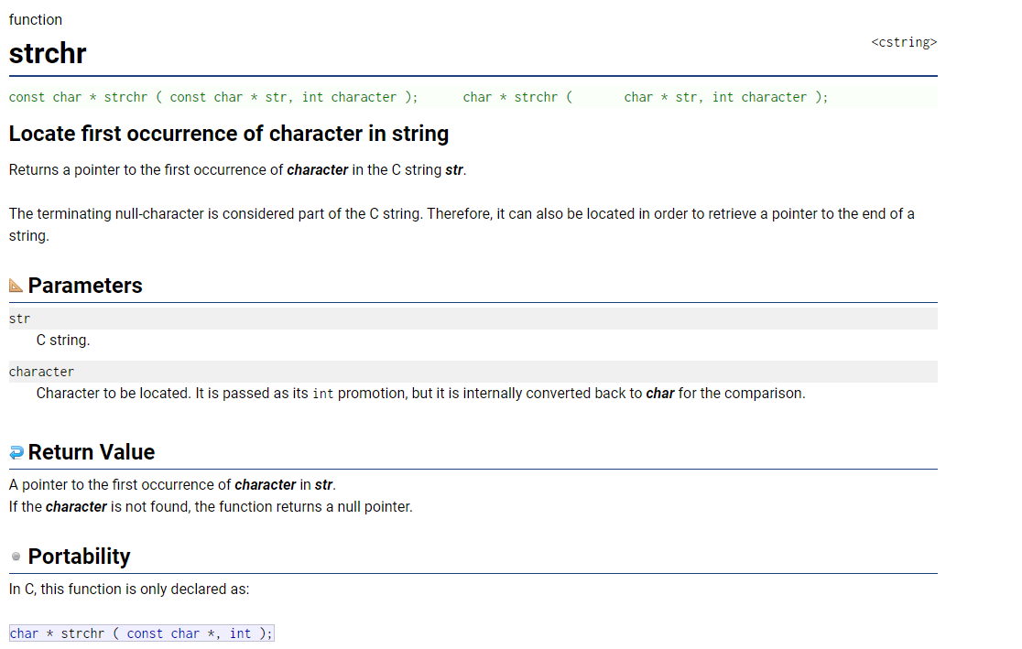
https://cplusplus.com/reference/cstring/
https://cplusplus.com/reference/cstring/strchr/

Slide 6
// find comma using standard function
char* result = NULL;
result = strchr(data, ',');
printf("%lu\n",sizeof(char));
if (result != NULL)
{
printf("Result address is %p\n", result);
printf("Data string address is %p\n", &data[0]);
char* dataStart = &data[0];
printf("Comma is located at %d\n", result - dataStart);
}
else
{
printf("Comma not found\n");
}

Slide 7
#include <stdio.h>
#include <stdlib.h>
#include <string.h>
/*
* Demonstrates searching a string
*/
int main(int argc, char** argv)
{
char data[] = "8.7,5.3";
// find comma manually
int length = strnlen(data, sizeof(data));
int i = 0;
while (data[i] != ',' &&
i < length)
{
i++;
}
if (i < length)
{
printf("Comma is located at %d\n", i);
}
else
{
printf("Comma not found\n");
}
// find comma using standard function
char* result = NULL;
result = strchr(data, ',');
if (result != NULL)
{
printf("Result address is %p\n", result);
printf("Data string address is %p\n", &data[0]);
char* dataStart = &data[0];
printf("Comma is located at %d\n", result - dataStart);
}
else
{
printf("Comma not found\n");
}
return (EXIT_SUCCESS);
}

