Slide 1
VIDEO: Cooper Pedy’s opals
Adapted: By Prof. Elizabeth Rodríguez

Slide 2
Video: Coober Pedy’s Opals

Slide 3
To start with, answer these questions:
What did you see?
Do you like the precious stones?
What colors are they?
Name 5 precious stones you know.
What materials of precious stones do you know?

Slide 4
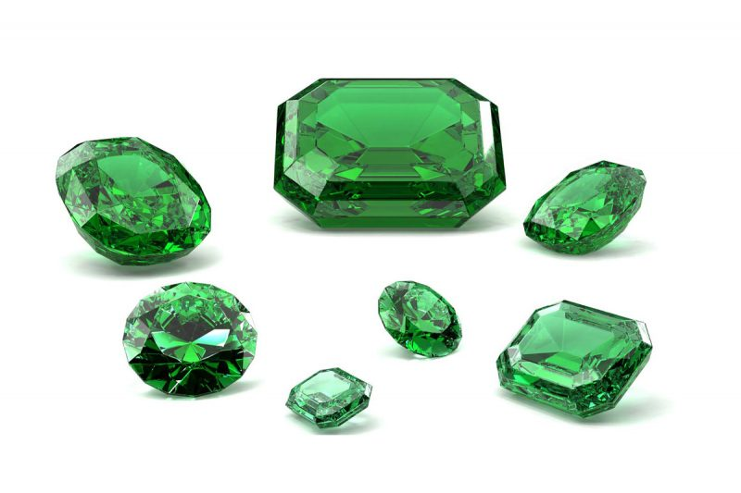
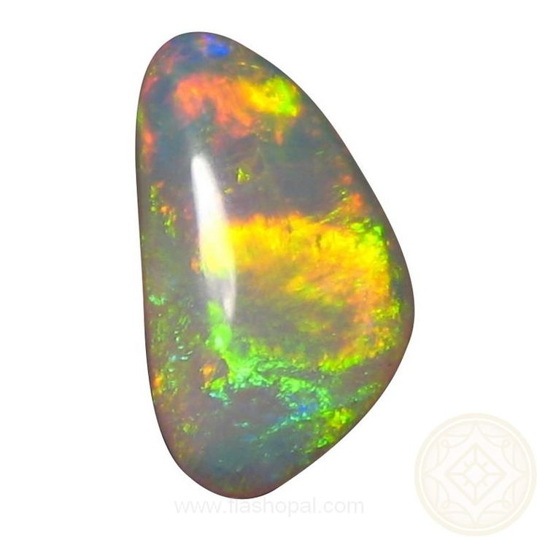
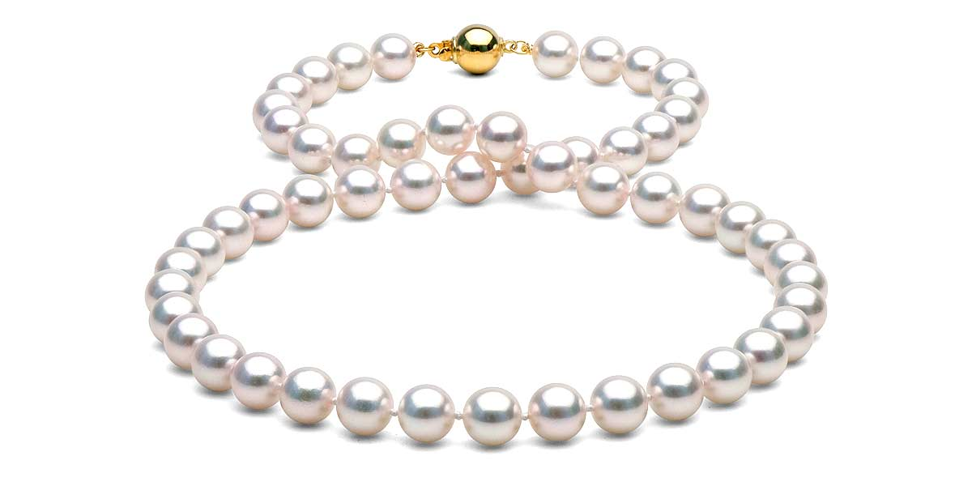
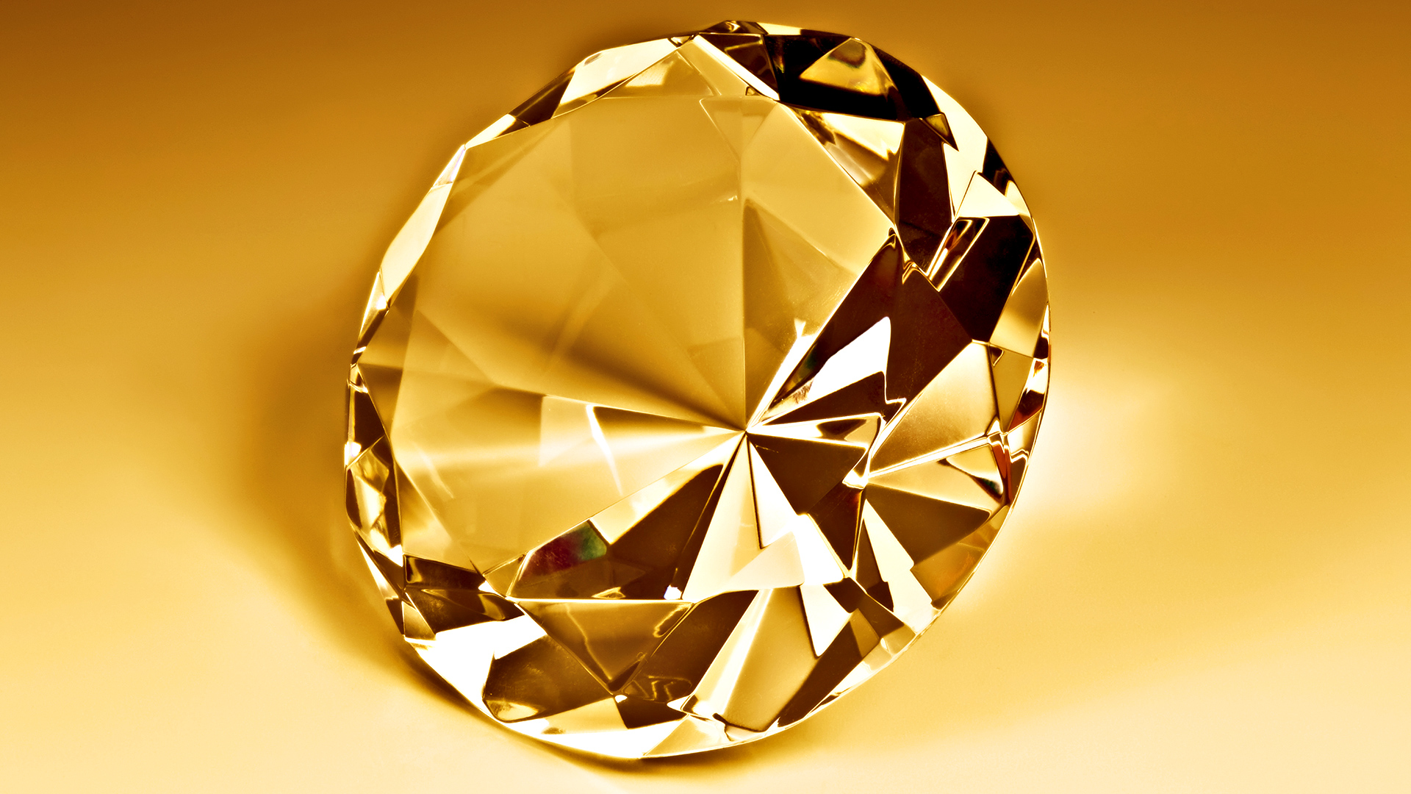
Stones
diamond.png

