Slide 1
Returning Data From a Function

Slide 2
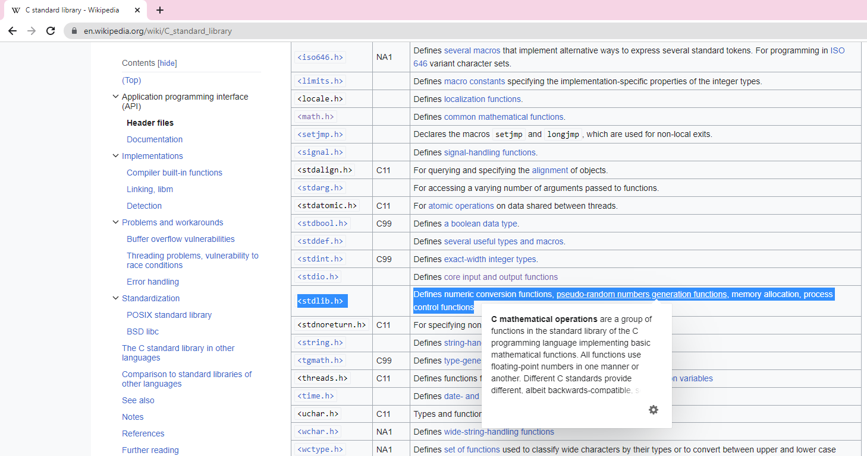
https://en.wikipedia.org/wiki/C_standard_library

Slide 3
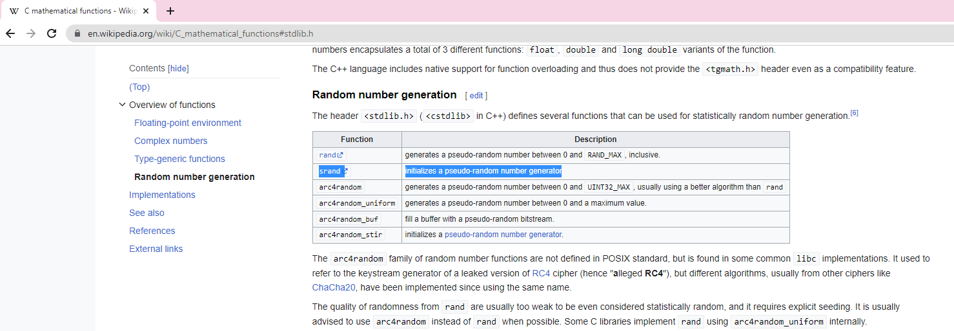

Slide 4
#include <stdio.h>
#include <stdlib.h>
#include <time.h>
int getRandom(); // function prototype
/*
* Demonstrates returning data from a function
*/
int main(int argc, char** argv)
{
// initialize random number generator and generate numbers
return (EXIT_SUCCESS);
}

Slide 5
#include <stdio.h>
#include <stdlib.h>
#include <time.h>
int getRandom(); // function prototype
/*
* Demonstrates returning data from a function
*/
int main(int argc, char** argv)
{
// initialize random number generator and generate numbers
return (EXIT_SUCCESS);
}
/*
* Generates a random number
*/
int getRandom()
{
return rand();
}

Slide 6
#include <stdio.h>
#include <stdlib.h>
#include <time.h>
int getRandom();
/*
* Demonstrates returning data from a function
*/
int main(int argc, char** argv)
{
// initialize random number generator and generate numbers
srand(time(0)); // seed random function
return (EXIT_SUCCESS);
}
/*
* Generates a random number
*/
int getRandom()
{
return rand();
}

Slide 7
#include <stdio.h>
#include <stdlib.h>
#include <time.h>
int getRandom(); // function prototype
/*
* Demonstrates returning data from a function
*/
int main(int argc, char** argv)
{
// initialize random number generator and generate numbers
srand(time(0));
for (int i = 1; i <= 5; i++)
{
printf("Random Number %d: %d\n", i, getRandom());
}
return (EXIT_SUCCESS);
}
/*
* Generates a random number
*/
int getRandom()
{
return rand();
}

Slide 8
#include <stdio.h>
#include <stdlib.h>
#include <time.h>
int getRandom();
/*
* Demonstrates returning data from a function
*/
int main(int argc, char** argv)
{
// initialize random number generator and generate numbers
//srand(time(0)); comment
for (int i = 1; i <= 5; i++)
{
printf("Random Number %d: %d\n", i, getRandom());
}
return (EXIT_SUCCESS);
}
/*
* Generates a random number
*/
int getRandom()
{
return rand();
}

Slide 9
#include <stdio.h>
#include <stdlib.h>
#include <time.h>
int getRandom();
/*
* Demonstrates returning data from a function
*/
int main(int argc, char** argv)
{
// initialize random number generator and generate numbers
srand(time(0));
for (int i = 1; i <= 5; i++)
{
printf("Random Number %d: %d\n", i, getRandom());
}
return (EXIT_SUCCESS);
}
/*
* Generates a random number
*/
int getRandom()
{
return rand();
}

Slide 10
Passing Data Into a Function

Slide 11
#include <stdio.h>
#include <stdlib.h>
/*
* Demonstrates functions with parameters
*/
int main(int argc, char** argv)
{
int score1 = 100;
int score2 = 99;
int scores[] = { 98, 99, 100 };
// calculate and print average of two scores
// calculate and print average of scores array
return (EXIT_SUCCESS);
}

Slide 12
#include <stdio.h>
#include <stdlib.h>
float averageScores(int firstScore, int secondScore); // function prototype
float averageScoreArray(int scores[], int count); // function prototype
/*
* Demonstrates functions with parameters
*/
int main(int argc, char** argv)
{
int score1 = 100;
int score2 = 99;
int scores[] = { 98, 99, 100 };
// calculate and print average of two scores
// calculate and print average of scores array
return (EXIT_SUCCESS);
}
/*
* Averages two scores
*/
float averageScores(int firstScore, int secondScore)
{
return (float)(firstScore + secondScore) / 2;
}
/*
* Averages the scores in an array
*/
float averageScoreArray(int scores[], int count)
{
int sum = 0;
for (int i = 0; i < count; i++)
{
sum += scores[i];
}
return (float)sum / count;
}

Slide 13
int main(int argc, char** argv)
{
int score1 = 100;
int score2 = 99;
int scores[] = { 98, 99, 100 };
// calculate and print average of two scores
float averageScore = averageScores(score1, score2);
printf("Average of %d and %d: %.2f\n", score1, score2,
averageScore);
return (EXIT_SUCCESS);
}

Slide 14
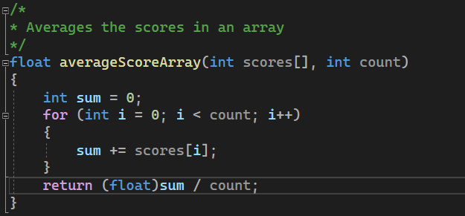
int main(int argc, char** argv)
{
int score1 = 100;
int score2 = 99;
int scores[] = { 98, 99, 100 };
// calculate and print average of two scores
float averageScore = averageScores(score1, score2);
printf("Average of %d and %d: %.2f\n", score1, score2,
averageScore);
// calculate and print average of scores array
printf("Average of scores in array: %.2f\n",
averageScoreArray(scores, sizeof(scores) / sizeof(scores[0])));
return (EXIT_SUCCESS);
}

Slide 15
{
int score1 = 100;
int score2 = 99;
//int scores[] = { 98, 99, 100 };
int scores[5] = { 98, 99, 100, 0, 0 };
// calculate and print average of two scores
float averageScore = averageScores(score1, score2);
printf("Average of %d and %d: %.2f\n", score1, score2,
averageScore);
// calculate and print average of scores array
/*printf("Average of scores in array: %.2f\n",
averageScoreArray(scores, sizeof(scores) / sizeof(scores[0])));*/
printf("Average of scores in array: %.2f\n",
averageScoreArray(scores, 3));
return (EXIT_SUCCESS);
}

