Slide 1
Prepositions of place

Slide 2
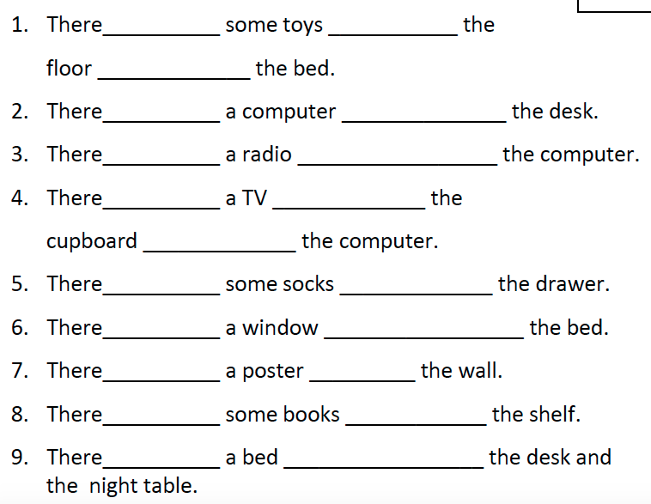

Slide 3
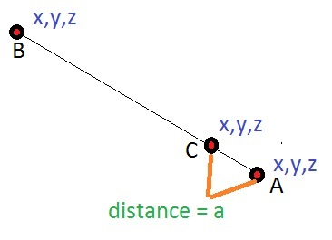
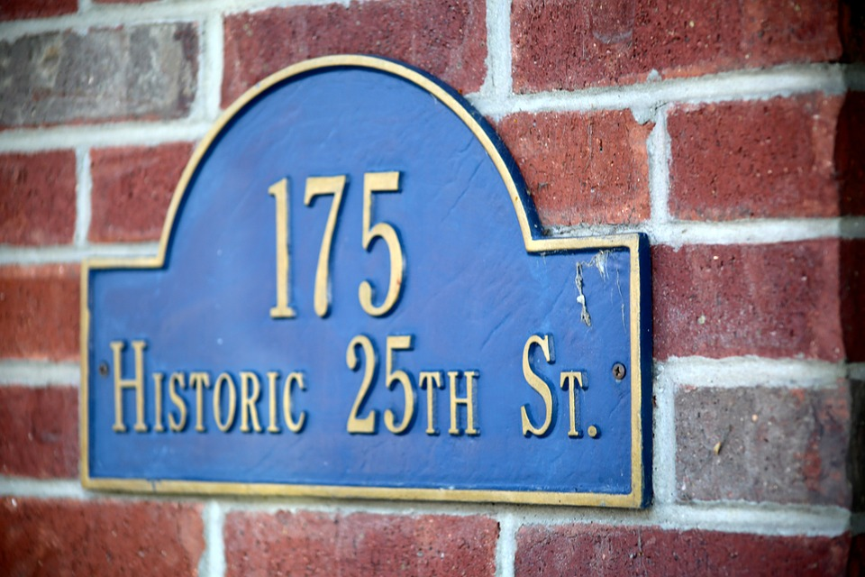
AT
Some specific points:
To talk about a particular position: at the door.
To say where an event takes place: at the party- at the conference- at the concert.
In the expressions: at school/university/college/work/home. Etc.
To talk about a person`s house or business: At ann’s house, at the baker’s.
With addresses:
(the house number + street):
at 2 Market street
We can say that somebody is at home or somebody is home:
For instance: Sarah will be at home all evening
Sarah will be home all evening.

Slide 4
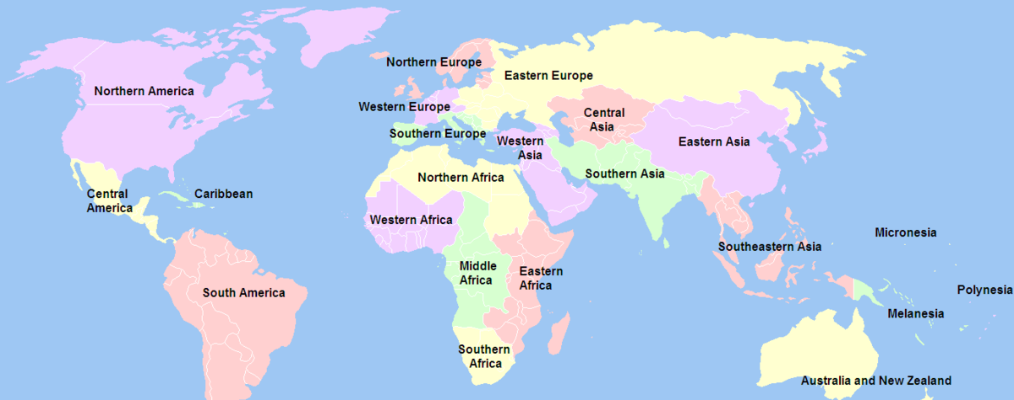
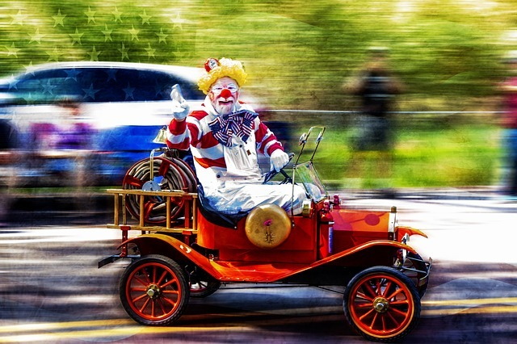
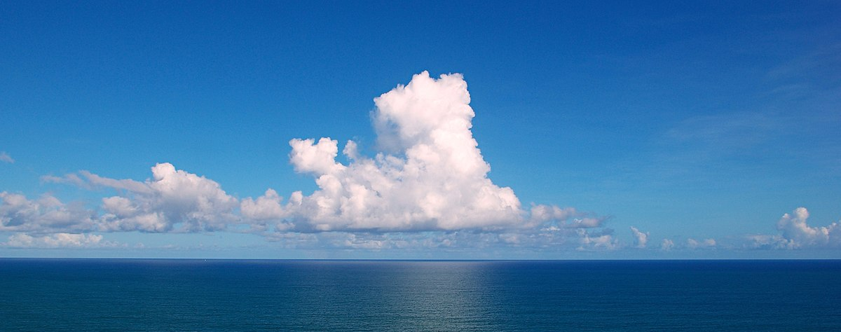
IN
with the names of cities and geographical regions: In Germany, in New York, in Asia.
With buildings, rooms and closed spaces: in a shop/in the kitchen/in the park/in the office.
In the expressions: in the sea/in the sky/ in bed/ in the picture/in the street, etc.

Slide 5
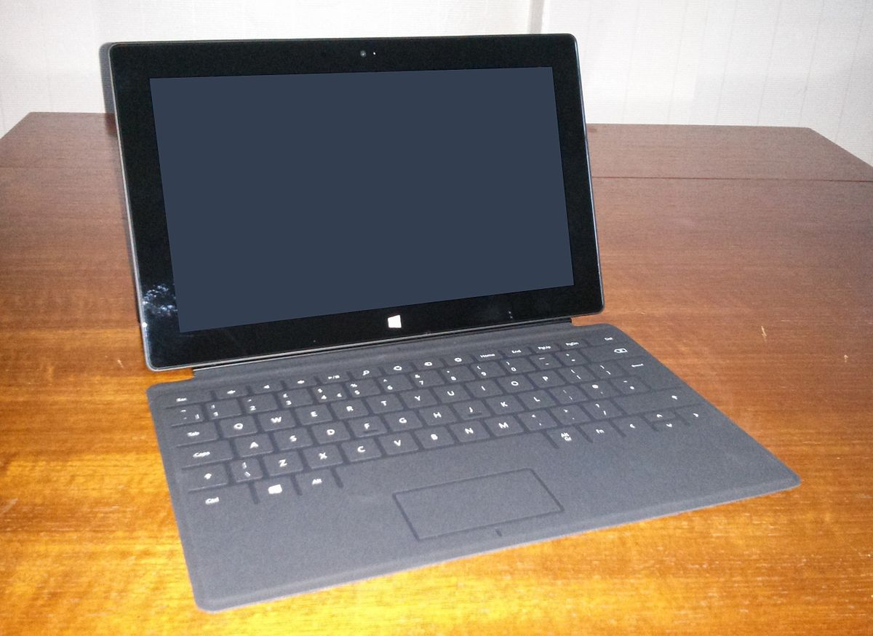
ON
To talk about a surface: on the floor/ on the shelf
To talk about transport (general): on the bike/bus/train/plane/ship. Except: in the car
When we talk about means of transport, we use the preposition by: by car/by bus/by train/ plane/ ship. Except: on foot
Directions: on the left/on the right/on the farm/on the menu, on the list, etc.

Slide 6
A. Fill in the gaps with in, on or at.
Are you going to write the report ____________ home or ____________ work?
The meeting is ____________ Zurich; ____________ Switzerland.
He’s staying ____________the Ritz Hotel ____________ Lisbon.
I’ m afraid he’s not ____________ the office today.
Our head office is ____________Cambridge.
Our grandfather is waiting for you ____________ the bus stop.
My house is ____________ the end of the street.
When will you arrive ____________ school?
Do you work ____________ an office?
____________School, there are many “No smoking” signs ____________ the walls.
Write your name ____________ the top right hand corner on the front page.
Sign your name ____________ the bottom.
The robbers are still ____________ the bank.
“Where’s Tom?” “He’s still ____________ the bank.”
Her mother works ____________ the local hospital.
There’s a good film on the cinema this week.
They were lost ____________ sea for eight days.
The sports results are ____________ the back page of the newspaper.
In England people drive ____________ the left.
Don’t let the kids play football ____________ the street.

