Slide 1
CSV String Processing

Slide 2
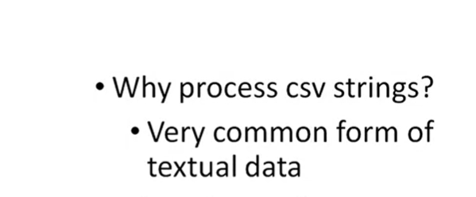

Slide 3
#define _CRT_SECURE_NO_WARNINGS
#include <stdio.h>
#include <stdlib.h>
#include <string.h>
/*
* Demonstrates CSV string processing
*/
int main(int argc, char** argv)
{
return (EXIT_SUCCESS);
}

Slide 4
int main(int argc, char** argv)
{
struct Vector {
float x;
float y;
};
typedef struct Vector Vector;
Vector point;
// read in point string from user
char pointString[100];
printf("Enter x and y for point (no spaces, comma-separated): ");
fgets(pointString, sizeof(pointString), stdin);

Slide 5
// read in point string from user
char pointString[100];
printf("Enter x and y for point (no spaces, comma-separated): ");
fgets(pointString, sizeof(pointString), stdin);
// find comma index
int commaIndex = -1;
char* result = NULL;
while (commaIndex == -1)
{
result = strchr(pointString, ',');
if (result != NULL)
{
char* pointStringStart = &pointString[0];
commaIndex = result - pointStringStart;
}
else
{
printf("\n");
printf("Invalid input: comma not found\n");
printf("Enter x and y for point (no spaces, comma-separated): ");
fgets(pointString, sizeof(pointString), stdin);
}
}

Slide 6
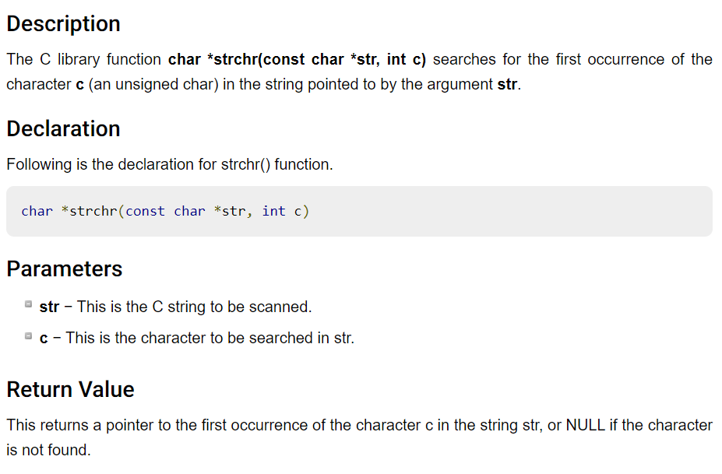

Slide 7
// extract x from point string
//char xString[commaIndex + 1];
// Visual Studio users can't create arrays with sizes based on user
// input because of the compiler Visual Studio uses
char* xString = malloc((commaIndex + 1) * sizeof(char));
strncpy(xString, pointString, commaIndex);
xString[commaIndex] = '\0';
point.x = atof(xString);
// Visual Studio: free memory because we used pointers
free(xString);
xString = NULL;

Slide 8
https://en.wikipedia.org/wiki/C_string_handling

Slide 9
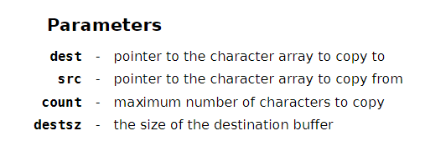
https://en.cppreference.com/w/c/string/byte/strncpy

Slide 10
// extract x from point string
//char xString[commaIndex + 1];
// Visual Studio users can't create arrays with sizes based on user
// input because of the compiler Visual Studio uses
char* xString = malloc((commaIndex + 1) * sizeof(char));
strncpy(xString, pointString, commaIndex);
xString[commaIndex] = '\0';
point.x = atof(xString);
// Visual Studio: free memory because we used pointers
free(xString);
xString = NULL;

Slide 11
// extract y from point string
// don't include newline character in point string length
int length = strnlen(pointString, sizeof(pointString)) - 1;
//char yString[length - commaIndex];
// Visual Studio users can't create arrays with sizes based on user
// input because of the compiler Visual Studio uses
char* yString = malloc((length - commaIndex) * sizeof(char));
int offset = commaIndex + 1;
for (int i = 0; i < length - commaIndex - 1; i++)
{
yString[i] = pointString[i + offset];
}
yString[length - commaIndex - 1] = '\0';
point.y = atof(yString);
// Visual Studio: free memory because we used pointers
free(yString);
yString = NULL;

Slide 12
// print point info
printf("\n");
printf("Point x: %f\n", point.x);
printf("Point y: %f\n", point.y);
printf("\n");
return (EXIT_SUCCESS);
}

Slide 13
#define _CRT_SECURE_NO_WARNINGS
#include <stdio.h>
#include <stdlib.h>
#include <string.h>
/*
* Demonstrates CSV string processing
*/
int main(int argc, char** argv)
{
struct Vector {
float x;
float y;
};
typedef struct Vector Vector;
Vector point;
// read in point string from user
char pointString[100];
printf("Enter x and y for point (no spaces, comma-separated): ");
fgets(pointString, sizeof(pointString), stdin);
// find comma index
int commaIndex = -1;
char* result = NULL;
while (commaIndex == -1)
{
result = strchr(pointString, ',');
if (result != NULL)
{
char* pointStringStart = &pointString[0];
commaIndex = result - pointStringStart;
}
else
{
printf("\n");
printf("Invalid input: comma not found\n");
printf("Enter x and y for point (no spaces, comma-separated): ");
fgets(pointString, sizeof(pointString), stdin);
}
}
// extract x from point string
//char xString[commaIndex + 1];
// Visual Studio users can't create arrays with sizes based on user
// input because of the compiler Visual Studio uses
char* xString = malloc((commaIndex + 1) * sizeof(char));
strncpy(xString, pointString, commaIndex);
xString[commaIndex] = '\0';
point.x = atof(xString);
// Visual Studio: free memory because we used pointers
free(xString);
xString = NULL;
// extract y from point string
// don't include newline character in point string length
int length = strnlen(pointString, sizeof(pointString)) - 1;
//char yString[length - commaIndex];
// Visual Studio users can't create arrays with sizes based on user
// input because of the compiler Visual Studio uses
char* yString = malloc((length - commaIndex) * sizeof(char));
int offset = commaIndex + 1;
for (int i = 0; i < length - commaIndex - 1; i++)
{
yString[i] = pointString[i + offset];
}
yString[length - commaIndex - 1] = '\0';
point.y = atof(yString);
// Visual Studio: free memory because we used pointers
free(yString);
yString = NULL;
// print point info
printf("\n");
printf("Point x: %f\n", point.x);
printf("Point y: %f\n", point.y);
printf("\n");
return (EXIT_SUCCESS);
}

