Slide 1
Strings Basics

Slide 2
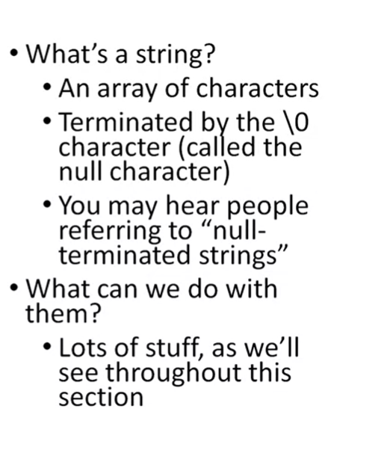

Slide 3
#include <stdio.h>
#include <stdlib.h>
/*
* Demonstrates string basics
*/
int main(int argc, char** argv)
{
char message[] = "ftatrwsy";
// output string information
int i = 0;
while (message[i] != '\0')
{
printf("message[%d] Address: %p Contents: %c\n", i, &message[i], message[i]);
i++;
}
// print message string
printf("Message: %s\n", message);
return (EXIT_SUCCESS);
}

Slide 4
#include <stdio.h>
#include <stdlib.h>
#include <string.h>
/*
* Finds the length of a string
*/
int main(int argc, char** argv)
{
char message[] = "Def Leppard rocks!";
// count and print the length of the string
int i = 0;
while (message[i] != '\0')
{
i++;
}
printf("%s has %d characters\n", message, i);
// print string length using function
printf("%s has %zu characters\n", message,strnlen(message, sizeof(message)));
return (EXIT_SUCCESS);
}
Length of string: strlen interpreta la cadena como una cadena de caracteres de un solo byte, de modo que el valor devuelto siempre es igual al número de bytes, incluso si la cadena contiene caracteres multibyte.

