Slide 1
The Caesar Cipher Revisited

Slide 2
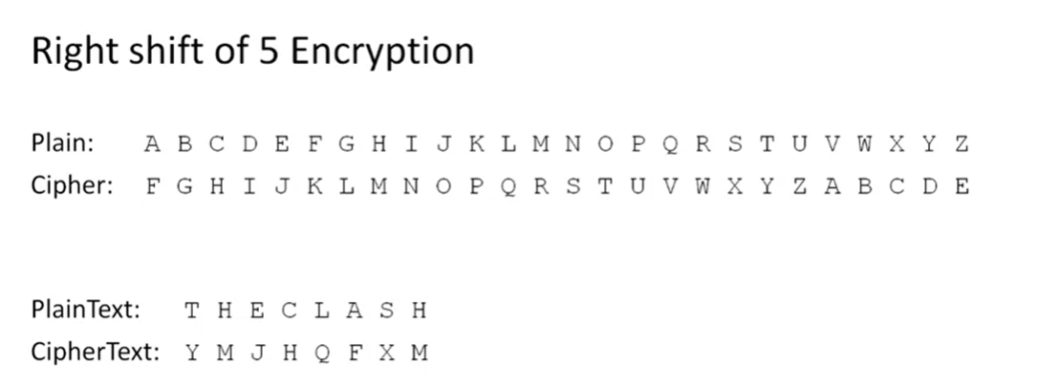

Slide 3
#include <stdio.h>
#include <stdlib.h>
#include <string.h>
#include <ctype.h>
#include <stdbool.h>
#define SHIFT_AMOUNT 5
/*
* Implement Caesar Cipher Right Shift 5 encryption and decryption
*/
int main(int argc, char** argv)
{
return (EXIT_SUCCESS);
}

Slide 4
int main(int argc, char** argv)
{
char originalMessage[100];
// prompt for and get valid string to be encrypted
bool validMessage = false;
printf("Enter message to be encrypted (upper case alphabetic characters only): ");
fgets(originalMessage, sizeof(originalMessage), stdin);
int originalMessageLength = strnlen(originalMessage, sizeof(originalMessage)) - 1;

Slide 5
while (!validMessage)
{
// invalid if non-upper case alpha characters in message (don't include newline at end))
validMessage = true;
for (int i = 0; i < originalMessageLength; i++)
{
if (!isupper(originalMessage[i]))
{
printf("\n");
printf("Message must contain only upper case alphabetic characters!\n");
printf("Enter message to be encrypted (upper case alphabetic characters only): ");
fgets(originalMessage, sizeof(originalMessage), stdin);
originalMessageLength = strnlen(originalMessage, sizeof(originalMessage)) - 1;
// reset flag and exit for loop
validMessage = false;
break;
}
}
}

Slide 6
// build encrypted string (make sure it's null-terminated)
//char encryptedMessage[originalMessageLength + 1];
// Visual Studio users can't create arrays with sizes based on user
// input because of the compiler Visual Studio uses
char* encryptedMessage = malloc((originalMessageLength + 1) * sizeof(char));
for (int i = 0; i < originalMessageLength; i++)
{
encryptedMessage[i] = originalMessage[i] + SHIFT_AMOUNT;
if (encryptedMessage[i] > 'Z')
{
encryptedMessage[i] -= 'Z' - 'A' + 1;
// Example: encrypting 'V' at 86 in table
// '[' is at 91 in table ('Z' is at 90 in table)
// 'Z' is 90, 'A' is 65, so 'Z' - 'A' + 1 is 26
// '[' is changed from 91 to 91 - 26, which is 65 ('A')
// this gives us exactly the wrapping we need
}
}
encryptedMessage[originalMessageLength] = '\0';

Slide 7
// build decrypted string (make sure it's null-terminated)
//int encryptedMessageLength = strnlen(encryptedMessage, sizeof(encryptedMessage));
//char decryptedMessage[encryptedMessageLength + 1];
// Visual Studio users can't create arrays with sizes based on user
// input because of the compiler Visual Studio uses
int encryptedMessageLength = originalMessageLength;
char* decryptedMessage = malloc((encryptedMessageLength + 1) * sizeof(char));
for (int i = 0; i < encryptedMessageLength; i++)
{
decryptedMessage[i] = encryptedMessage[i] - SHIFT_AMOUNT;
if (decryptedMessage[i] < 'A')
{
decryptedMessage[i] += 'Z' - 'A' + 1;
// Example: decrypting 'E' at 69 in table
// '@' is at 64 in table ('A' is at 65 in table)
// 'Z' is 90, 'A' is 65, so 'Z' - 'A' + 1 is 26
// '@' is changed from 64 to 64 + 26, which is 90 ('Z')
// this gives us exactly the wrapping we need
}
}
decryptedMessage[encryptedMessageLength] = '\0';

Slide 8
// print messages
printf("\n");
printf("Original Message : %s", originalMessage);
printf("Encrypted Message: %s\n", encryptedMessage);
printf("Decrypted Message: %s\n", decryptedMessage);
// Visual Studio: free memory because we used pointers
free(encryptedMessage);
encryptedMessage = NULL;
free(decryptedMessage);
decryptedMessage = NULL;
printf("\n");
return (EXIT_SUCCESS);

Slide 9
// build encrypted string (make sure it's null-terminated)
//char encryptedMessage[originalMessageLength + 1];
// Visual Studio users can't create arrays with sizes based on user
// input because of the compiler Visual Studio uses
char* encryptedMessage = malloc((originalMessageLength + 1) * sizeof(char));
for (int i = 0; i < originalMessageLength; i++)
{
encryptedMessage[i] = originalMessage[i] + SHIFT_AMOUNT;
if (encryptedMessage[i] > 'Z')
{
encryptedMessage[i] -= 'Z' - 'A' + 1;
// Example: encrypting 'V' at 86 in table
// '[' is at 91 in table ('Z' is at 90 in table)
// 'Z' is 90, 'A' is 65, so 'Z' - 'A' + 1 is 26
// '[' is changed from 91 to 91 - 26, which is 65 ('A')
// this gives us exactly the wrapping we need
}
}
encryptedMessage[originalMessageLength] = '\0';
// build decrypted string (make sure it's null-terminated)
//int encryptedMessageLength = strnlen(encryptedMessage, sizeof(encryptedMessage));
//char decryptedMessage[encryptedMessageLength + 1];
// Visual Studio users can't create arrays with sizes based on user
// input because of the compiler Visual Studio uses
int encryptedMessageLength = originalMessageLength;
char* decryptedMessage = malloc((encryptedMessageLength + 1) * sizeof(char));
for (int i = 0; i < encryptedMessageLength; i++)
{
decryptedMessage[i] = encryptedMessage[i] - SHIFT_AMOUNT;
if (decryptedMessage[i] < 'A')
{
decryptedMessage[i] += 'Z' - 'A' + 1;
// Example: decrypting 'E' at 69 in table
// '@' is at 64 in table ('A' is at 65 in table)
// 'Z' is 90, 'A' is 65, so 'Z' - 'A' + 1 is 26
// '@' is changed from 64 to 64 + 26, which is 90 ('Z')
// this gives us exactly the wrapping we need
}
}
decryptedMessage[encryptedMessageLength] = '\0';
// print messages
printf("\n");
printf("Original Message : %s", originalMessage);
printf("Encrypted Message: %s\n", encryptedMessage);
printf("Decrypted Message: %s\n", decryptedMessage);
// Visual Studio: free memory because we used pointers
free(encryptedMessage);
encryptedMessage = NULL;
free(decryptedMessage);
decryptedMessage = NULL;
printf("\n");
return (EXIT_SUCCESS);
}
#include <stdio.h>
#include <stdlib.h>
#include <string.h>
#include <ctype.h>
#include <stdbool.h>
#define SHIFT_AMOUNT 5
/*
* Implement Caesar Cipher Right Shift 5 encryption and decryption
*/
int main(int argc, char** argv)
{
char originalMessage[100];
// prompt for and get valid string to be encrypted
bool validMessage = false;
printf("Enter message to be encrypted (upper case alphabetic characters only): ");
fgets(originalMessage, sizeof(originalMessage), stdin);
int originalMessageLength = strnlen(originalMessage, sizeof(originalMessage)) - 1;
while (!validMessage)
{
// invalid if non-upper case alpha characters in message (don't include newline at end))
validMessage = true;
for (int i = 0; i < originalMessageLength; i++)
{
if (!isupper(originalMessage[i]))
{
printf("\n");
printf("Message must contain only upper case alphabetic characters!\n");
printf("Enter message to be encrypted (upper case alphabetic characters only): ");
fgets(originalMessage, sizeof(originalMessage), stdin);
originalMessageLength = strnlen(originalMessage, sizeof(originalMessage)) - 1;
// reset flag and exit for loop
validMessage = false;
break;
}
}
}

Slide 10
Exercise in class: Full Caesar Cipher
Objective: Build on the Strings Caesar Cipher lecture final code to implement a complete Caesar Cipher program
Problem – Generate a complete Caesar Cipher solution
Start with the final code from Strings Caesar Cipher lecture.
Ask the user whether they want to left or right shift and loop while they enter an invalid response. Remember to use the getchar function to clear the input buffer after reading in their choice.
Ask the user how many characters they want to shift, 1 to 25, and loop while they enter an invalid response.
Change the encryption and decryption code to shift in the appropriate direction by the appropriate amount based on the user responses above.

