Slide 1
Arrays in C

Slide 3
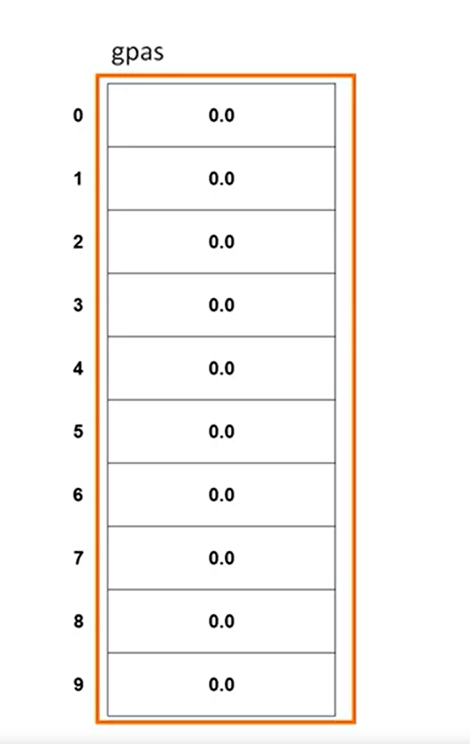

Slide 4
#define _CRT_SECURE_NO_WARNINGS
#include <stdio.h>
#include <stdlib.h>
/*
* Demonstrates arrays
*/
int main(int argc, char** argv)
{
return (EXIT_SUCCESS);
}

Slide 5
#define _CRT_SECURE_NO_WARNINGS
#include <stdio.h>
#include <stdlib.h>
/*
* Demonstrates arrays
*/
int main(int argc, char** argv)
{
int scores[5];
scores[0] = 100;
scores[1] = 95;
return (EXIT_SUCCESS);
}

Slide 6
#define _CRT_SECURE_NO_WARNINGS
#include <stdio.h>
#include <stdlib.h>
/*
* Demonstrates arrays
*/
int main(int argc, char** argv)
{
int scores[5];
//scores[0] = 100;
//scores[1] = 95;
// fill the array with test scores
for (int i = 0; i < 5; i++)
{
// pro for and get valid test score
printf("Enter score %d (0-100): ", i + 1);
scanf("%d", &scores[i]);
}
return (EXIT_SUCCESS);
}

Slide 7
// fill the array with test scores
for (int i = 0; i < 5; i++)
{
// prompt for and get valid test score
printf("Enter score %d (0-100): ", i + 1);
scanf("%d", &scores[i]);
while (scores[i] < 0 || scores[i] > 100)
{
printf("\n");
printf("Score must be between 0 and 100\n");
printf("Enter score %d (0-100): ", i + 1);
scanf("%d", &scores[i]);
}
}
Test

Slide 8
int main(int argc, char** argv)
{
int scores[5];
//scores[0] = 100;
//scores[1] = 95;
// fill the array with test scores
for (int i = 0; i < 5; i++)
{
// prompt for and get valid test score
printf("Enter score %d (0-100): ", i + 1);
scanf("%d", &scores[i]);
while (scores[i] < 0 || scores[i] > 100)
{
printf("\n");
printf("Score must be between 0 and 100\n");
printf("Enter score %d (0-100): ", i + 1);
scanf("%d", &scores[i]);
}
}
// print array
printf("\n");
for (int i = 0; i < 5; i++)
{
printf("Score %d is %d\n", i + 1, scores[i]);
}
return (EXIT_SUCCESS);
}

