Slide 1
String Input

Slide 2
#include <stdio.h>
#include <stdlib.h>
#include <string.h>
/*
* Demonstrates string input
*/
int main(int argc, char** argv)
{
// read in data from user
// print out data
return (EXIT_SUCCESS);
}

Slide 3
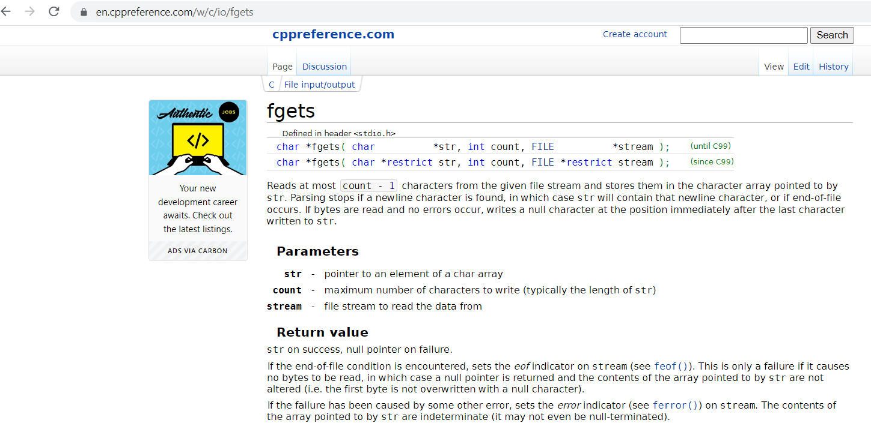
https://en.wikipedia.org/wiki/C_file_input/output

Slide 4
char data[100];
// read in data from user
printf("Enter x and y (no spaces, comma-separated): ");
fgets(data, sizeof(data), stdin); // stdin significa ingreso por teclado
// print out data
printf("Data input: %s\n", data);

Slide 5
#include <stdio.h>
#include <stdlib.h>
#include <string.h>
/*
* Demonstrates string input
*/
int main(int argc, char** argv)
{
char data[100];
// read in data from user
printf("Enter x and y (no spaces, comma-separated): ");
fgets(data, sizeof(data), stdin);
// print out data
printf("Data input: %s\n", data);
return (EXIT_SUCCESS);
}

Slide 6
Converting Strings to Numbers
#include <stdio.h>
#include <stdlib.h>
#include <string.h>
/*
* Demonstrates string input
*/
int main(int argc, char** argv)
{
// read in data from user
// print out data
return (EXIT_SUCCESS);
}

Slide 7
Converting Strings to Numbers
#include <stdio.h>
#include <stdlib.h>
#include <string.h>
/*
* Demonstrates converting strings to numbers
*/
int main(int argc, char** argv)
{
char floatStringData[100];
float floatData;
// read in float data
printf("Enter Floating Point Data: ");
fgets(floatStringData, sizeof(floatStringData), stdin);
printf("Float String Data: %s\n", floatStringData);
// convert and print float data
return (EXIT_SUCCESS);
}

Slide 8
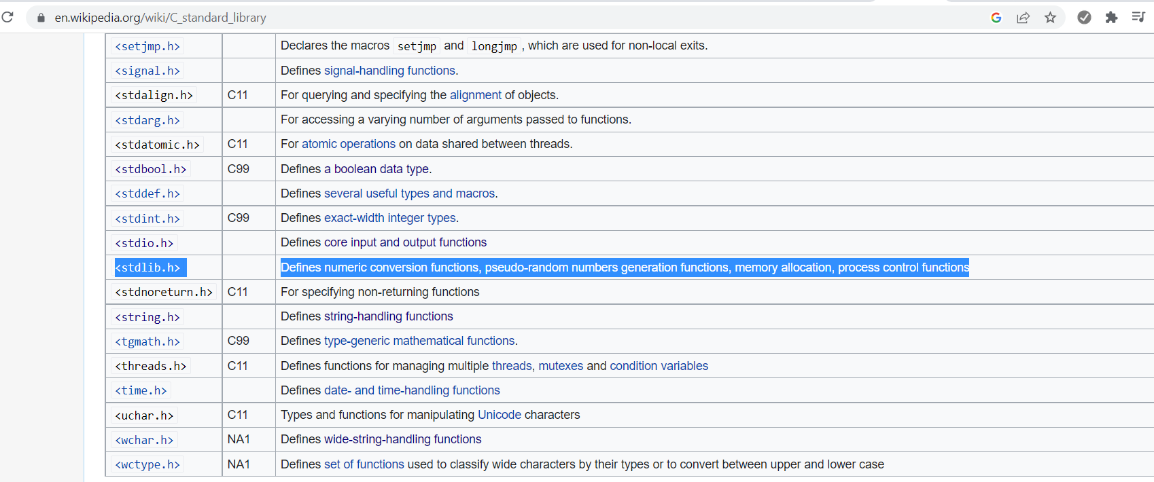

Slide 10
char floatStringData[100];
float floatData;
// read in float data
printf("Enter Floating Point Data: ");
fgets(floatStringData, sizeof(floatStringData), stdin);
printf("Float String Data: %s\n", floatStringData);
// convert and print float data
floatData = atof(floatStringData);
printf("Float Data: %f\n", floatData);

Slide 11
char intStringData[100];
int intData;
// read in int data
printf("\n");
printf("Enter Integer Data: ");
fgets(intStringData, sizeof(intStringData), stdin);
printf("Integer String Data: %s\n", intStringData);
// convert and print int data
intData = atoi(intStringData);
printf("Integer Data: %d\n", intData);

Slide 12
#include <stdio.h>
#include <stdlib.h>
#include <string.h>
/*
* Demonstrates converting strings to numbers
*/
int main(int argc, char** argv)
{
char floatStringData[100];
float floatData;
// read in float data
printf("Enter Floating Point Data: ");
fgets(floatStringData, sizeof(floatStringData), stdin);
printf("Float String Data: %s\n", floatStringData);
// convert and print float data
floatData = atof(floatStringData);
printf("Float Data: %f\n", floatData);
char intStringData[100];
int intData;
// read in int data
printf("\n");
printf("Enter Integer Data: ");
fgets(intStringData, sizeof(intStringData), stdin);
printf("Integer String Data: %s\n", intStringData);
// convert and print int data
intData = atoi(intStringData);
printf("Integer Data: %d\n", intData);
return (EXIT_SUCCESS);
}

