Slide 1
Find the Queen

Slide 2
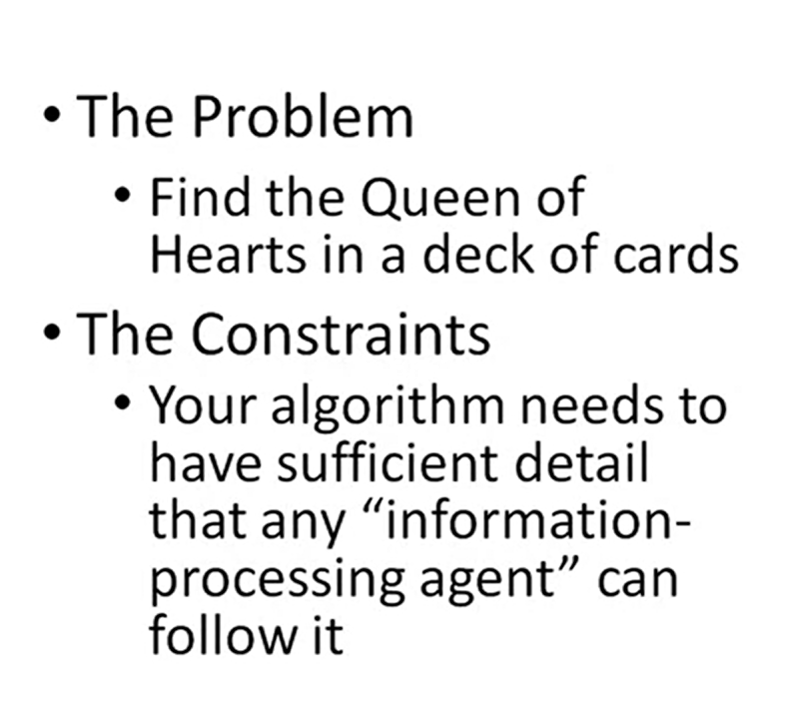
An algorithm is a step-by-step plan for solving a problem or detailed set of steps that we follow to solve a particular problem.

