Slide 1
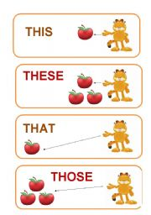
Demonstratives
Always refer to a definite person, place or thing.

Slide 2
this
Used to talk about singular things/ near
Example:
Angela said: “This juice is delicious”.

Slide 3
That
Used to talk about singular/ not near
Example:
That car looks awesome.

Slide 4
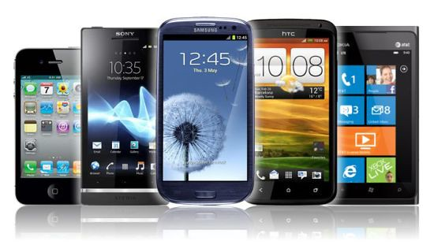
These
Used to talk about things which are plural and near us.
Example:
These are the latest cell phones in our country.

Slide 5
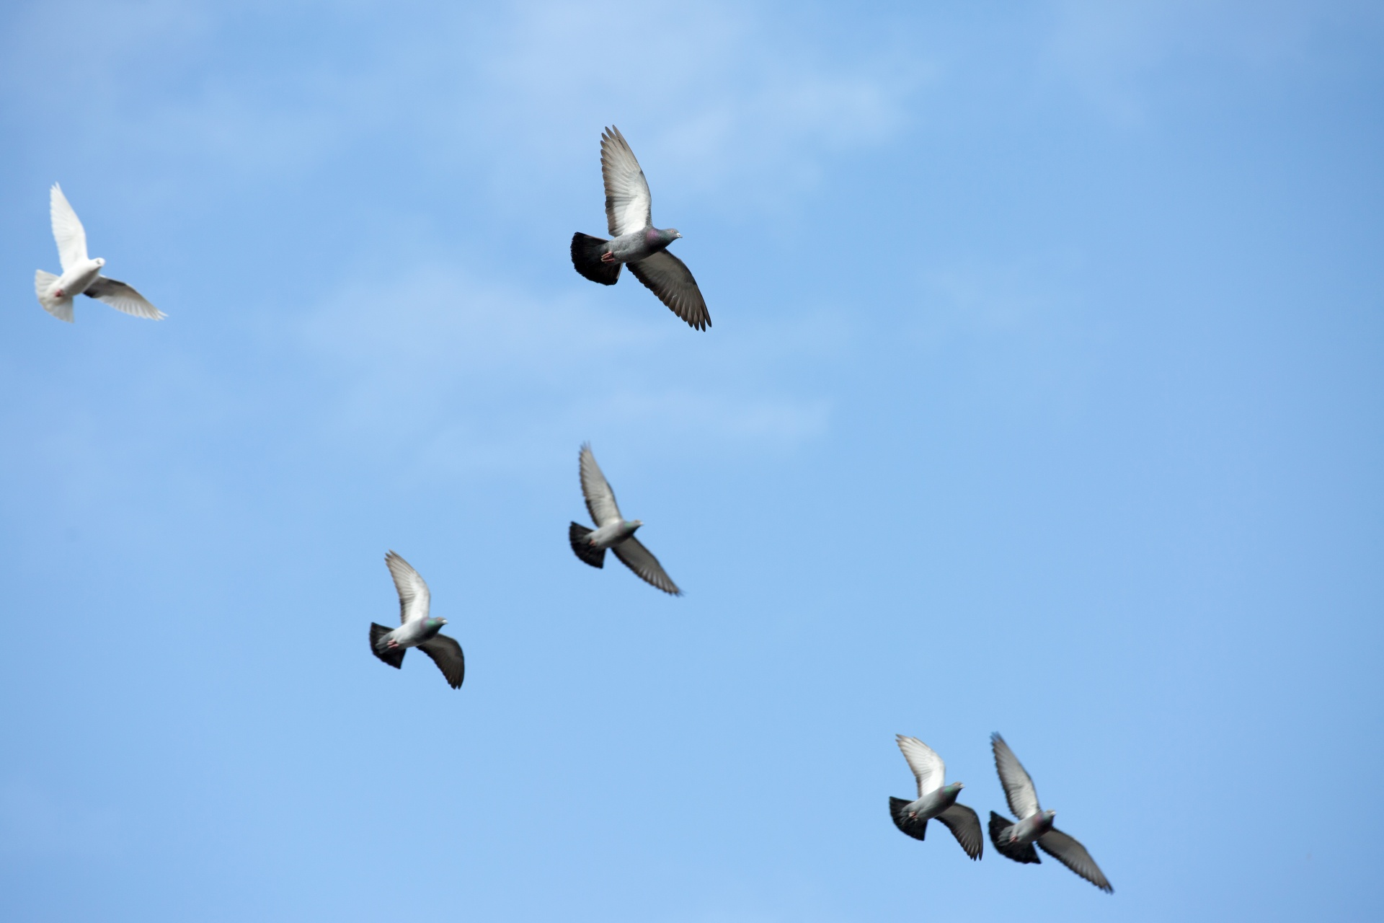
Those
Used to talk about plural things which are not near us.
Example:
Look at those birds, they are called pigeons.

Slide 6
This, that, these, those. (Taken from: New Total English E. book.) Listening
Listen to Jodie and Karl. PRACTICE ON PRONUNCIATION. What things do they look at on Jane`s stall?
J: It isn`t very busy today, is it? I know, let`s go and have a look at Jane`s clothes stall.
K: OK. … Hi, Jane! Only us! Oh, look –this is horrible! What is it?
J: I`m not sure … is it a belt?
K: I really don`t know. And look over there. Now, that`s really ugly!
J: Oh, It is. What is it?
K: I think it`s a coat. But she has some nice scarves, look.
J: Oh, yeah, these are pretty. …Jane Hi I want one of these scarves. OK?
Ja: Sure. Put it over there and come back later.
J: OK, thanks. Karl, just look at those shoes, they`re so old-fashioned!
K: Yeah, but that bag is really useful – like that.
J: Come on Karl, there are some people at our stall.

Slide 7
Fill in the blanks with a demonstrative:
……… man, the one standing on the corner, looks like a thief.
……… book isn`t very clear. In fact, I don`t understand any of …….explanations.
What are ………….people across the street protesting?
Here, ………… flowers are for you.
Look out the window. Do you see ………green car? It`s my father`s.

Slide 8
UNIT 2 - Listening 1.10 - page 23. Student´s book
Complete the spaces with the information given on the audio. I= Interviewer A= Andy Torbet
I= Hello. Today, I´m in the north of Scotland. We´re at the bottom of a …………...
It´s very beautiful but it´s very cold and …….
here with Andy Torbet.
Andy, …….. ……….. from Scotland?
A= Yes, I am. I´m ……….. Aberdeen.
I= Now Andy, ……………. A professional climber so …….. ………….. got a
rucksack ……….. you today. …………. Always in your ………………..?
A= Well, ………….. is ………. ………. It´s good because It´s ………….. today,
but it´s also important ………… it´s ……… because of the …………
I= I see. And ………… ………….?
A= It´s a first- aid kit. ……… always in ……. Rucksack.
I= mmm, Good Idea. And what´s …………?
A= It´s my camera. …….. …………. It ……………….
And ………… are my climbing …………..
I= Right. And over ………… what ………. ……………?
A= My ………………
I= right, ………….. are important ………….! Ok. So ……… ………….
Got everything. Let´s ……… climbing.
A= Sure. Let´s go.

