Slide 1
Nesting and Boxes

Slide 2
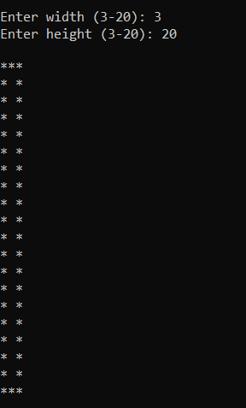

Slide 3
#define _CRT_SECURE_NO_WARNINGS
#include <stdio.h>
#include <stdlib.h>
/*
* NESTED AND BOXES Book. Beginning C for Ivor Horton
*/
int main(int argc, char** argv)
{
return (EXIT_SUCCESS);
}

Slide 4
#define _CRT_SECURE_NO_WARNINGS
#include <stdio.h>
#include <stdlib.h>
/*
* NESTED AND BOXES Book. Beginning C for Ivor Horton
*/
int main(int argc, char** argv)
{
int width;
int height;
return (EXIT_SUCCESS);
}

Slide 5
int main(int argc, char** argv)
{
int width;
int height;
// get valid width
printf("\n");
printf("Enter width (3-20): ");
scanf("%d", &width);
while (width < 3 || width > 20)
{
// print error message and get new width
printf("\n");
printf("Width must be between 3 and 20.\n");
printf("Enter width (3-20): ");
scanf("%d", &width);
}

Slide 6
// get valid width
printf("\n");
printf("Enter width (3-20): ");
scanf("%d", &width);
while (width < 3 || width > 20)
{
// print error message and get new width
printf("\n");
printf("Width must be between 3 and 20.\n");
printf("Enter width (3-20): ");
scanf("%d", &width);
}
// get valid height
printf("Enter height (3-20): ");
scanf("%d", &height);
while (height < 3 || height > 20)
{
// print error message and get new height
printf("\n");
printf("Height must be between 3 and 20.\n");
printf("Enter height (3-20): ");
scanf("%d", &height);
}
return (EXIT_SUCCESS);
}
Test!!!!!!.......

Slide 7
// get valid height
printf("Enter height (3-20): ");
scanf("%d", &height);
while (height < 3 || height > 20)
{
// print error message and get new height
printf("\n");
printf("Height must be between 3 and 20.\n");
printf("Enter height (3-20): ");
scanf("%d", &height);
}
// print top row
printf("\n");
for (int i = 1; i <= width; i++)
{
printf("*");
}
printf("\n");

Slide 8
// print top row
printf("\n");
for (int i = 1; i <= width; i++)
{
printf("*");
}
printf("\n");
// print bottom row
for (int i = 1; i <= width; i++)
{
printf("*");
}
printf("\n");
return (EXIT_SUCCESS);
}
Test…..!!!!!!!

Slide 9
// print top row
printf("\n");
for (int i = 1; i <= width; i++)
{
printf("*");
}
printf("\n");
// print interior of box
for (int i = 2; i < height; i++)
{
printf("*");
for (int j = 2; j < width; j++)
{
printf(" ");
}
printf("*");
printf("\n");
}
// print bottom row
for (int i = 1; i <= width; i++)
{
printf("*");
}
printf("\n");
return (EXIT_SUCCESS);
}
Final test!!!

Slide 10
#define _CRT_SECURE_NO_WARNINGS
#include <stdio.h>
#include <stdlib.h>
/*
* Demonstrates using while loops, for loops, and nested for loops
*
* The idea for this problem comes from Beginning C by Ivor Horton
*/
int main(int argc, char** argv)
{
int width;
int height;
// get valid width
printf("\n");
printf("Enter width (3-20): ");
scanf("%d", &width);
while (width < 3 ||width > 20)
{
// print error message and get new width
printf("\n");
printf("Width must be between 3 and 20.\n");
printf("Enter width (3-20): ");
scanf("%d", &width);
}
// get valid height
printf("Enter height (3-20): ");
scanf("%d", &height);
while (height < 3 || height > 20)
{
// print error message and get new height
printf("\n");
printf("Height must be between 3 and 20.\n");
printf("Enter height (3-20): ");
scanf("%d", &height);
}
// print top row
printf("\n");
for (int i = 1; i <= width; i++)
{
printf("*");
}
printf("\n");
// print interior of box
for (int i = 2; i < height; i++)
{
printf("*");
for (int j = 2; j < width; j++)
{
printf(" ");
}
printf("*");
printf("\n");
}
// print bottom row
for (int i = 1; i <= width; i++)
{
printf("*");
}
printf("\n");
return (EXIT_SUCCESS);
}

