Slide 1
Spell Checker web service
(you build a web client that interacts with the service)
The client uses a servlet class and a JSP page. The user passes information to the servlet from the JSP page
Fuente: https://netbeans.org/kb/docs/websvc/client.html

Slide 2
Creating the Client
Choose File > New Project. Under Categories, choose Java Web. Under Projects, choose Web Application. Click Next. Name the project SpellCheckService and make sure that you specify an appropriate server as your target server. Leave all other options at default and click Finish.
In the Projects window, right-click the SpellCheckService project node and choose New > Web Service Client . Click Next.
Select WSDL URL and specify the following URL for the web service: http://wsf.cdyne.com/SpellChecker/check.asmx?wsdl
If you are behind a firewall, you might need to specify a proxy server—otherwise the WSDL file cannot be downloaded. To specify the proxy server, click Set Proxy in the wizard. The IDE's Options window opens, where you can set the proxy universally for the IDE.
Leave the package name blank. By default the client class package name is taken from the WSDL. In this case is com.cdyne.ws. Click Finish.

Slide 3
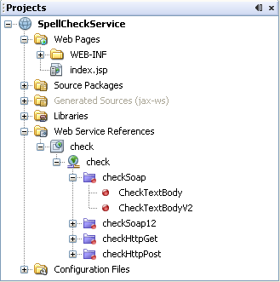
In the Projects window, within the Web Service References node, you see the following:
The Projects window shows that a web service called 'check' has made a number of 'CheckTextBody' and 'CheckTextBodyV2' operations available to your application. These operations check a string for spelling errors and returns data to be processed by the client.
The V2 version of the service does not require authentication.

Slide 4
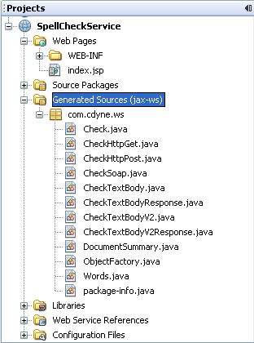
Within the Generated Sources node, you see the client stubs that were generated by the JAX-WS Web Service Client wizard.

Slide 5
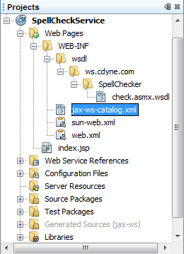
Expand the WEB-INF node and the wsdl subnode. You find a local copy of the WSDL file, named check.asmx.wsdl.

Slide 6
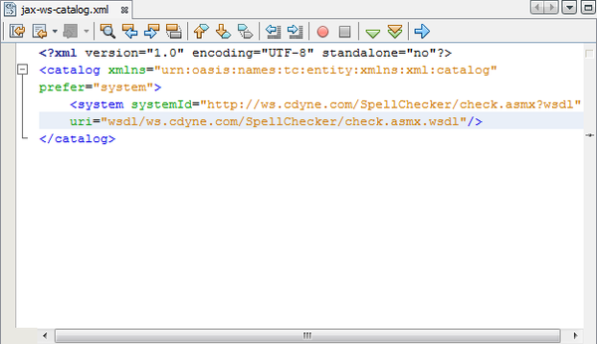
The URL of the WSDL that you used to create the client is mapped to the local copy of the WSDL in jax-ws-catalog.xml. Mapping to a local copy has several advantages.
The remote copy of the WSDL does not have to be available for the client to run. The client is faster, because it does not need to parse a remote WSDL file.

Slide 7
Developing the Client
There are many ways to implement a web service client. The web service's WSDL file restricts the type of information that you can send to the web service, and it restricts the type of information you receive in return.
However, the WSDL file lays no restrictions on how you pass the information it needs, nor on what the user interface consists of.
The client implementation you build below consists of a JSP page which allows the user to enter text to be checked and a servlet which passes the text to the web service and then produces a report containing the result.

Slide 8
Coding the JSP Page
Our JSP page will consist of a text area, where the user will enter text, and a button for sending the text to the web service.
In the Projects window, expand the Web Pages node of the SpellCheckService project and double-click index.jsp so that it opens in the Source Editor.
Copy the following code and paste it over the <body> tags in index.jsp:
<body>
<form name="Test" method="post" action="SpellCheckServlet">
<p>Digite el texto a revisar:</p>
<p>
<p><textarea rows="7" name="TextArea1" cols="40" ID="Textarea1"></textarea></p> <p> <input type="submit" value=“Revisar" name="spellcheckbutton">
</form>
</body>
The previously listed code specifies that when the submit button is clicked, the content of the textarea is posted to a servlet called SpellCheckServlet.

Slide 9
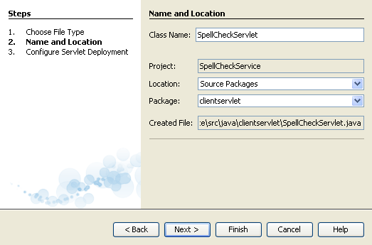
Creating and Coding the Servlet
You only need to deal with the business logic, that is, the preparation of the text to be sent and the processing of the result.
Right-click the SpellCheckService project node in the Projects window, choose New > Servlet. Click Next.
Name the servlet SpellCheckServlet and type clientservlet in the Package drop-down. Click Next.

Slide 10
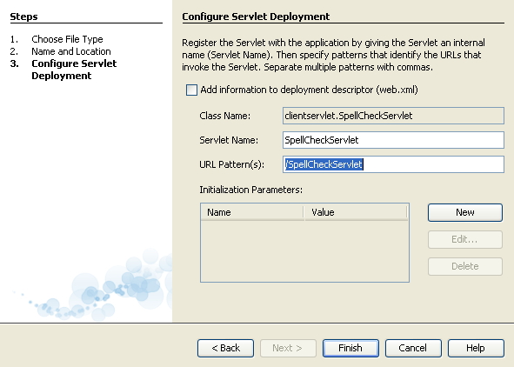
In the Configure Servlet Deployment panel, note that the URL mapping for this servlet is /SpellCheckServlet. Accept the defaults and click Finish. The servlet opens in the Source Editor.

Slide 11
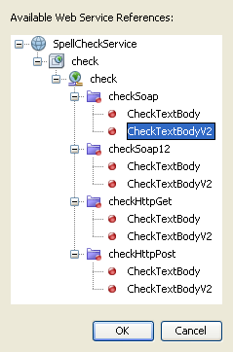
Put your cursor inside the Source Editor, inside the processRequest method body of SpellCheckServlet.java, and add some new lines right at the top of the method.
Right-click in the space that you created in the previous step, and choose Insert Code > Call Web Service Operation. Click the checkSoap.CheckTextBodyV2 operation in the "Select Operation to Invoke" dialog box, as shown below:
Click OK
Note: You can also drag and drop the operation node directly from the Projects window into the editor, instead of calling up the dialog shown above.

Slide 12
At the end of the SpellCheckServlet class, you see a private method for calling the SpellCheckerV2 service and returning a com.cdyne.ws.DocumentSummary object .
private DocumentSummary checkTextBodyV2(java.lang.String bodyText) { com.cdyne.ws.CheckSoap port = service.getCheckSoap(); return port.checkTextBodyV2(bodyText); }
This method is all you need to invoke the operation on the web service. In addition, the following lines of code (in bold) are declared at the top of the class:
public class SpellCheckServlet extends HttpServlet { @WebServiceRef(wsdlLocation = "http://wsf.cdyne.com/SpellChecker/check.asmx?WSDL") private Check service;

Slide 13
Replace the try block of the processRequest() method with the code that follows. The in-line comments throughout the code below explain the purpose of each line.
try {
String TextArea1 = request.getParameter("TextArea1"); java.lang.String texto = TextArea1;
com.cdyne.ws.DocumentSummary doc = checkTextBodyV2(texto); String allcontent = doc.getBody();
int no_of_mistakes = doc.getMisspelledWordCount();
List allwrongwords = doc.getMisspelledWord();
out.println("<html>");
out.println("<head>");
out.println("<title>Reporte de Verificacion Sintactica</title>");
out.println("</head>");
out.println("<body>");
out.println("<h2><font color='red'>Informe de Verificacion</font></h2>");
out.println("<hr><b>Your text:</b> \"" + allcontent + "\"" + "<p>");

Slide 14
for (int i = 0; i < allwrongwords.size(); i++) {
String onewrongword = ((Words) allwrongwords.get(i)).getWord();
int onewordsuggestioncount = ((Words) allwrongwords.get(i)).getSuggestionCount();
List allsuggestions = ((Words) allwrongwords.get(i)).getSuggestions();
out.println("<hr><p><b>Palabra Errada:</b><font color='red'> " + onewrongword + "</font>");
out.println("<p><b>" + onewordsuggestioncount + " Sugerencias:</b><br>");
for (int k = 0; k < allsuggestions.size(); k++) {
String onesuggestion = (String) allsuggestions.get(k);
out.println(onesuggestion);
}
}
out.println("<hr>");
out.println("<font color='red'><b>Resumen:</b> " + no_of_mistakes + " Errores (");
for (int i = 0; i < allwrongwords.size(); i++) {
String onewrongword = ((Words) allwrongwords.get(i)).getWord();
out.println(onewrongword);
}
out.println(").");
out.println("</font>");
out.println("</body>");
out.println("</html>");
} catch (Exception ex) {
out.println("exception" + ex);
}
finally {
out.close();
}

Slide 15
You see a number of error bars and warning icons, indicating classes that are not found. To fix imports after pasting the code, right-click anywhere, which opens a context menu, and select Fix Imports. (You have a choice of List classes to import. Accept the default java.util.List.)
The full list of imported classes follows:
import com.cdyne.ws.Check;
import com.cdyne.ws.Words;
import java.io.IOException;
import java.io.PrintWriter;
import java.util.List;
import javax.servlet.ServletException;
import javax.servlet.http.HttpServlet;
import javax.servlet.http.HttpServletRequest;
import javax.servlet.http.HttpServletResponse;
import javax.xml.ws.WebServiceRef;

Slide 16
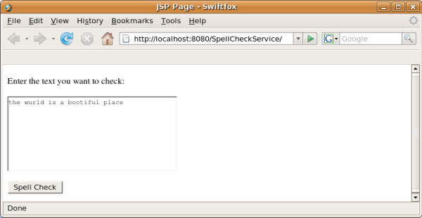
Deploying the Client
The IDE uses an Ant build script to build and run your application. The IDE generates the build script based on the options you entered when creating the project. You can fine tune these options in the project's Project Properties dialog box (right-click the project node in the Projects window and choose Properties).
Right-click the project node and choose Run. After a while, the application deploys and displays the JSP page that you coded in the previous section.
Enter some text, making sure that some of it is incorrectly spelled:

