Slide 1
Ejemplos de sistemas combinacionales
Electrónica digital

Slide 2
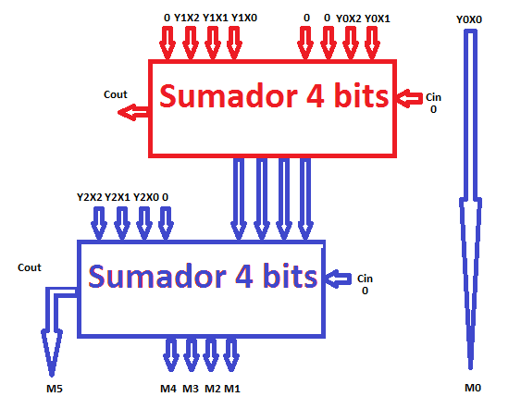
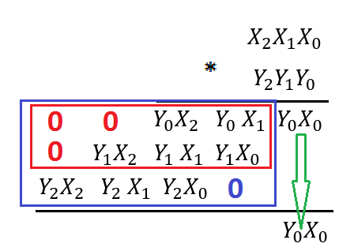
Multiplicador 3 BITS

Slide 3
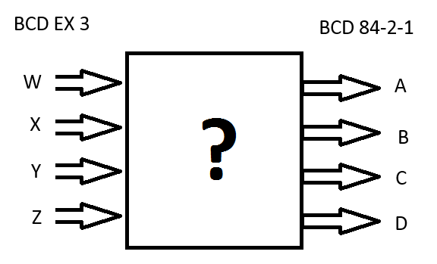
CONDICIONES DE NO IMPORTA
DISEÑAR UN CONVERSOR DE CODIGO DE BCD EX3 A BCD 84-2-1
 | BCD EX 3 |  |  |  | BCD 84-2-1
BASE 10 | W | X | Y | Z | A | B | C | D
0 | 0 | 0 | 1 | 1 | 0 | 0 | 0 | 0
1 | 0 | 1 | 0 | 0 | 0 | 1 | 1 | 1
2 | 0 | 1 | 0 | 1 | 0 | 1 | 1 | 0
3 | 0 | 1 | 1 | 0 | 0 | 1 | 0 | 1
4 | 0 | 1 | 1 | 1 | 0 | 1 | 0 | 0
5 | 1 | 0 | 0 | 0 | 1 | 0 | 1 | 1
6 | 1 | 0 | 0 | 1 | 1 | 0 | 1 | 0
7 | 1 | 0 | 1 | 0 | 1 | 0 | 0 | 1
8 | 1 | 0 | 1 | 1 | 1 | 0 | 0 | 0
9 | 1 | 1 | 0 | 0 | 1 | 1 | 1 | 1
 | 0 | 0 | 0 | 0 | X | X | X | X
 | 0 | 0 | 0 | 1 | X | X | X | X
 | 0 | 0 | 1 | 0 | X | X | X | X
 | 1 | 1 | 0 | 1 | X | X | X | X
 | 1 | 1 | 1 | 0 | X | X | X | X
 | 1 | 1 | 1 | 1 | X | X | X | X

Slide 4
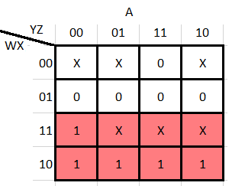
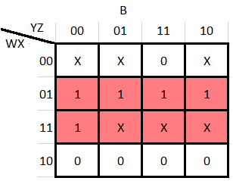
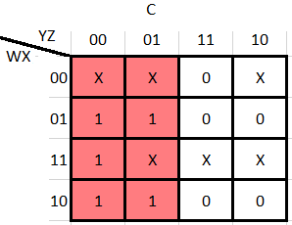
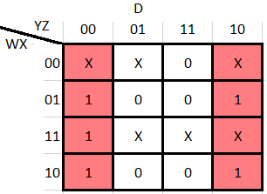

CONDICIONES DE NO IMPORTA
$A\left(W,X,Y,Z\right)=X(0,1,2,13,14,15)$
$B\left(W,X,Y,Z\right)=X(0,1,2,13,14,15)$
$C\left(W,X,Y,Z\right)=X(0,1,2,13,14,15)$
$D\left(W,X,Y,Z\right)=X(0,1,2,13,14,15)$
$A\left(W,X,Y,Z\right)=W$
$B\left(W,X,Y,Z\right)=X$
$C\left(W,X,Y,Z\right)=\overline{Y}$
$D\left(W,X,Y,Z\right)=\overline{Z}$

Slide 5
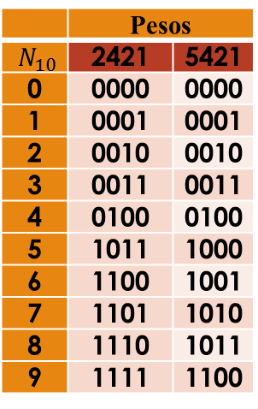
 | Pesos
$N_{10}$ | 2421 | 5421
0 | 0000 | 0000
1 | 0001 | 0001
2 | 0010 | 0010
3 | 0011 | 0011
4 | 0100 | 0100
5 | 1011 | 1000
6 | 1100 | 1001
7 | 1101 | 1010
8 | 1110 | 1011
9 | 1111 | 1100

Slide 6
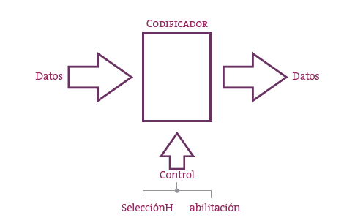
Codificador
Los codificadores son los dispositivos encargados de la codificación. El concepto de codificación, tal y como se exploró en la sección de Códigos, está vinculado a la “traducción” de un código a otro.

Slide 7
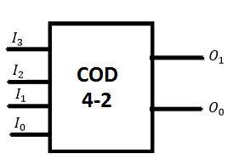
CODIFICADOR 4-2
$$I_{3}$$ | $$I_{2}$$ | $$I_{1}$$ | $$I_{0}$$ | $$O_{1}$$ | $$O_{0}$$
0 | 0 | 0 | 1 | 0 | 0
0 | 0 | 1 | 0 | 0 | 1
0 | 1 | 0 | 0 | 1 | 0
1 | 0 | 0 | 0 | 1 | 1
$$O_{0}\left(I_{3},I_{2},I_{1},I_{0}\right)=∑\left(2,8\right)=\overline{I_{3}}\overline{I_{2}}I_{1}\overline{I_{0}}+I_{3}\overline{I_{2}}\overline{I_{1}}\overline{I_{0}}$$
$$O_{1}\left(I_{3},I_{2},I_{1},I_{0}\right)=∑\left(4,8\right)=\overline{I_{3}}I_{2}\overline{I_{1}}\overline{I_{0}}+I_{3}\overline{I_{2}}\overline{I_{1}}\overline{I_{0}}$$
CONDICIONES DE NO IMPORTA
$$O_{0}\left(I_{3},I_{2},I_{1},I_{0}\right)=I_{1}+I_{3}$$
$$O_{1}\left(I_{3},I_{2},I_{1},I_{0}\right)=I_{2}+I_{3}$$

Slide 8
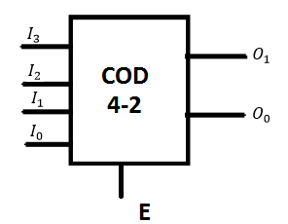
CODIFICADOR 4-2 CON ENEABLE
E | $$I_{3}$$ | $$I_{2}$$ | $$I_{1}$$ | $$I_{0}$$ | $$O_{1}$$ | $$O_{0}$$
0 | X | X | X | X | 0 | 0
1 | 0 | 0 | 0 | 1 | 0 | 0
1 | 0 | 0 | 1 | 0 | 0 | 1
1 | 0 | 1 | 0 | 0 | 1 | 0
1 | 1 | 0 | 0 | 0 | 1 | 1
$$O_{0}\left(I_{3},I_{2},I_{1},I_{0}\right)={EI}_{1}+EI_{3}$$
$$O_{1}\left(I_{3},I_{2},I_{1},I_{0}\right)={EI}_{2}+{EI}_{3}$$

Slide 9
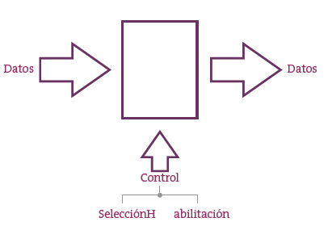
DECODIFICADORES
Este circuito realiza la operación inversa a la de un codificador de datos

Slide 10
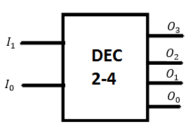
DECODIFICADOR 2-4
$$I_{1}$$ | $$I_{0}$$ | $$O_{3}$$ | $$O_{2}$$ | $$O_{1}$$ | $$O_{0}$$
0 | 0 | 0 | 0 | 0 | 1
0 | 1 | 0 | 0 | 1 | 0
1 | 0 | 0 | 1 | 0 | 0
1 | 1 | 1 | 0 | 0 | 0
$$O_{0}\left(I_{1},I_{0}\right)=\overline{I_{1}}\overline{I_{0}}$$
$$O_{1}\left(I_{1},I_{0}\right)=\overline{I_{1}}I_{0}$$
$$O_{2} \left(I_{1},I_{0}\right)=I_{1}\overline{I_{0}}$$
$$O_{3}\left(I_{1},I_{0}\right)=I_{1}I_{0}$$

Slide 11
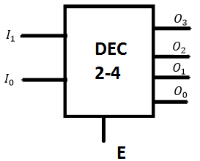
DECODIFICADOR 2-4 CON ENEABLE
E | $$I_{1}$$ | $$I_{0}$$ | $$O_{3}$$ | $$O_{2}$$ | $$O_{1}$$ | $$O_{0}$$
0 | X | X | 0 | 0 | 0 | 0
1 | 0 | 0 | 0 | 0 | 0 | 1
1 | 0 | 1 | 0 | 0 | 1 | 0
1 | 1 | 0 | 0 | 1 | 0 | 0
1 | 1 | 1 | 1 | 0 | 0 | 0
$$O_{0}\left(I_{1},I_{0}\right)=E\overline{I_{1}}\overline{I_{0}}$$
$$O_{1}\left(I_{1},I_{0}\right)=E\overline{I_{1}}I_{0}$$
$$O_{2} \left(I_{1},I_{0}\right)=EI_{1}\overline{I_{0}}$$
$$O_{3}\left(I_{1},I_{0}\right)={EI}_{1}I_{0}$$

Slide 12
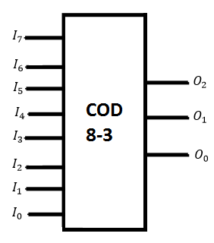
CODIFICADOR 8-3
$$I_{7}$$ | $$I_{6}$$ | $$I_{5}$$ | $$I_{4}$$ | $$I_{3}$$ | $$I_{2}$$ | $$I_{1}$$ | $$I_{0}$$ | $$O_{2}$$ | $$O_{1}$$ | $$O_{0}$$
0 | 0 | 0 | 0 | 0 | 0 | 0 | 1 | 0 | 0 | 0
0 | 0 | 0 | 0 | 0 | 0 | 1 | 0 | 0 | 0 | 1
0 | 0 | 0 | 0 | 0 | 1 | 0 | 0 | 0 | 1 | 0
0 | 0 | 0 | 0 | 1 | 0 | 0 | 0 | 0 | 1 | 1
0 | 0 | 0 | 1 | 0 | 0 | 0 | 0 | 1 | 0 | 0
0 | 0 | 1 | 0 | 0 | 0 | 0 | 0 | 1 | 0 | 1
0 | 1 | 0 | 0 | 0 | 0 | 0 | 0 | 1 | 1 | 0
1 | 0 | 0 | 0 | 0 | 0 | 0 | 0 | 1 | 1 | 1
$$O_{0}\left(I_{7},I_{6},I_{5},I_{4},I_{3},I_{2},I_{1},I_{0}\right)=I_{1}+I_{3}+I_{5}+I_{7}$$
$$O_{1}\left(I_{7},I_{6},I_{5},I_{4},I_{3},I_{2},I_{1},I_{0}\right)=I_{2}+I_{3}+I_{6}+I_{7}$$
$$O_{2}\left(I_{7},I_{6},I_{5},I_{4},I_{3},I_{2},I_{1},I_{0}\right)=I_{4}+I_{5}+I_{6}+I_{7}$$

Slide 13
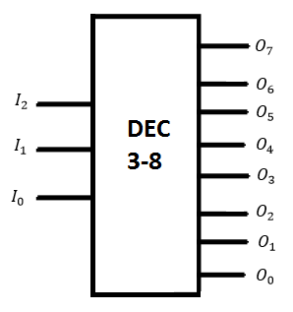
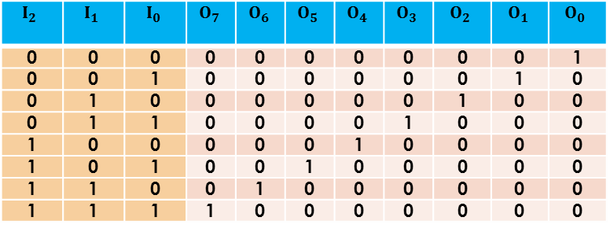
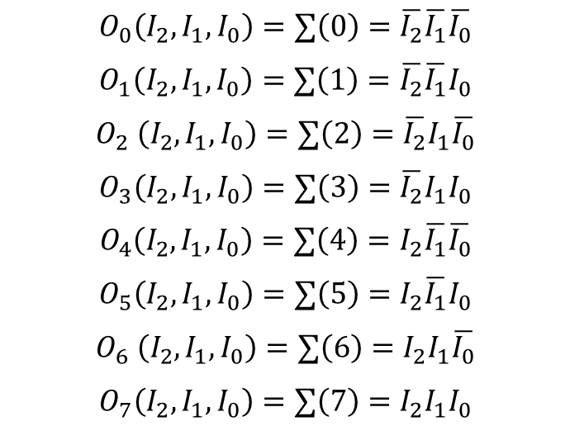
DECODIFICADOR 3-8
$$I_{2}$$ | $$I_{1}$$ | $$I_{0}$$ | $$O_{7}$$ | $$O_{6}$$ | $$O_{5}$$ | $$O_{4}$$ | $$O_{3}$$ | $$O_{2}$$ | $$O_{1}$$ | $$O_{0}$$
0 | 0 | 0 | 0 | 0 | 0 | 0 | 0 | 0 | 0 | 1
0 | 0 | 1 | 0 | 0 | 0 | 0 | 0 | 0 | 1 | 0
0 | 1 | 0 | 0 | 0 | 0 | 0 | 0 | 1 | 0 | 0
0 | 1 | 1 | 0 | 0 | 0 | 0 | 1 | 0 | 0 | 0
1 | 0 | 0 | 0 | 0 | 0 | 1 | 0 | 0 | 0 | 0
1 | 0 | 1 | 0 | 0 | 1 | 0 | 0 | 0 | 0 | 0
1 | 1 | 0 | 0 | 1 | 0 | 0 | 0 | 0 | 0 | 0
1 | 1 | 1 | 1 | 0 | 0 | 0 | 0 | 0 | 0 | 0
$$O_{0}\left(I_{2},I_{1},I_{0}\right)=∑\left(0\right)=\overline{I_{2}}\overline{I_{1}}\overline{I_{0}}$$
$$O_{1}\left(I_{2},I_{1},I_{0}\right)=∑\left(1\right)=\overline{I_{2}}\overline{I_{1}}I_{0}$$
$$O_{2} \left({I_{2},I}_{1},I_{0}\right)=∑\left(2\right)=\overline{I_{2}}I_{1}\overline{I_{0}}$$
$$O_{3}\left({I_{2},I}_{1},I_{0}\right)=∑\left(3\right)=\overline{I_{2}}I_{1}I_{0}$$
$$O_{4}\left(I_{2},I_{1},I_{0}\right)=∑\left(4\right)=I_{2}\overline{I_{1}}\overline{I_{0}}$$
$$O_{5}\left(I_{2},I_{1},I_{0}\right)=∑\left(5\right)=I_{2}\overline{I_{1}}I_{0}$$
$$O_{6} \left({I_{2},I}_{1},I_{0}\right)=∑\left(6\right)=I_{2}I_{1}\overline{I_{0}}$$
$$O_{7}\left({I_{2},I}_{1},I_{0}\right)=∑\left(7\right)=I_{2}I_{1}I_{0}$$

Slide 14
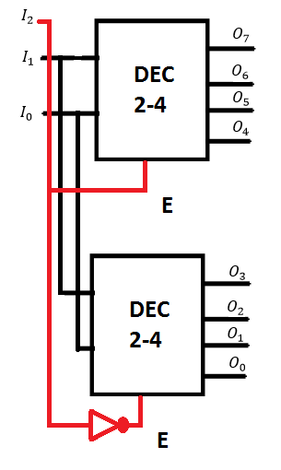
Decodificador de 3-8 a partir de decodificadores de 2-4
$$I_{2}$$ | $$I_{1}$$ | $$I_{0}$$ | $$O_{7}$$ | $$O_{6}$$ | $$O_{5}$$ | $$O_{4}$$ | $$O_{3}$$ | $$O_{2}$$ | $$O_{1}$$ | $$O_{0}$$
0 | 0 | 0 | 0 | 0 | 0 | 0 | 0 | 0 | 0 | 1
0 | 0 | 1 | 0 | 0 | 0 | 0 | 0 | 0 | 1 | 0
0 | 1 | 0 | 0 | 0 | 0 | 0 | 0 | 1 | 0 | 0
0 | 1 | 1 | 0 | 0 | 0 | 0 | 1 | 0 | 0 | 0
1 | 0 | 0 | 0 | 0 | 0 | 1 | 0 | 0 | 0 | 0
1 | 0 | 1 | 0 | 0 | 1 | 0 | 0 | 0 | 0 | 0
1 | 1 | 0 | 0 | 1 | 0 | 0 | 0 | 0 | 0 | 0
1 | 1 | 1 | 1 | 0 | 0 | 0 | 0 | 0 | 0 | 0

Slide 15
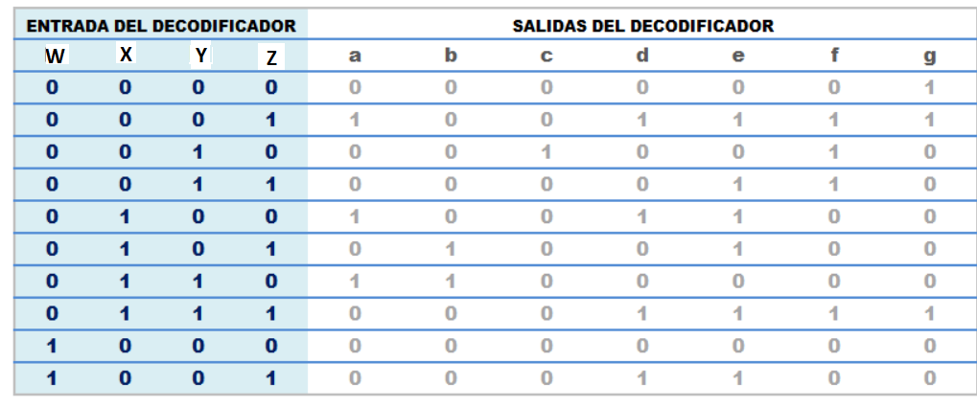
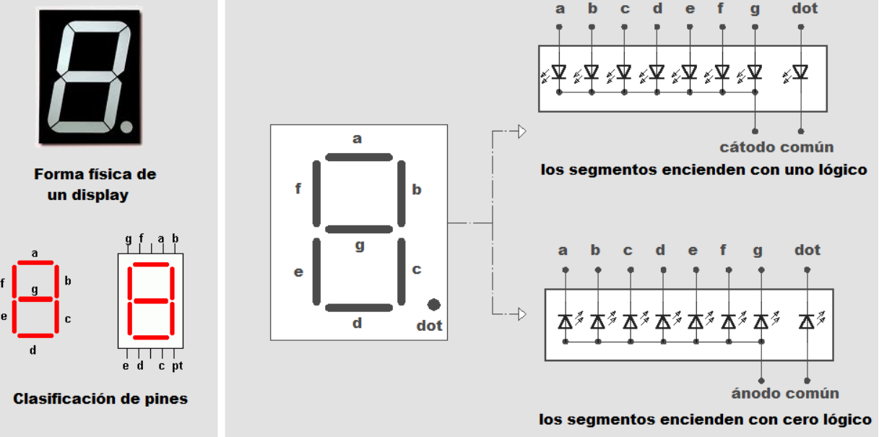
CODFICIADOR DE 4 A 7 SEGMENTOS

