Slide 1
Multiplexores y demultiplexores
Electrónica Digital

Slide 2
Multiplexores
Un multiplexor es un circuito digital que selecciona una de entre varias entradas de datos Ii y lleva su valor lógico a la única salida Z del circuito. La selección de los datos se realiza mediante una o varias entradas de control Sj. La codificación binaria resultante de las entradas S indica el índice de la entrada I que pasa a la salida.
Existiendo una entrada de habilitación (enable),la cual pone en funcionamiento el circuito,y trabaj en bajo áctivo.

Slide 3
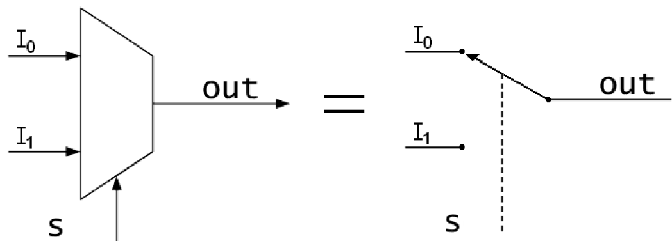
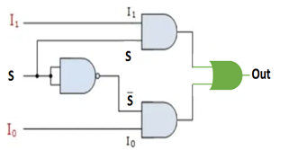
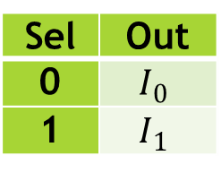
Multiplexor 2-1
Sel | Out
0 | $$I_{0}$$
1 | $$I_{1}$$
$$Out=\overline{S}I_{0}+SI_{1}$$

Slide 4
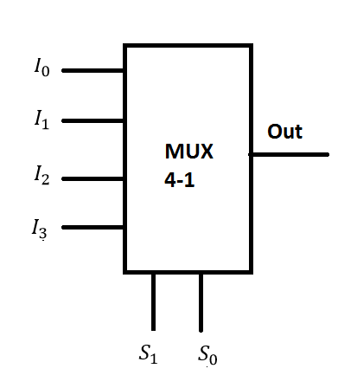
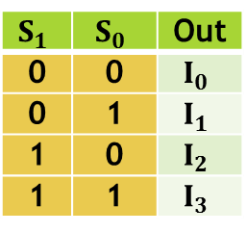
Multiplexor 4-1
$$S_{1}$$ | $$S_{0}$$ | Out
0 | 0 | $$I_{0}$$
0 | 1 | $$I_{1}$$
1 | 0 | $$I_{2}$$
1 | 1 | $$I_{3}$$
o$ut=\overline{S_{1}}\overline{S_{0}}I_{0}+ \overline{S_{1}}S_{0}I_{1}+S_{1}\overline{S_{0}}I_{2}+S_{1}S_{0}I_{3}$

Slide 5
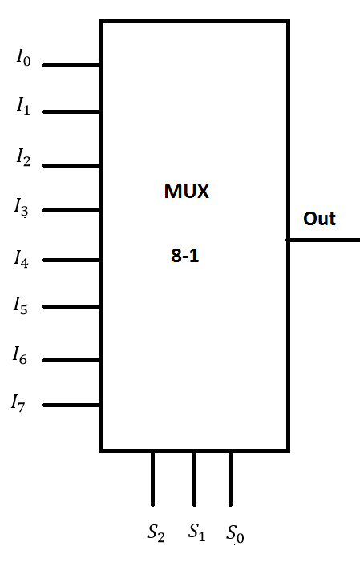
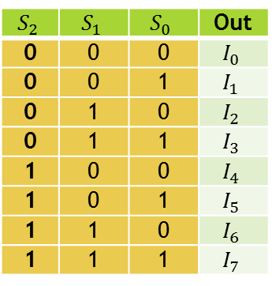
Multiplexor 8-1
$$S_{2}$$ | $$S_{1}$$ | $$S_{0}$$ | Out
0 | 0 | 0 | $$I_{0}$$
0 | 0 | 1 | $$I_{1}$$
0 | 1 | 0 | $$I_{2}$$
0 | 1 | 1 | $$I_{3}$$
1 | 0 | 0 | $$I_{4}$$
1 | 0 | 1 | $$I_{5}$$
1 | 1 | 0 | $$I_{6}$$
1 | 1 | 1 | $$I_{7}$$
$$Out=\overline{S_{2}}\overline{S_{1}}\overline{S_{0}}I_{0}+ \overline{S_{2}}\overline{S_{1}}S_{0}I_{1}+\overline{S_{2}}S_{1}\overline{S_{0}}I_{2}+\overline{S_{2}}S_{1}S_{0}I_{3}+S_{2}\overline{S_{1}}{\overline{S_{0}}I}_{4}+S_{2}\overline{S_{1}}{ S_{0}I}_{5}+S_{2}S_{1}\overline{S_{0}}{ I}_{6}+S_{2}S_{1}S_{0}{ I}_{7}$$

Slide 6
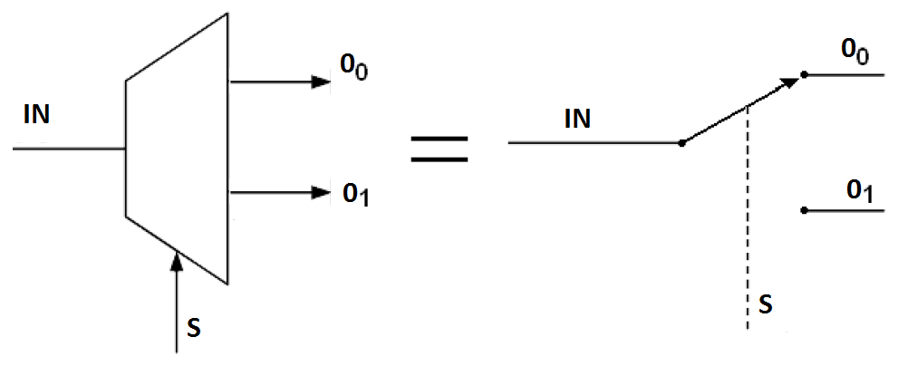
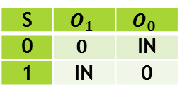
Demultiplexor 1-2
$$O_{1}=INS$$
$$O_{0}=IN\overline{S}$$
S | $$O_{1}$$ | $$O_{0}$$
0 | $$0$$ | IN
1 | IN | 0

Slide 7
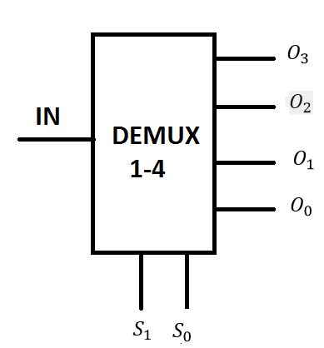
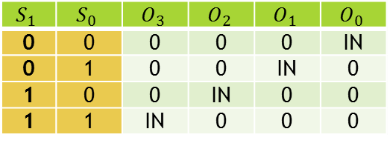
DEMULTIPLEXOR 1-4
$$S_{1}$$ | $$S_{0}$$ | $$O_{3}$$ | $$O_{2}$$ | $$O_{1}$$ | $$O_{0}$$
0 | 0 | 0 | 0 | 0 | IN
0 | 1 | 0 | 0 | IN | 0
1 | 0 | 0 | IN | 0 | 0
1 | 1 | IN | 0 | 0 | 0
$$O_{3}=INS_{1}S_{0}$$
$$O_{2}=INS_{1}\overline{S_{0}}$$
$$O_{1}=IN\overline{S_{1}}S_{0}$$
$$O_{0}=IN\overline{S_{1}} \overline{S_{0}}$$

Slide 8
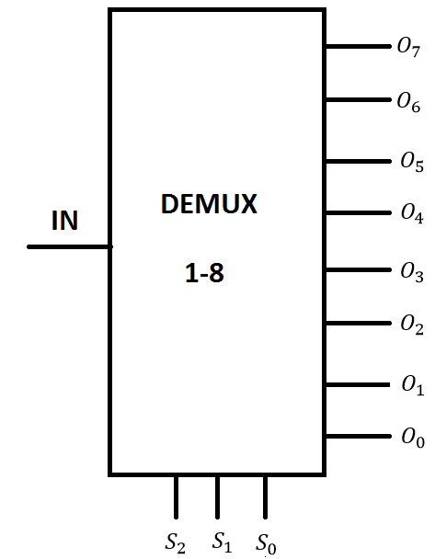
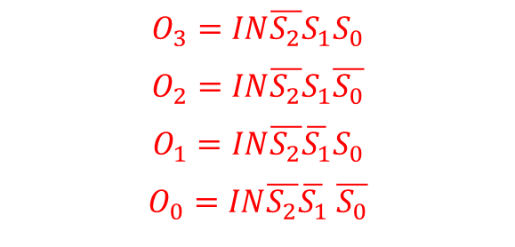
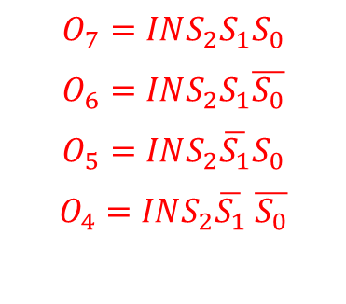
DEMULTIPLEXOR 1-8
$$S_{2}$$ | $$S_{1}$$ | $$S_{0}$$ | $$O_{7}$$ | $$O_{6}$$ | $$O_{5}$$ | $$O_{4}$$ | $$O_{3}$$ | $$O_{2}$$ | $$O_{1}$$ | $$O_{0}$$
0 | 0 | 0 | 0 | 0 | 0 | 0 | 0 | 0 | 0 | IN
0 | 0 | 1 | 0 | 0 | 0 | 0 | 0 | 0 | IN | 0
0 | 1 | 0 | 0 | 0 | 0 | 0 | 0 | IN | 0 | 0
0 | 1 | 1 | 0 | 0 | 0 | 0 | IN | 0 | 0 | 0
1 | 0 | 0 | 0 | 0 | 0 | IN | 0 | 0 | 0 | 0
1 | 0 | 1 | 0 | 0 | IN | 0 | 0 | 0 | 0 | 0
1 | 1 | 0 | 0 | IN | 0 | 0 | 0 | 0 | 0 | 0
1 | 1 | 1 | IN | 0 | 0 | 0 | 0 | 0 | 0 | 0
$$O_{7}=IN{S_{2}S}_{1}S_{0}$$
$$O_{6}=INS_{2}S_{1}\overline{S_{0}}$$
$$O_{5}=INS_{2}\overline{S_{1}}S_{0}$$
$$O_{4}=INS_{2}\overline{S_{1}} \overline{S_{0}}$$
$$O_{3}=IN\overline{S_{2}}S_{1}S_{0}$$
$$O_{2}=IN{\overline{S_{2}}S}_{1}\overline{S_{0}}$$
$$O_{1}=IN\overline{S_{2}}\overline{S_{1}}S_{0}$$
$$O_{0}=IN\overline{S_{2}}\overline{S_{1}} \overline{S_{0}}$$

Slide 9
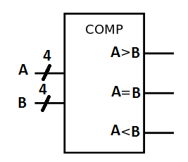
COMPARADOR DE MAGNITUD
A | B | A>B | A=B | A<B
1101 | 1100 | 1 | 0 | 0
1010 | 1010 | 0 | 1 | 0
1011 | 1100 | 0 | 0 | 1

Slide 10
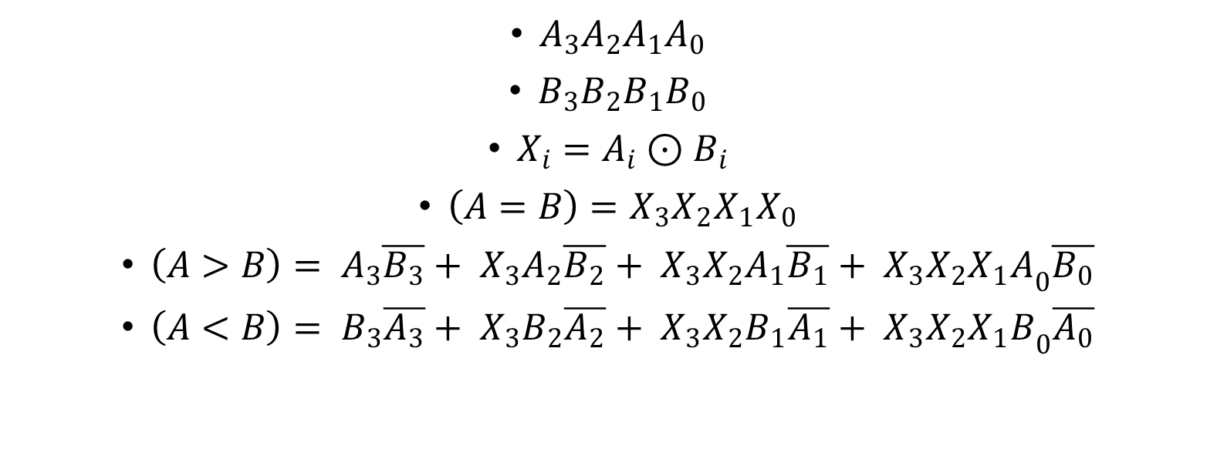
COMPARADOR DE MAGNITUD
$A_{3}A_{2}A_{1}A_{0}$
$B_{3}B_{2}B_{1}B_{0}$
$X_{i}=A_{i}⊙B_{i}$
$\left(A=B\right)=X_{3}X_{2}X_{1}X_{0}$
$\left(A>B\right)= A_{3}\overline{B_{3}}+ X_{3}A_{2}\overline{B_{2}}+ X_{3}X_{2}A_{1}\overline{B_{1}}+ X_{3}X_{2}{X_{1}A}_{0}\overline{B_{0}}$
$\left(A<B\right)= B_{3}\overline{A_{3}}+ X_{3}B_{2}\overline{A_{2}}+ X_{3}X_{2}B_{1}\overline{A_{1}}+ X_{3}X_{2}{X_{1}B}_{0}\overline{A_{0}}$

