Slide 1
Why C?

Slide 2
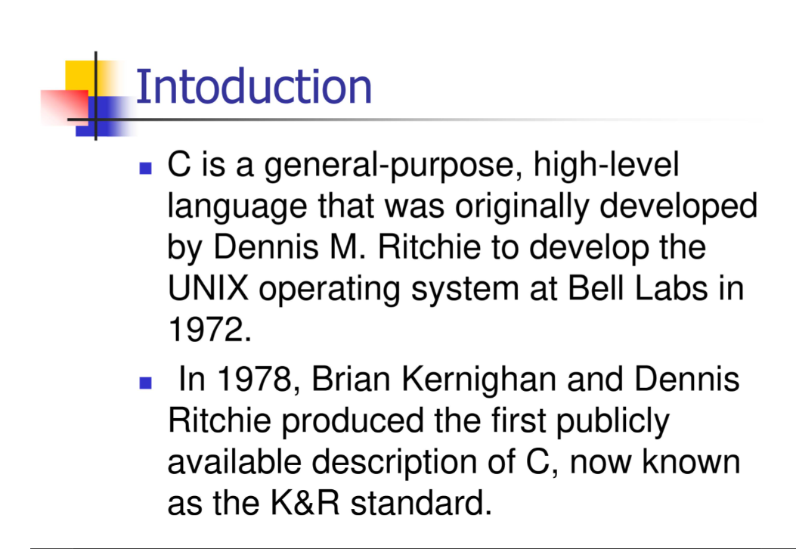

Slide 3
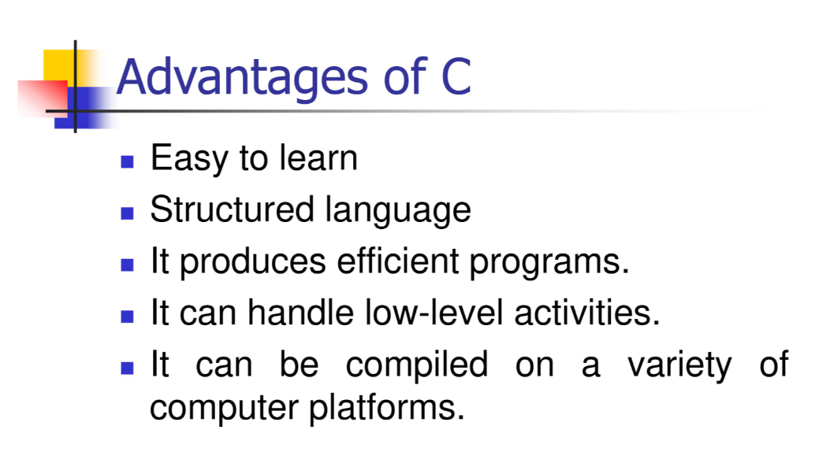

Slide 4
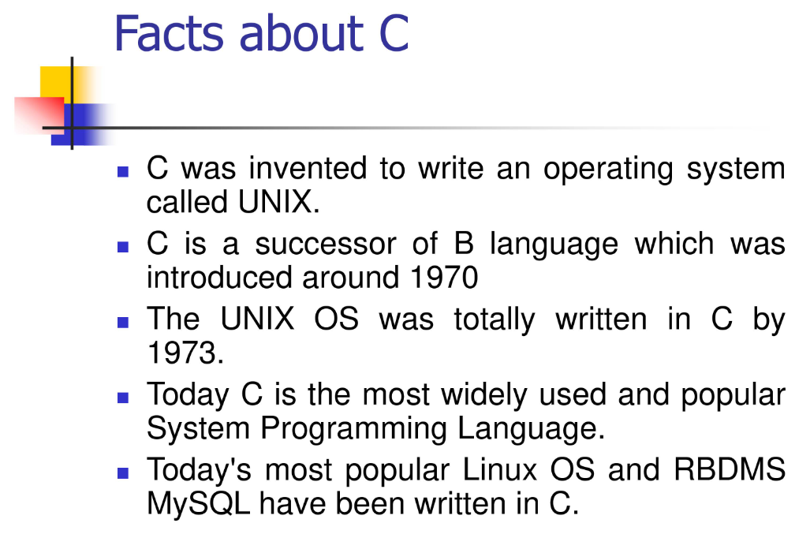

Slide 5
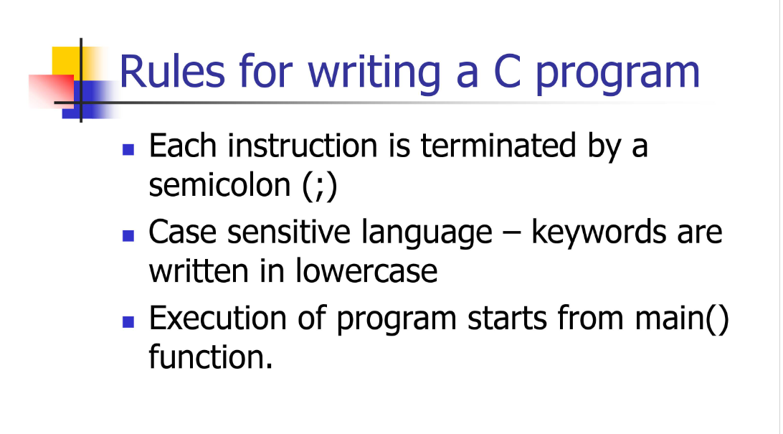

Slide 6
Any developers writing any of the following pieces of code in C:
Embedded software / firmware / internet-of-things
Device drivers
Operating system / kernel
Virtual machines
Compilers for other programming languages
Emulators of all kinds
Anything else where high performance and low resource usage outweigh the negatives of potentially longer development time

Slide 7
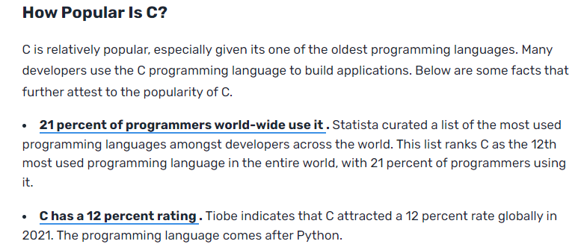

Slide 8
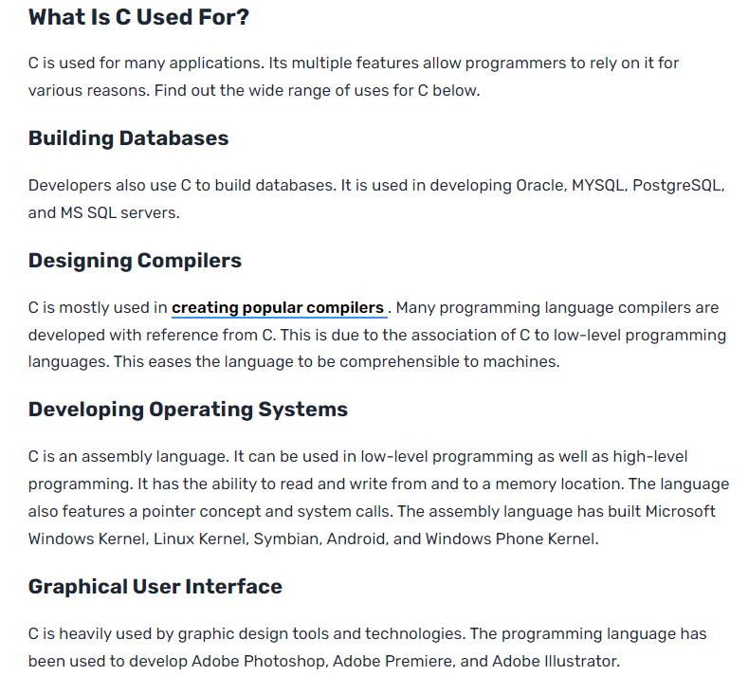

Slide 9
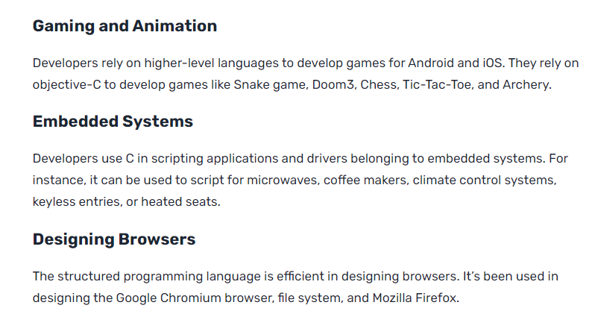

Slide 10
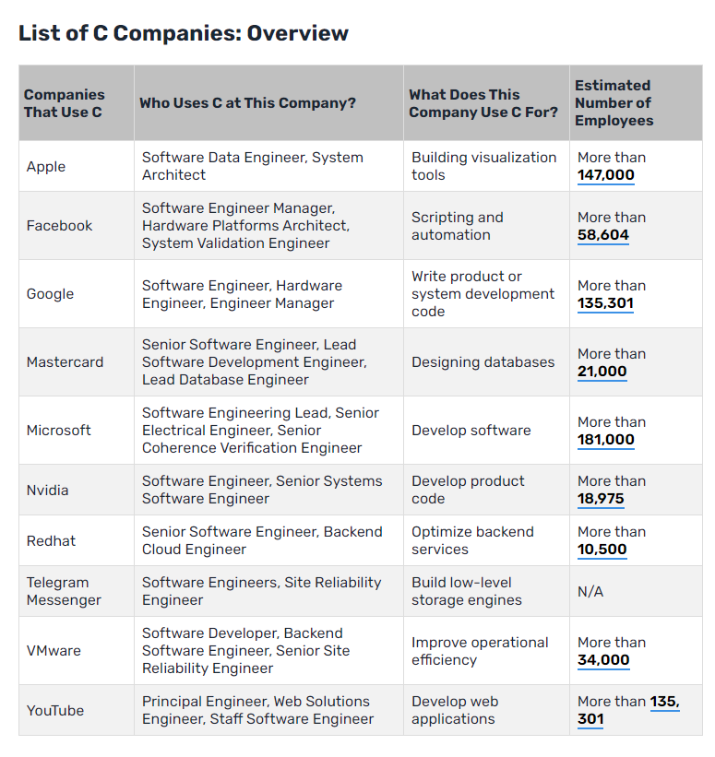

Slide 11
https://careerkarma.com/blog/who-uses-c/#:~:text=Top%20companies%20such%20as%20Google,day%2Dto%2Dday%20activities.

Slide 12
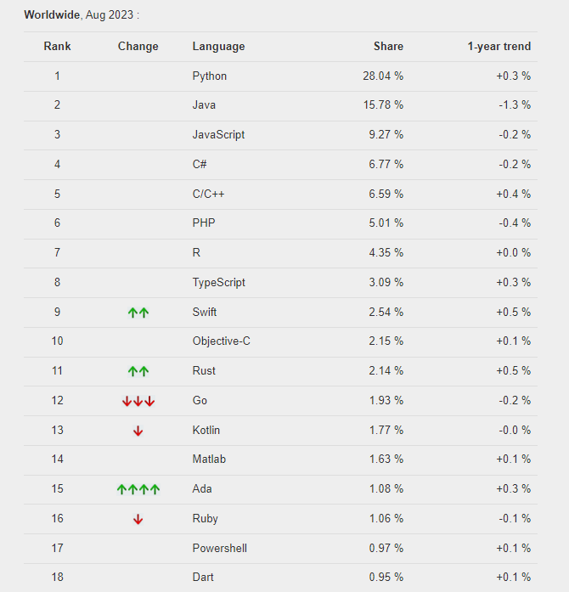
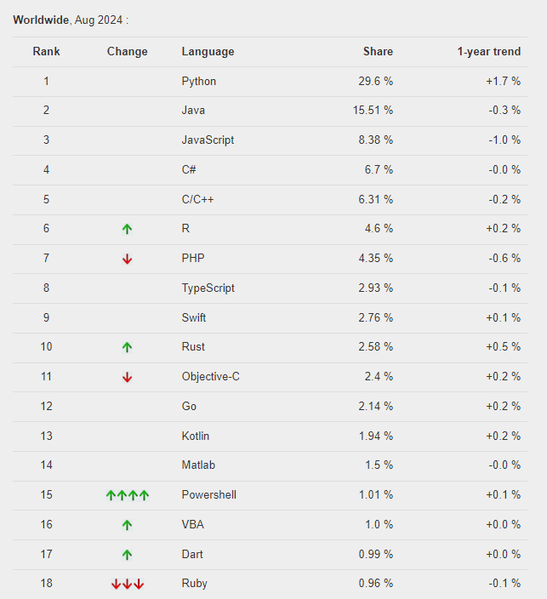
https://pypl.github.io/PYPL.html
The PYPL PopularitY of Programming Language Index is created by analyzing how often language tutorials are searched on Google.

Slide 13
https://www.tiobe.com/tiobe-index/
The TIOBE Programming Community index is an indicator of the popularity of programming languages.
The index is updated once a month.
The ratings are based on the number of skilled engineers world-wide, courses and third party vendors. Popular search engines such as Google, Bing, Yahoo!, Wikipedia, Amazon, YouTube and Baidu are used to calculate the ratings. It is important to note that the TIOBE index is not about the best programming language or the language in which most lines of code have been written.

Slide 14
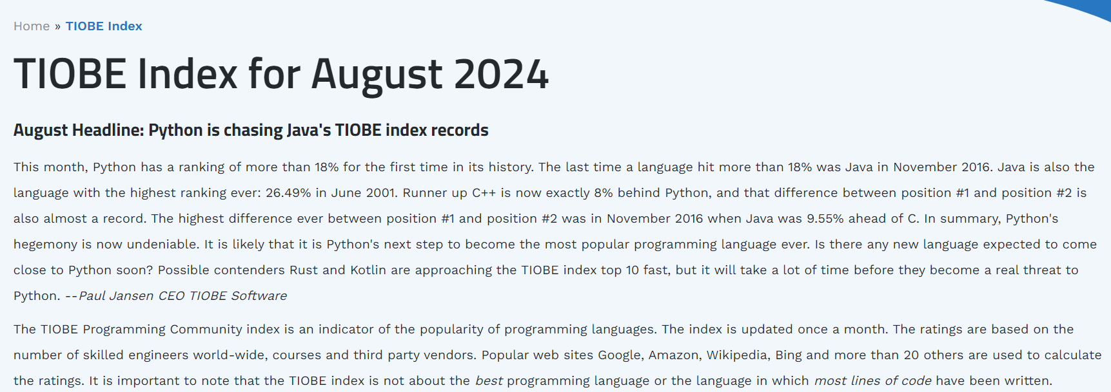

Slide 15
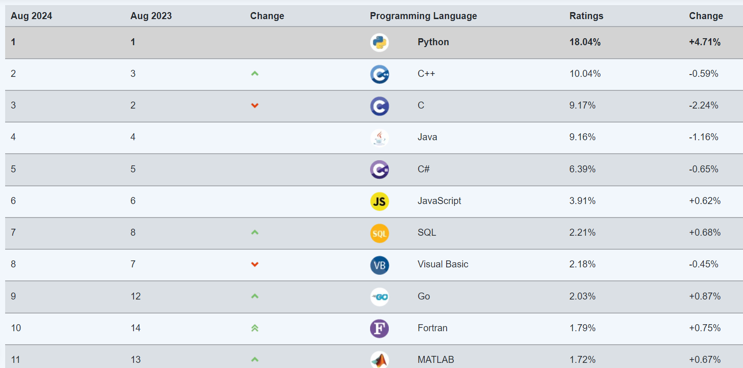

Slide 16
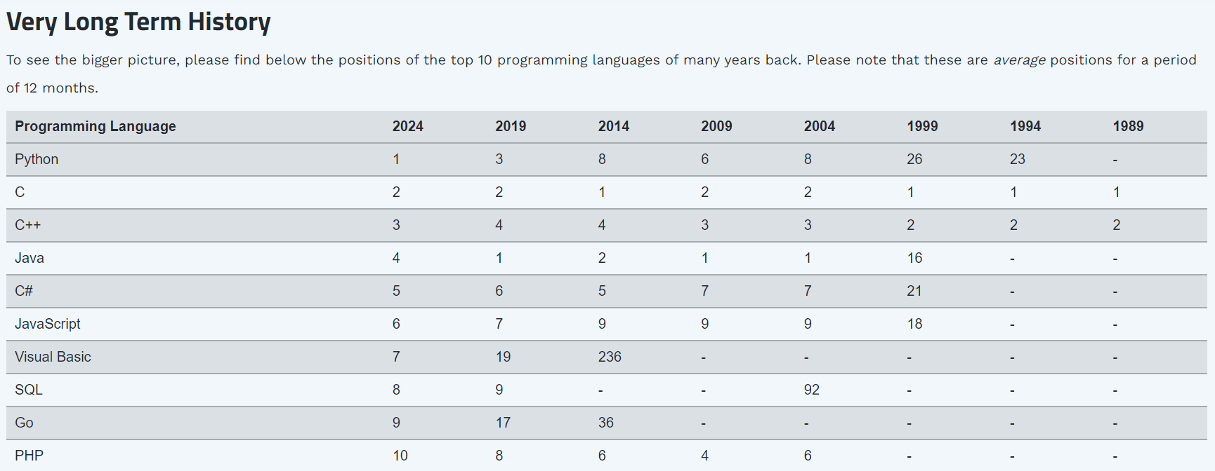

Slide 17
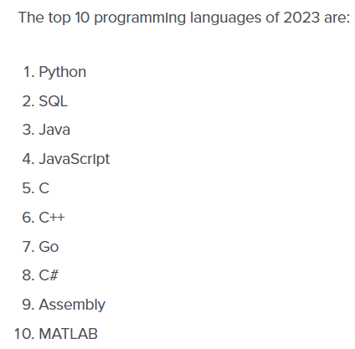
https://www.codingdojo.com/blog/top-programming-languages
Coding Dojo es una organización sin fines de lucro que se enfoca en la enseñanza de programación y tecnología de manera accesible y divertida. Ofrecen cursos en línea y en persona para aprender lenguajes de programación como Python, Ruby on Rails, MEAN Stack, etc. También ofrecen programas intensivos de codificación para ayudar a los estudiantes a obtener habilidades prácticas y mejorar su carrera en tecnología.
Every year, Coding Dojo lists the top programming languages based on what employers want most in job candidates.
We determine this list by reviewing Indeed and LinkedIn. We use this list to find out the number of job listings that include each of the top 20 languages listed. The 10 with the most job listings get included in the roundup.

Slide 18
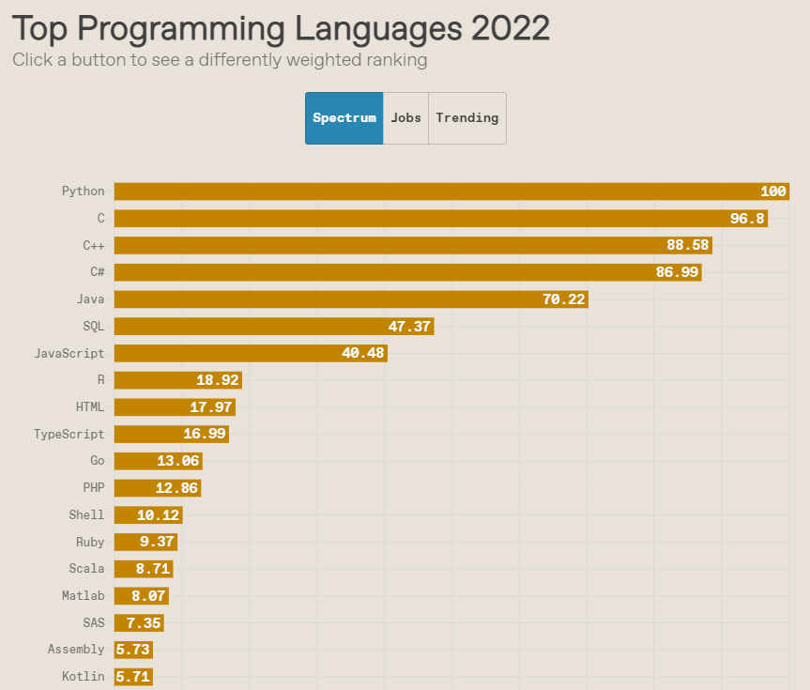
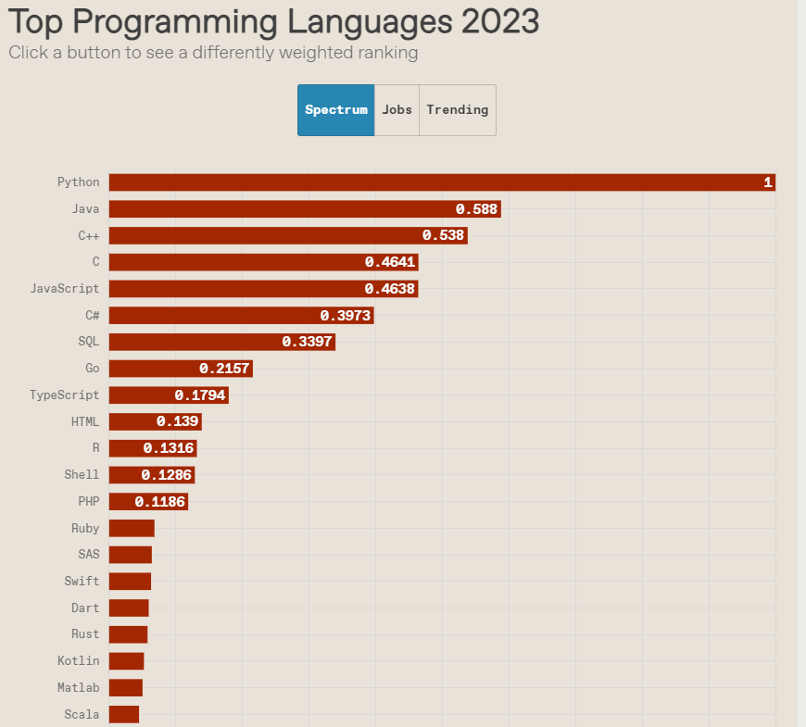
https://spectrum.ieee.org/top-programming-languages-2023
“Spectrum” ranking—which is weighted to reflect the interests of the typical IEEE member—

Slide 19
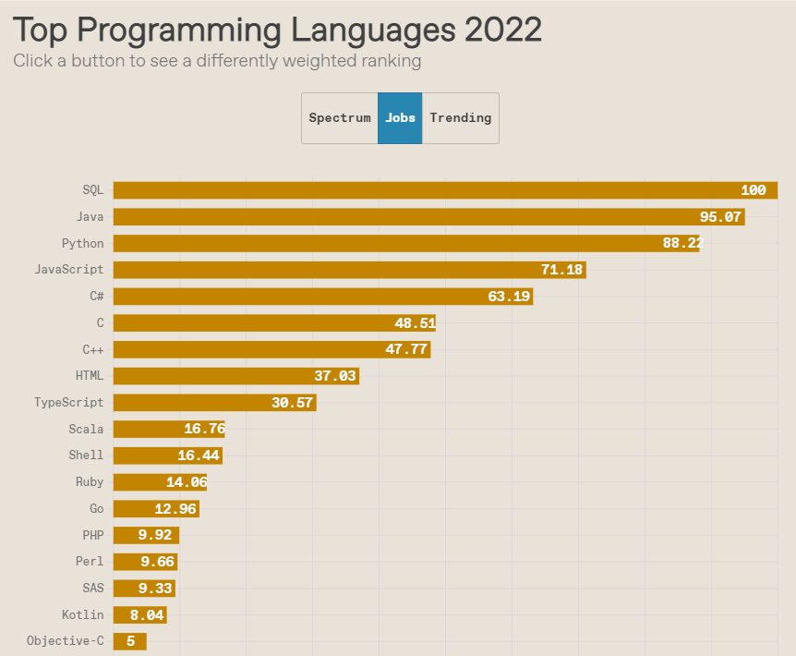
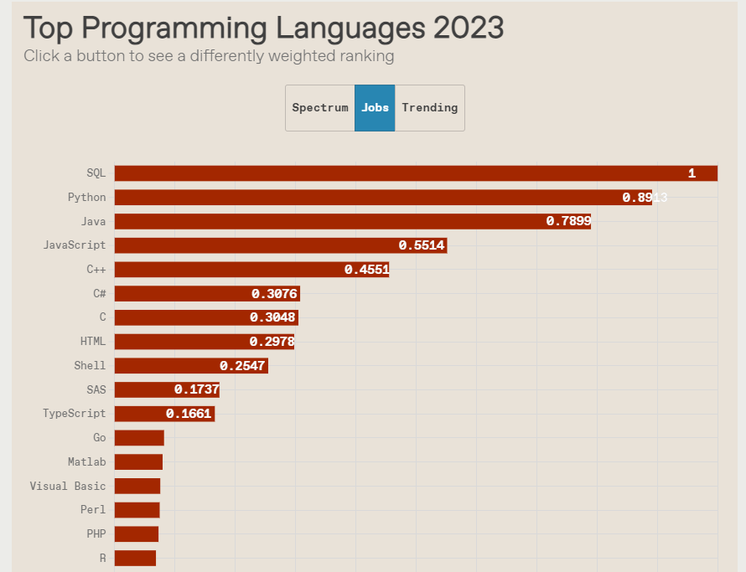
https://spectrum.ieee.org/top-programming-languages-2023
In our “Jobs” ranking, it is SQL that shines at No. 1. Ironically though, you’re very unlikely to get a job as a pure SQL programmer. Instead, employers love, love, love, seeing SQL skills in tandem with some other language such as Java or C++

Slide 20
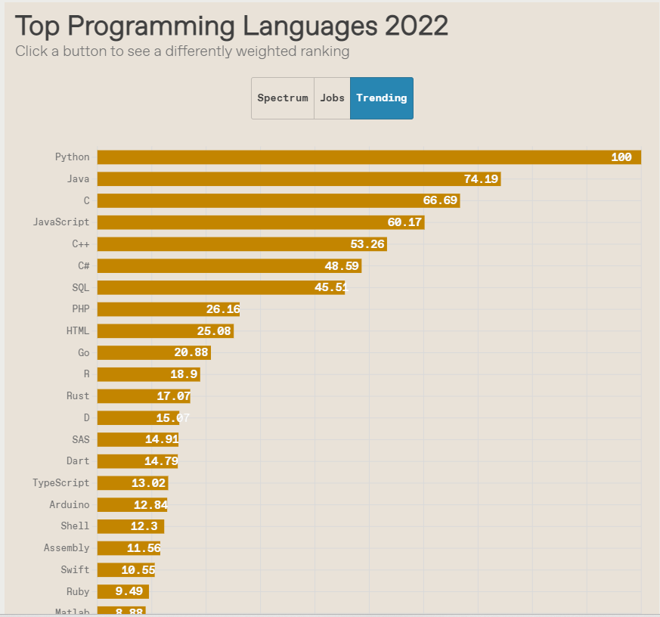
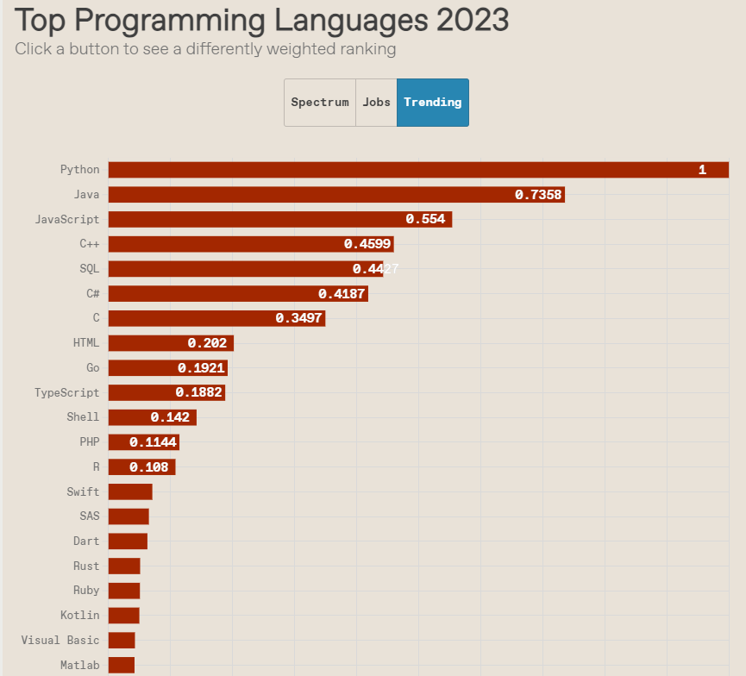
https://spectrum.ieee.org/top-programming-languages-2023

Slide 21
https://spectrum.ieee.org/top-programming-languages-methods

Slide 22
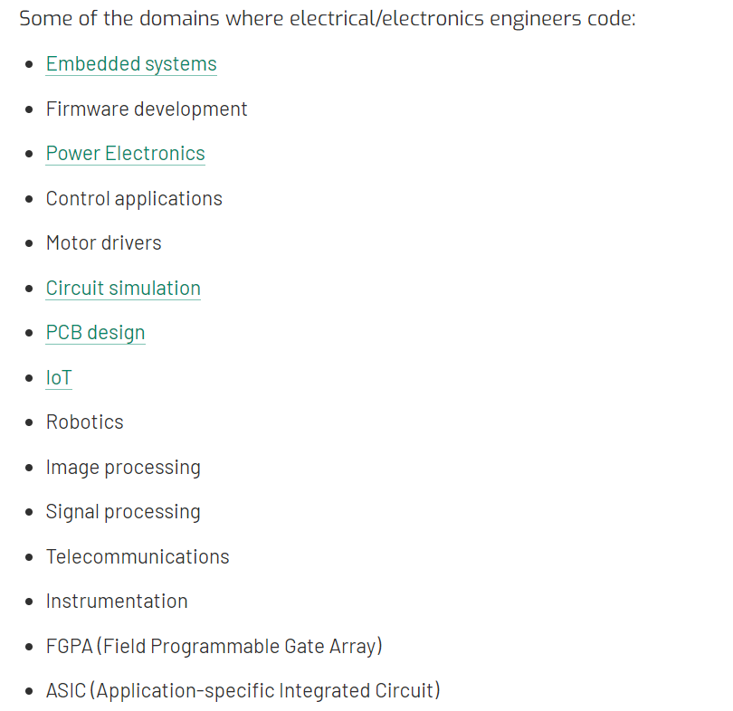
https://www.power-and-beyond.com/scope-of-coding-for-electrical-and-electronics-engineers-five-types-of-programming-languages-you-must-know-a-d19b94cfe63ddbb14bbff55cba41b548/
Scope of coding for electrical and electronics engineers: Five types of programming languages you must know
09.08.2023 From Venus Kohli

Slide 23
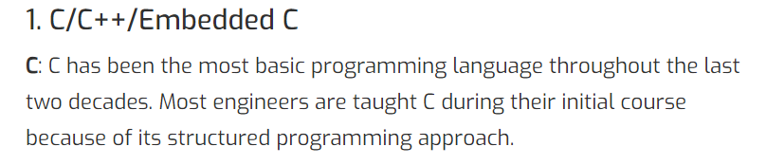
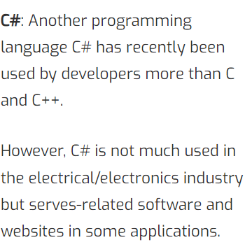

Slide 24
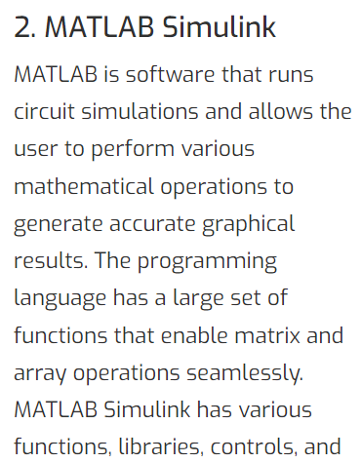
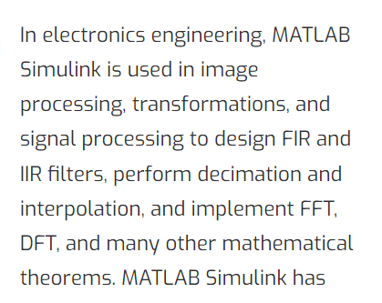
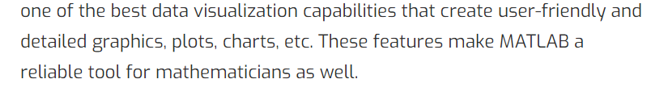

Slide 25
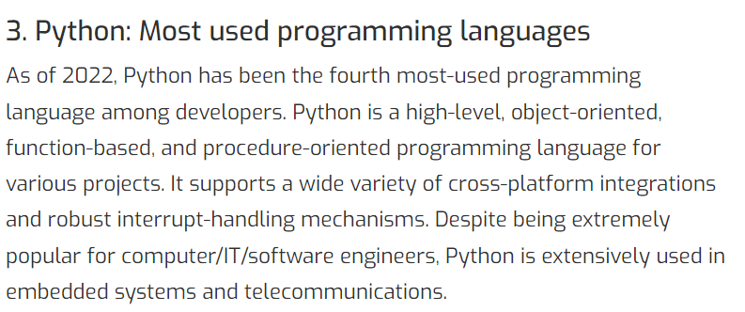
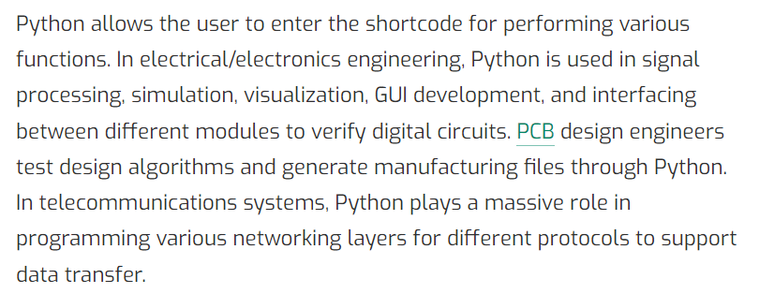

Slide 26
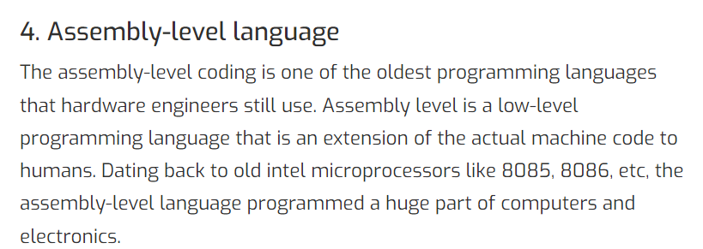
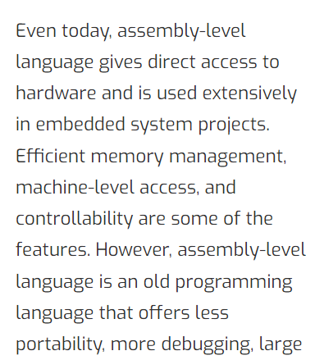


Slide 27
