Slide 1
Data Types

Slide 2
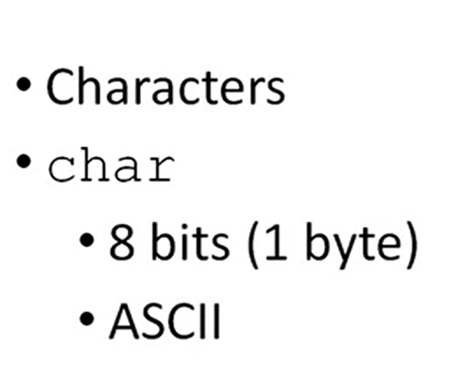
The Char Data Type

Slide 3
The Char Data Type
/*
* File: main.c
* Author: <your name here>
*/
#include <stdio.h>
#include <stdlib.h>
/*
* Demonstrate char data type
*/
int main(int argc, char** argv)
{
return EXIT_SUCCESS;
}
CharDataType

Slide 4
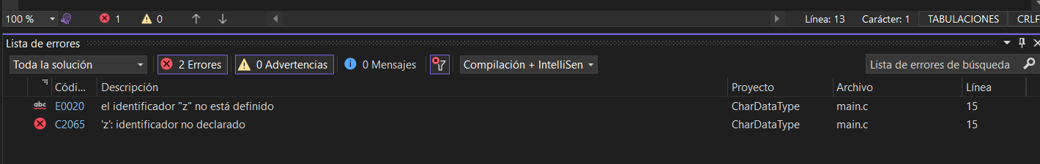
The Char Data Type
int main(int argc, char** argv)
{
char menuChoice = z;
return EXIT_SUCCESS;
}

Slide 5
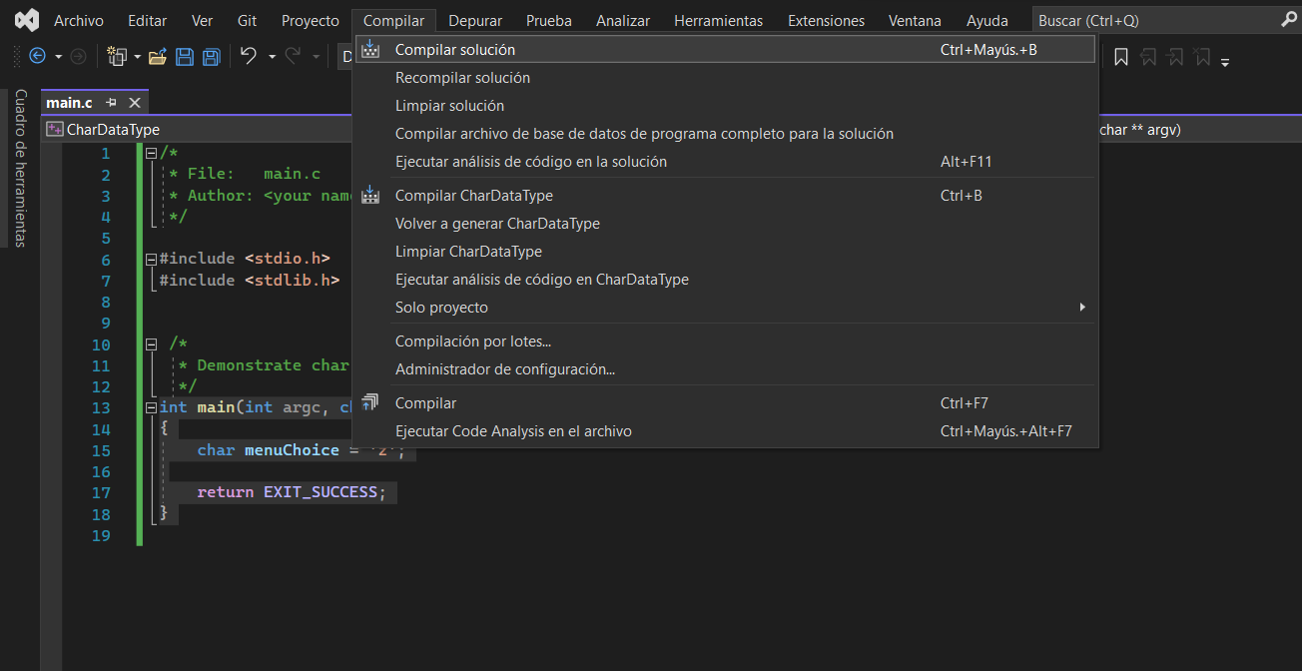
The Char Data Type
int main(int argc, char** argv)
{
char menuChoice = 'z';// apóstrofe
return EXIT_SUCCESS;
}
Operación Compilar iniciada..
========== Compilación: 0 correctos, 0 dieron error, 1 actualizados, 0 omitidos ==========

Slide 6
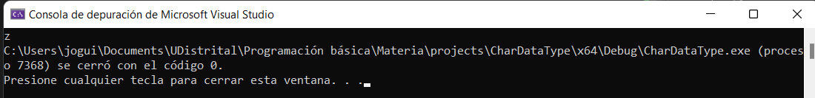
The Char Data Type
int main(int argc, char** argv)
{
char menuChoice = 'z';
printf("%c", menuChoice);
return EXIT_SUCCESS;
}

Slide 7
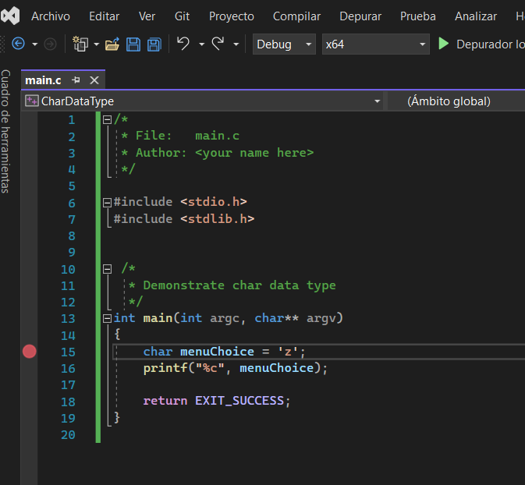
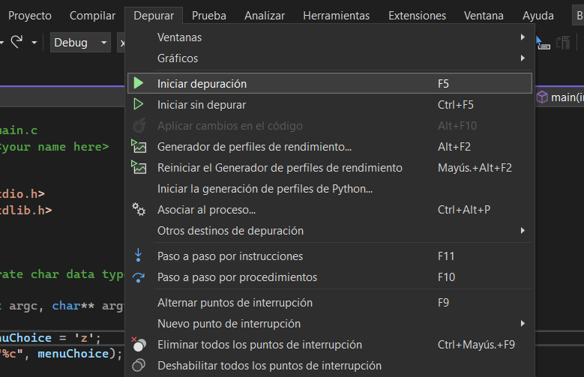
The Char Data Type
Debugger o depurador

Slide 8
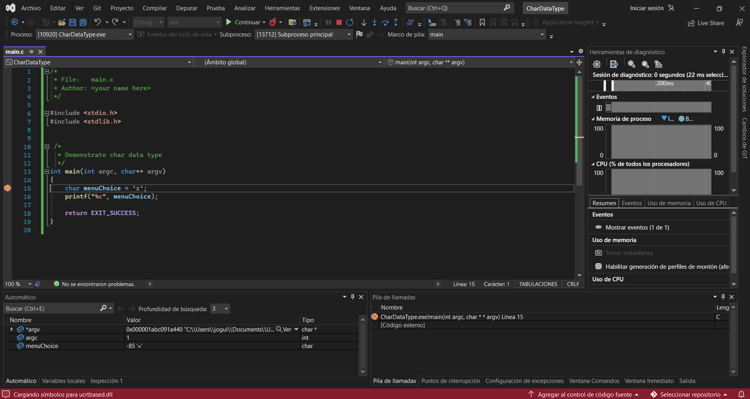
The Char Data Type

Slide 9
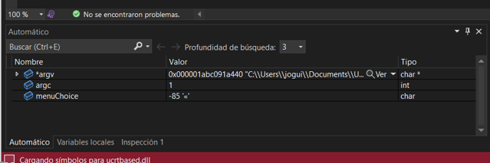
The Char Data Type

Slide 10
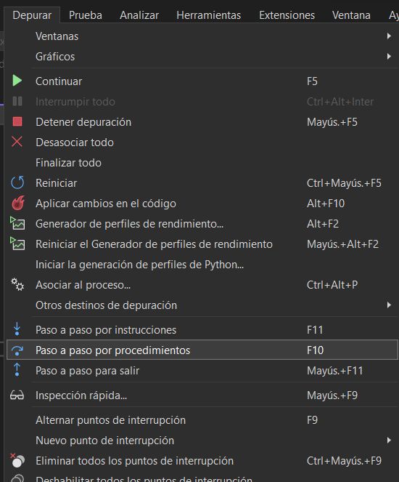
The Char Data Type

Slide 11
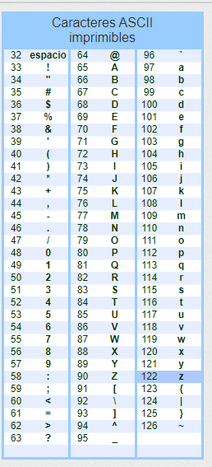
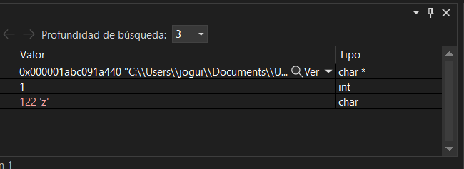
The Char Data Type

Slide 12
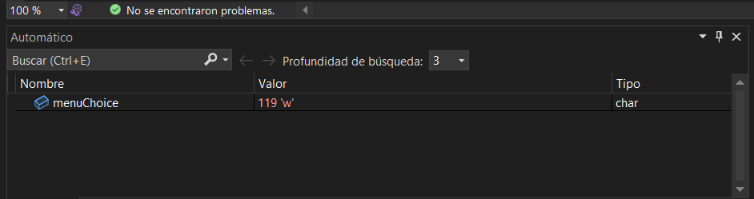

The Char Data Type
int main(int argc, char** argv)
{
char menuChoice = 'z';
printf("%c", menuChoice);
menuChoice = 119;
return EXIT_SUCCESS;
}

Slide 13
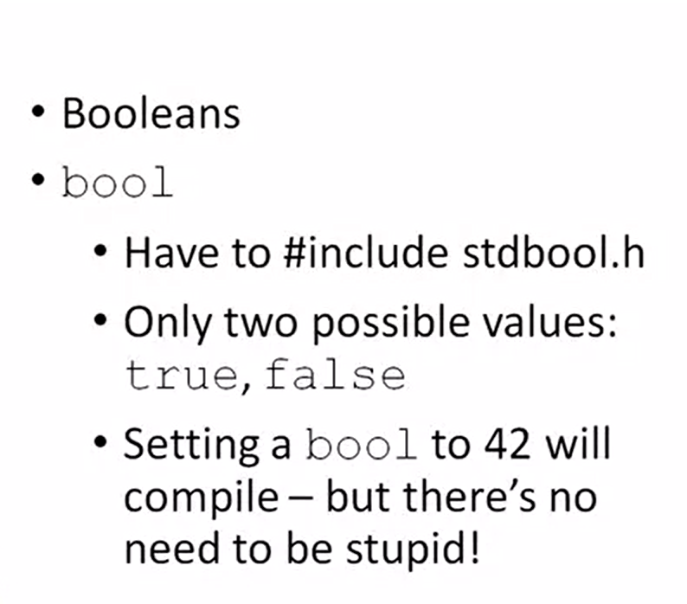
The Bool Data Type
False = 0
True = 1. True ≠0.

Slide 14
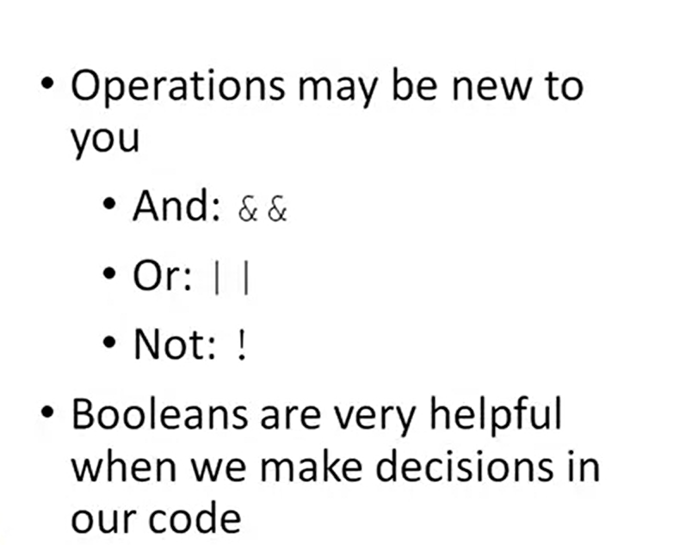
The Bool Data Type

Slide 15
User-Defined Data Types
Las estructuras son colecciones de variables relacionadas bajo un nombre.
Las estructuras pueden contener variables de muchos tipos diferentes de datos.

Slide 16
User-Defined Data Types
/*
* File: main.c
* Author: <your name here>
*/
#include <stdio.h>
#include <stdlib.h>
/*
* Demonstrate user-defined data types
*/
int main(int argc, char** argv)
{
struct Student // estructura de datos
{
};
return EXIT_SUCCESS;
}

Slide 17
User-Defined Data Types
int main(int argc, char** argv)
{
struct Student // estructura de datos
{
int number; // ID of student
float percent; // % of class attendance
char grade; // grade using letters
};
return EXIT_SUCCESS;
}

Slide 18
User-Defined Data Types
{
typedef struct Student estudiante;
struct Student // estructura de datos
{
int number; // ID of student
float percent; // % of class attendance
char grade; // grade
};
estudiante student0;
return EXIT_SUCCESS;
}

Slide 19
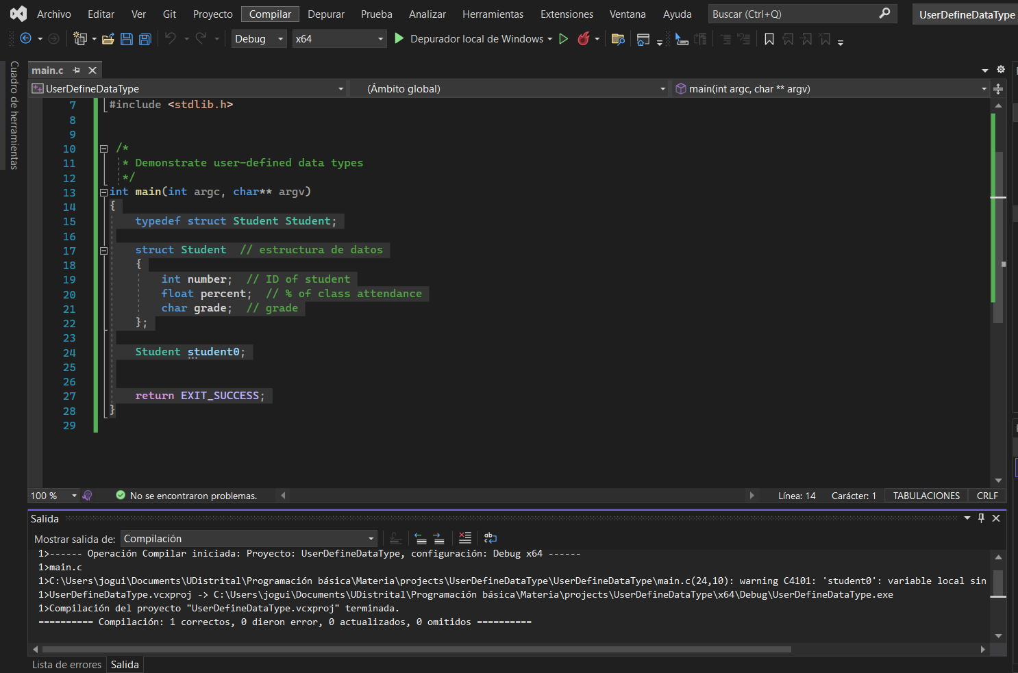
User-Defined Data Types

Slide 20
User-Defined Data Types
int main(int argc, char** argv)
{
typedef struct Student estudiante;
struct Student // estructura de datos
{
int number; // ID of student
float percent; // % of class attendance
char grade; // grade
};
// initialize and print student info
estudiante student0 = {202237890, 90.5, 'C'};
return EXIT_SUCCESS;
}

Slide 21
User-Defined Data Types
int main(int argc, char** argv)
{
typedef struct Student estudiante;
struct Student // estructura de datos
{
int number; // ID of student
float percent; // % of class attendance
char grade; // grade
};
// initialize and print student info
estudiante student0 = {202237890, 90.5, 'C'};
printf("Student0\n");
printf("-------\n");
printf("Number: %d\n", student0.number);
printf("Percent: %0.1f\n", student0.percent);
printf("Grade: %c\n", student0.grade);
printf("\n");
return EXIT_SUCCESS;
}

Slide 22
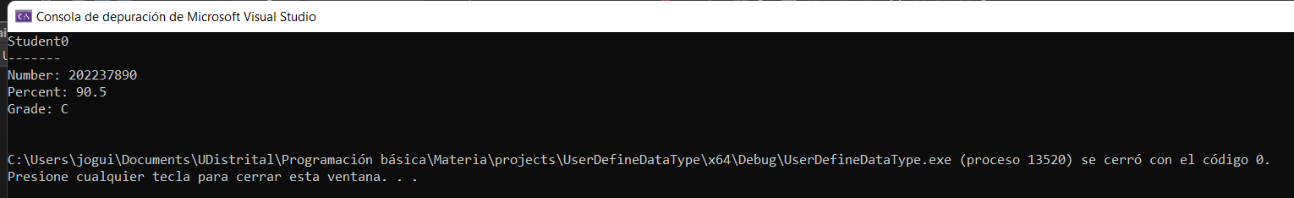
User-Defined Data Types

Slide 23
User-Defined Data Types
estudiante student1;
student1.number = 23445;
student1.percent = 59.99;
student1.grade = 'F';
printf("student1\n");
printf("-------\n");
printf("Number: %d\n", student1.number);
printf("Percent: %0.2f\n", student1.percent);
printf("Grade: %c\n", student1.grade);
printf("\n");

Slide 24
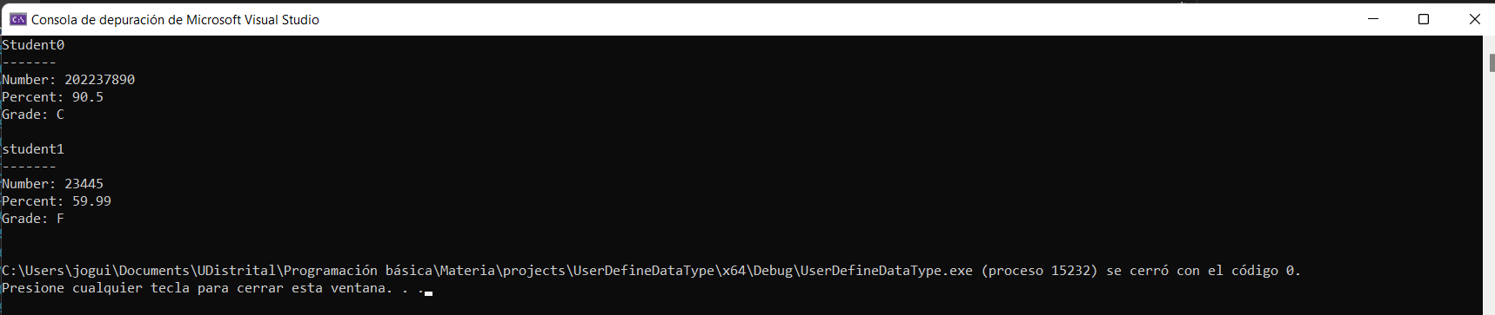
User-Defined Data Types

Slide 25
Assignment Description
You’ve decided that Chemistry is an awesome field to explore. Since we recently celebrated the 150th anniversary of Mendeleev’s periodic table of the elements, you decide to go look at the (current) periodic table of the elements. You’re so excited by the beauty and elegance of that arrangement that you decide to print out the symbols for the first 10 elements in the periodic table of the elements.
Create a new C project named whatever you want in Visual Studio.
Requirements
Your solution must do the following:
· Print the symbol for each of the first 10 elements of the periodic table, with each symbol appearing on its own line in the output
· Do NOT print anything else in your output; if you do, you’ll confuse the automated grader and you’ll get a bad grade!
In case you’re having a hard time understanding what your output should look like, here are the first 3 lines of required output (you’ll have 10 lines of output):
H
He
Li

Slide 26
Crear un proyecto en visual studio. Declare una variable llamada edad tipo int, donde ponga el promedio de la edad de los dos estudiantes. Visualice en pantalla esa edad. Ahora crear una variable y visualice la edad en promedio de sus padres, utilizando una variable tipo int. Presentela por pantalla. Calcule la diferencia de edad entre las dos variables, y presente el resultado en pantalla.
Declare una variable float que almacene el resultado obtenido entre la división del número aleatorio y MAX_SCORE, y multiplique por 100 para obtener el porcentaje, visualice el valor e imprímalo en pantalla, en porcentaje, utilizando 2 décimas de precisión. Repita el proceso pero con 0 décimas de precisión.

